Slide 1

Luma Change Liaison Meeting
March 2023

Slide 2
Introduction
Thank you for being here!
Expectations:
  Please give the presenters your full attention.
  Please utilize the chat functionality (bottom right) to ask questions, or wait until the end of the presentation to come off of mute and ask.
  This meeting is being recorded and will be provided in the follow-up email.

Slide 3

Agenda
Agenda
Luma Role Workshops
Security Role Workbooks
Luma Labs
Training Update
Operational Readiness Program (ORP)
Cutover
Change Liaison Communications Toolkit
Key Takeaways

Slide 4

Luma Role Workshops

Slide 5
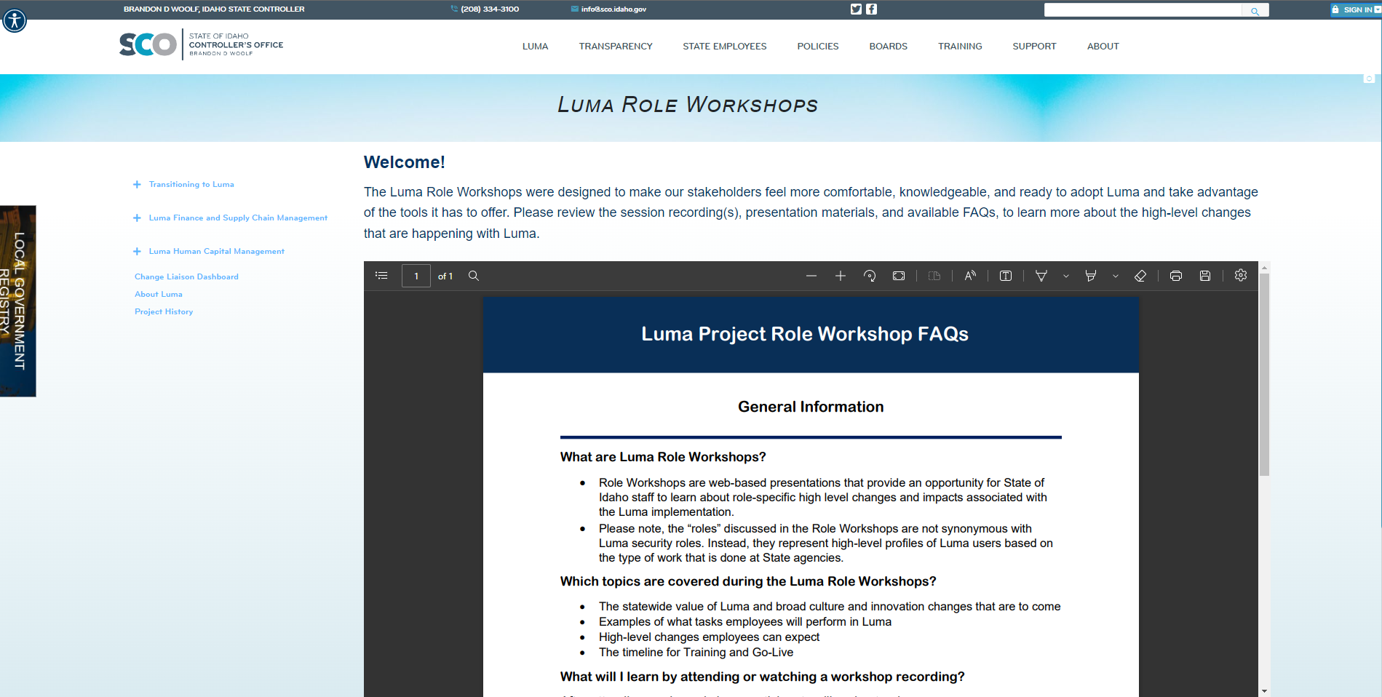
Luma Role Workshops
Luma Role Workshops are virtual events scheduled from late February through March that will provide an opportunity for State of Idaho staff to learn about role-specific changes and impacts associated with the Luma implementation prior to formal training. The workshops reiterate the statewide value of Luma and cover what the employee will do in Luma, what changes they can expect, and a timeline for training and Go-Live. Sessions will be recorded and available via the Luma Website.
We will be offering six role workshops:
Finance Professionals (completed on February 23rd and 28th)
Procurement Professionals (completed on February 22nd and 27th)
Recruiter (Date To Be Determined)
HR Generalist (Date To Be Determined)
Manager (a link to the recording will be distributed to all Managers in late March)
Employee (a link to the recording will be distributed to all State employees in late March)
Role Workshop Webpage – Located on the CL Dashboard

Slide 6

Security Role Workbooks

Slide 7
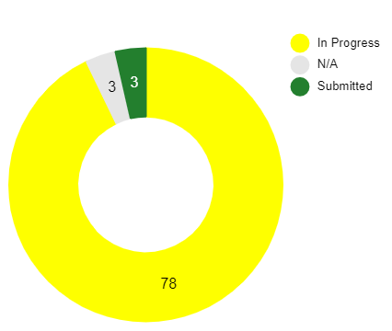
Security Role Workbooks
This workbook includes the Finance and Procurement security roles. The Approval role has been removed as we have that data from your workflows workbooks. Expense Management roles have also been excluded because all employees will have access to Expense Management
Workbook Submission Progress
Due Date
March
10th

Slide 8

Luma Labs

Slide 9
Luma Labs
Luma Labs provide Idaho agency employees an opportunity to experience their Chart of Account (COA) data, HR organizational structure setup, a sample of basic processes, and configuration. Luma Labs are a live virtual activity that started on February 27th and will run through the end of March.
Schedule:
Monday 1:00PM-2:00PM MST, Welcome
Tuesday 11:00AM-12:00PM MST, Demo
Wednesday 3:00PM-4:00PM MST, Questions and Answers
Thursday/Friday Follow-up Days
*times & days will vary by topic
Topics:
Chart of Accounts – Week of February 27th
Procurement – Week of March 6th
  How to purchase a good
  How to purchase a service
Finance – Week of March 13th
  Entering a basic invoice
  Processing a non-AR Cash payment
HCM – Week of March 20th
HCM – Week of March 27th

Slide 10

Luma Training Update

Slide 11
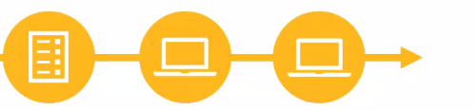
Luma Training Update
A Training Showcase Kickoff will be held on Tuesday, March 14th from 2 pm - 3 pm
Training will be available as stand-alone/self-paced and virtual instructor-led courses
An individual’s role will determine the type/amount of training needed
Generally, core users (frequent Luma users) will need more instruction
2023
April May June
Training
Registration
Employee Luma
Training
*Specific dates to be
communicated separately

Slide 12

Operational Readiness
Program (ORP)

Slide 13
Operational Readiness
Program (ORP)
What is an Operational Readiness Program (ORP)?
An agency ORP is based on the idea that each agency will experience the Luma transition with unique opportunities and challenges operationally. The ORP has various tools to assist you in your assessment in identifying specific areas to focus on to achieve a successful go-live.
Who participates in an Operational Readiness Program (ORP)?
Agency leaders will guide the conversation and support the program by being responsible, accountable, and consistently informed of the results.
Bureau Chiefs and leaders will perform and manage the program. Change liaisons will support and inform teams.
Timeline
Kickoff
3/9/2023
March
Monthly
Office Hours
April
Monthly
Office Hours
May
Monthly
Office Hours
June
Monthly
Office Hours
July
Monthly
Office Hours
August
Monthly
Office Hours
September
Monthly
Office Hours
March
Use tools for assessment
April
Use tools for assessment
May
Use tools for assessment
June-July
Use tools for assessment
August-September
Use Sustainment tools for continued assessment

Slide 14

Luma Cutover

Slide 15
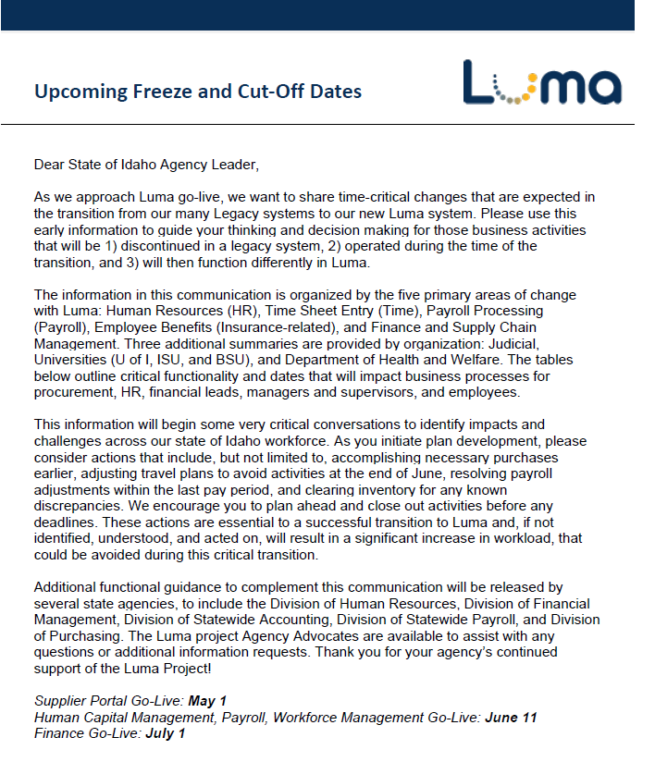
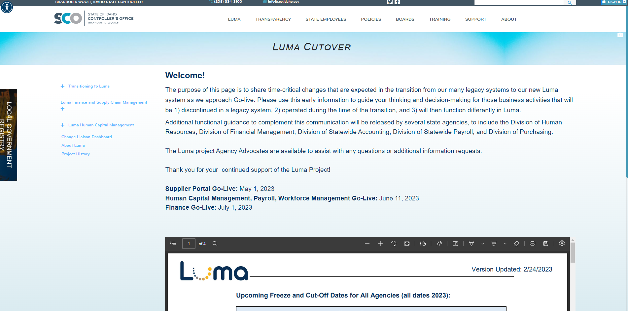
Luma Cutover
Last Friday, Agency Advocates sent out the following memo to our Agency partners to inform them of the upcoming cutover and freeze dates.
We will be sharing process updates in the coming weeks!
Luma Cutover Webpage

Slide 16

Change Liaison
Communications Toolkit

Slide 17
CL Communications Toolkit
Release Date: Monday, March 6th
Toolkit Table of Contents
Tool # | Description | Slide Numbers
1 | Role Workshops FAQ Webpage | 3-4
2 | Operational Readiness Program (ORP) Update | 4-5
3 | Readiness Checklist Introduction | 6-7
4 | User Experience (UX) Simulations | 8-9
5 | Cutover Information | 10-11
- | Appendix – Resources, Toolkit Instructions

Slide 18

Key Takeaways

Slide 19

Thank you!
Sheena Coles
SColes@sco.Idaho.gov
208-334-3100
Alex Doench
adoench@sco.Idaho.gov
208-332-8841
Danielle Stevens
dstevens@sco.Idaho.gov
208-332-8868
Chris Lehosit
clehosit@sco.Idaho.gov
208-332-8887
Krystal Griffith
kgriffith@sco.Idaho.gov
208-332-8861
Elijah Stearns
estearns@sco.Idaho.gov
208-332-8871

