Slide 1





Change Liaison Meeting
June 15th, 2022

Slide 2
Welcome!
Thank you for being here!
Expectations:
  Please give presenters your full attention.
  Please utilize the chat functionality (bottom right) to ask questions, or wait until the end of the presentation to come off of mute and ask.
  This meeting is being recorded and will be provided in the follow-up email.

Slide 3

Phase 1 Update
Phase 2 Update
Training
Key Takeaways
Q&A
AGENDA
Notes:
Intro - Elijah
Phase 1 Update – Sheena/Scott
Phase 2 Update - Greg
Phase 2 Activities - Greg
Training – Krystal/Sara
Key Takeaways - Sheena

Slide 4

Luma Phase 1 Update

Slide 5
Getting back into Agency Testing
Goal:
Establish and configure a new tenant allowing the project to enter into Agency Testing.
Business process validation sessions with agencies.
Agency configuration workbook updates.
“We want to see how our setup for Projects and Program is going to work from Purchasing to Budgets and Reporting. How are your Project Activities going to give this big picture look before we get back into the weeds?
“…how our setup will actually work, and the impact of our setup on all steps of the process, from budget-->purchasing-->reporting etc. It is difficult to complete the workbooks without knowing what it will look like on the back end when it's actually being used.”
“We need to be able to see what the output is from everything that we input.”
“And see the actual system, not slides that have bubbles of information.”

Slide 6
Phase 1 Initiative Schedule
 | May |  |  |  | June |  |  |  | July |  |  |  | August
Initiative Activities and Milestones as of June 3 | 9 | 16 | 23 | 30 | 6 | 13 | 20 | 27 | 4 | 11 | 18 | 25 | 1 | 8 | 15 | 22 | 29
Agency Partnership Strategy Start Overall Strategy Revision Start Open BP & Workbook Value Update Outreach and Engagement Start Agency Functionality Workshop Outreach and Engagement
Update Test Strategy and Plans Publish Updated Test Strategy Publish Updated SIT Plan Start Project Team SIT
Functional Review & Confirmation of Luma Roles and Associated Security Define Strategy Complete Review Implement Changes
Agency Functionality Workshops Define Strategy Start Agency Outreach Complete Workshops
Activity
Milestone Not Started
Milestone In progress

Slide 7
Business Process Validation Session
The Business Process Validation is going to be similar to a Sprint Session.
01
02
03
04
Validate agency requirements and identify critical and unique scenarios as required
Address open scenarios
Demo Infor functionality
Validate that the solution meets State requirements

Slide 8
COA Workbook Refresh
Our first priority is to ensure our existing Chart of Account (COA) workbooks are up to date for your agency. All of the other system configuration efforts rest upon this step. In 2020, the Luma Chart of Accounts team met with every agency to build the first COA configuration workbooks.
We are requesting agencies conduct a review of their COA workbooks. Significant time may have passed since your last submission, so re-visiting this opportunity now is timely given our goal to get agency personnel in a testing environment.
Required:
Chart of Accounts (COA) Org Unit: mandatory dimension.
Optional:
COA Additional Reporting: optional dimension.
COA Location Dimension: optional dimension.
COA Program Dimension: optional dimension.
COA Default: if updates are made to any of the workbooks above, it’s very likely that the COA Default workbook will need to be updated as well.
Payroll Crosswalk: if updates are made to any of the workbooks above, it’s very likely that the Payroll Crosswalk workbook will need to be updated as well.
Due June 17th

Slide 9

Luma Phase 2 Update

Slide 10
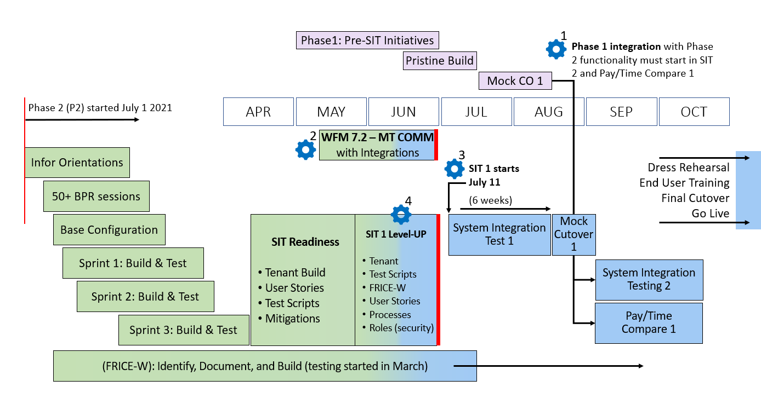
Phase 2 Roadmap through October
(updated June 7, 2022)

Slide 11
Assessed Deployment Options (revisited)
Moderate Impact
High Impact
Type Category - Option ID |  | Implementation Date
and Risk Impact (color) |  | Jan-23 | Apr-23 | Jul-23 | Jan-24
Phased Finance First 2 |  | Finance | HR/Pay/Time
Phased Finance First 3 |  | Finance |  | HR/Pay/Time
Phased Finance First 4 |  |  |  | Finance | HR/Pay/Time
Big Bang 6 |  |  |  | Finance + HR/Pay/Time
Phased HR/Pay/Time First 7 |  | HR/Pay/Time |  | Finance
Split & Re-combine 8 |  | HR only |  | Finance + Pay/Time
  Impact Analysis
  Mid-Year Conversion considerations
  Phasing Order considerations
  HR/Pay/Time Split considerations
Type Category - Option ID |  | Implementation Date
High Risk Impact |  | Oct-22 | Jan-23
Phased Finance First 1 |  | Finance | HR/Pay/Time
Big Bang 5 |  |  | Finance + HR/Pay/Time

Slide 12
Edge Entities (Cont.)

Slide 13
Edge Entities
Edge Entity | Started | Current Activity & Status | Approach
Judicial | Y | Interface Designs | Mini-HR master to use Luma Payroll
Public Health D 1 | Y | Configuration | Non state employee type
Public Health D 2 | Y | Configuration | Non state employee type
Public Health D 3 | Y | Configuration | Non state employee type
Public Health D 4 | Y | Configuration | Non state employee type
Public Health D 5 | Y | Configuration | Non state employee type
Public Health D 6 | Y | Configuration | Non state employee type
Public Health D 7 | Y | Configuration | Non state employee type
Transportation (ITD) | Y | Interface Builds | Full HR in Luma; Time entry in Advantage
University of Idaho | Y | Team organized and meeting | Discovery in process; increase simplicity and accuracy
Idaho State University | Y | Meeting scheduled 6/16 | Undetermined
State Insurance Fund | Y | Strategy Decisions | Undecided
Boise State University | N | Schedule first meeting | Undetermined

Slide 14

Training

Slide 15
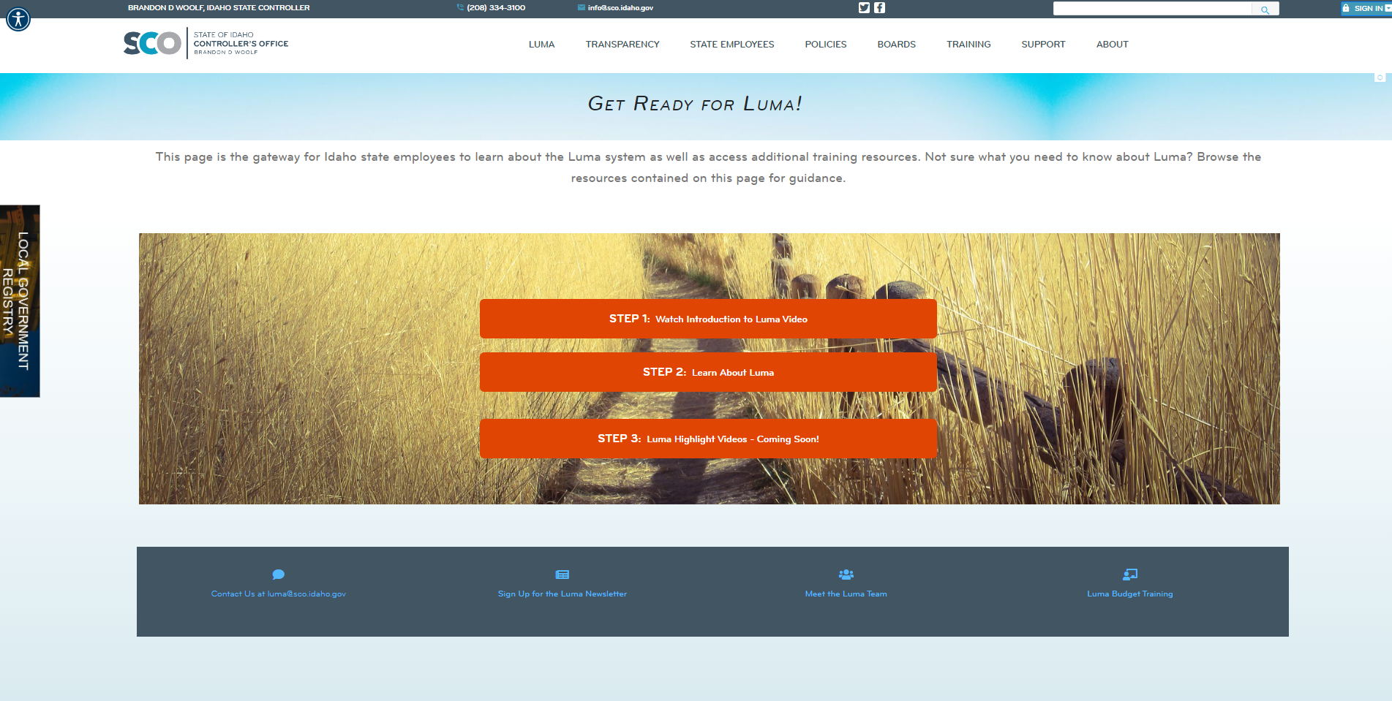
“Get Ready for Luma!” Webpage

Slide 16


Slide 17
Budget Training
Refresher Training
Thursday, June 16th | 1:00 PM
Tuesday, June 21st | 1:00 PM
Thursday, July 7th | 1:00 PM
Luma Budget New User Training
Wednesday, June 22nd and Thursday, June 23rd 9:00 AM -5:00PM
Wednesday, June 29th and Thursday, June 30th 9:00 AM -5:00PM
Wednesday, July 13th and Thursday, July 14th 9:00 AM -5:00PM
Personal Cost Forecaster (PCF) Refresher Training
Wednesday, July 27th | 11:00 AM
Thursday, July 28th | 1:00 PM

Slide 18


Luma Practical Overview
Luma
How does it impact me?
Payroll & Workforce Management
Procurement
Projects & Grants

Slide 19

Key Takeaways

Slide 20

Thank You!
Sheena Coles
SColes@sco.Idaho.gov
208-334-3100
Alex Doench
adoench@sco.Idaho.gov
208-332-8841
Chris Lehosit
clehosit@sco.Idaho.gov
208-332-8887
Elijah Stearns
estearns@sco.idaho.gov
208-332-8871
Danielle Stevens
dstevens@sco.Idaho.gov
208-332-8868

