Slide 1
Change Liaison Communication Toolkit
April 2023

Slide 2
Toolkit Table of Contents
Toolkit | Description
April Communications Toolkit focus: | Generate awareness and engagement around the following topics: Luma Training registration process, Luma webpage with Cutover information, April Operational Readiness Program activities, DUO/Service Desk Changes, and other topics.
What to accomplish with this Toolkit: | Familiarize and/or share components within this toolkit, which are designed to prepare agency employees to successfully understand and adopt Luma.
Tool # | Description | Slide Numbers
1 | Luma Training Registration | 3-4
2 | Luma Cutover Webpage | 5-6
3 | Luma Showcase Timeline | 7-8
4 | ORP: April Readiness Checklist and Support Sessions | 9-10
5 | Luma Go-Live Engagement Template Language | 11-12
6 | DUO/Service Desk Changes | 13-14
7 | Coming Soon: Employee and Manager Role Workshops | 15-16
- | Appendix – Resources, Toolkit Instructions
2

Slide 3
Training Registration Information
Tool # 1 | Item | Tool name: Luma Training Registration Information
 | Focus | Response
 | Why is this important? | Registering for training is the first step to ensuring that state employees feel comfortable and knowledgeable using the Luma system.
 | Who is the target audience? | All employees.
 | What is the objective? | Provide need-to-know information on how to register for Luma training.
 | What are some suggested communication/distribution channels? | Agency newsletters, intranet sites, and message boards.
 | Recommended timing: | At your earliest convenience.
3

Slide 4
Training Registration Information
When does training registration begin?
Training registration begins the week of April 10th
What training do employees complete?
Pre-Req Training
Welcome to Luma
Accessing Luma
Basic Navigation
Accessing Luma Training
Luma Support
All employee training (mass end-user)
Role-specific training
How is training delivered?
VILT (virtual instructor-led training, register to attend the online class)
Self-paced training (complete independently)
What do employees do after they complete pre-req training?
Start on all employee training (micro learnings)
What are the next steps for training?
Look for email communication with the next steps and instructions about the following topics:
Pre-req training, employee training, and manager training
How do I receive credit for completing the class?
Complete the course evaluation or assessment to get credit for the course
To get credit for the course, complete the knowledge check or course evaluation – these are automatically sent by and to the Service Portal “My To Dos”
4

Slide 5
Luma Cutover Webpage
Tool # 2 | Item | Tool name: Luma Cutover Webpage
 | Focus | Response
 | Why is this important? | As agencies transition from operating in legacy environments to Luma, there are several critical functionality and dates to be aware of that will impact business processes for procurement, HR, financial leads, managers, and employees. All relevant information is now available on the Luma Cutover Webpage.
 | Who is the target audience? | Agency leadership, finance and procurement employees, human resources employees.
 | What is the objective? | There are a number of Cutover activities that agencies must complete for a successful implementation of Luma; the Luma Cutover Webpage serves as a centralized location where up-to-date Cutover information can be accessed.
 | What are some suggested communication/distribution channels? | Agency meetings, newsletters, and message boards.
 | Recommended timing: | At your earliest convenience.
5

Slide 6
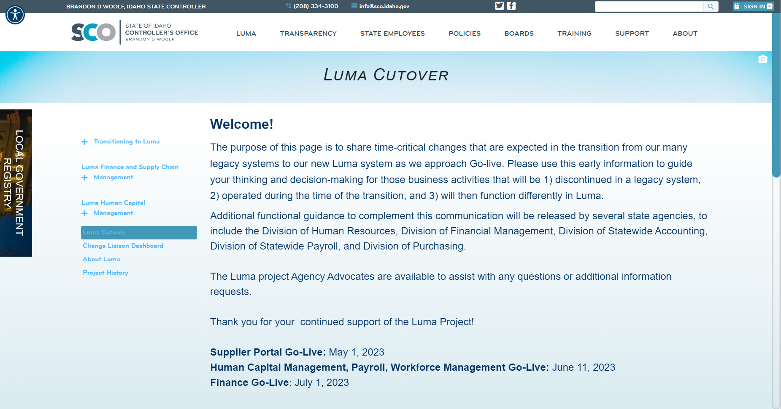
Luma Cutover Webpage
The Luma Cutover page will be a one-stop shop for stakeholders to access information on upcoming freeze and cut-off dates as we approach Go-Live.
6

Slide 7
Luma Showcase Timeline
Tool # 3 | Item | Tool name: Luma Showcase Timeline & Topics
 | Focus | Response
 | Why is this important? | Due to requests for increased touchpoints and greater visibility into the Luma transition, we are planning a series of Luma Monthly Showcase Sessions for Change Liaisons. Each session will be led by a subject matter expert (SME) who will speak on the topic at hand followed by Q&A.
 | Who is the target audience? | Change Liaisons and any colleagues they would like to invite.
 | What is the objective? | Provide an overview of planned Luma Showcase topics and tentative dates.
 | What are some suggested communication/distribution channels? | Not applicable to this tool.
 | Recommended timing: | Not applicable to this tool.
7

Slide 8
Luma Showcase Timeline
April
May
June
July
Cutover and Conversion Workbooks
Reports
Technology- Mingle (formerly Enterprise Dashboard) & Service Desk
Sustainment
MONTHLY TOPIC
SME
Cutover Team
Luma OCM
CSC
Sustainment Team
Address cutover freeze dates and procedures.
Provide support in completing conversion workbooks.
Support agencies with report submissions.
Offer tutorial on how to access Mingle and Service Desk.
Post go-live session to support the adoption of the Luma system.
OBJECTIVES
DATE
4/19
TBD
TBD
TBD
8

Slide 9
ORP: April Resources and Activities
Tool # 4 | Item | Tool name: ORP – April Resources and Activities
 | Focus | Response
 | Why is this important? | The Operational Readiness Program is a guided process for agencies to systematically review how the upcoming transition to Luma will impact their current business processes. The Luma Project team will be continuously updating ORP tools throughout the month of April and is targeting April 27th for the monthly ORP Support Session.
 | Who is the target audience? | Agency Leaders will guide this multi-month process.
 | What is the objective? | To provide Change Liaisons details of expected ORP resources and activities for the month of April.
 | What are some suggested communication/distribution channels? | Support your agency leadership in this initiative, and when notified, follow-up with them to make sure they received invitations to Support Sessions. If they cannot attend, help them make sure that your agency is represented with agency leaders who can receive the important information.
 | Recommended timing: | Not applicable to this tool.
9

Slide 10
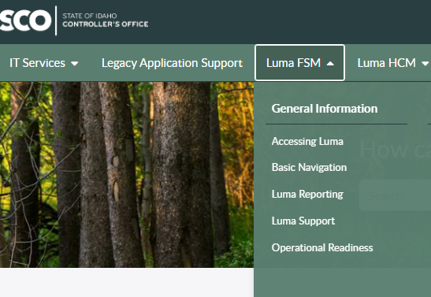
ORP: April Resources and Activities
You can find the following resources on the Service Desk Tile in the Enterprise Dashboard:
Leadership Readiness Checklist for April/May
Readiness Checklist by Role
Additional Impact Statements forthcoming
Monthly Support Session: 4/27 at 11:00 AM (invitation forthcoming)
10

Slide 11
Luma Go-Live Engagement Template Language
Tool # 5 | Item | Tool name: Luma Go-Live Engagement Template Language
 | Focus | Response
 | Why is this important? | As a recognized change agent within your agency, you are in a unique position to help engage colleagues who may not be as familiar with Luma. This tool provides sample language – written by fellow Change Liaisons – for your consideration as you share Go-Live information and updates with your peers and staff.
 | Who is the target audience? | Change Liaisons.
 | What is the objective? | Encourage, coach, and support agency employees to be engaged with the Luma project prior to the start of training.
 | What are some suggested communication/distribution channels? | Email, agency newsletters.
 | Recommended timing: | At your earliest convenience. Please copy your Agency Advocate when you share this email.
11

Slide 12
Luma Go-Live Engagement Template Language
Click here to access two documents that provides draft language for engaging your agency colleagues about the transition to Luma prior to training. Tailor these messages to best fit your agency!
If necessary, coordinate with your agency leadership to send this email, incorporating any of their input.
Agency colleagues,
Luma, the State’s new enterprise accounting and human capital software system, is going live July 1st of 2023. In preparation I will be sharing out information from the Luma team at the Idaho State Controller’s Office from time-to-time.
What does this mean for you? It means a new mobile friendly way to access your timesheet, more interactive employee evaluation processes, and better government transparency.
Fun Fact!
The communications shared here were developed by your agency Change Liaison colleagues!
EXAMPLE
12

Slide 13
DUO/Service Desk Changes Announcement
Tool # 6 | Item | Tool name: Duo/Service Desk Changes Announcement
 | Focus | Response
 | Why is this important? | The Luma tool is secured through the DUO Multi-Factor Authentication (DUO MFA) process. Much of the information and training content is secured through DUO MFA.
 | Who is the target audience? | All Employees.
 | What is the objective? | To ensure employees have access to the tools and information needed to complete their tasks.
 | What are some suggested communication/distribution channels? | Email, agency newsletter.
 | Recommended timing: | Based on agency need.
13

Slide 14
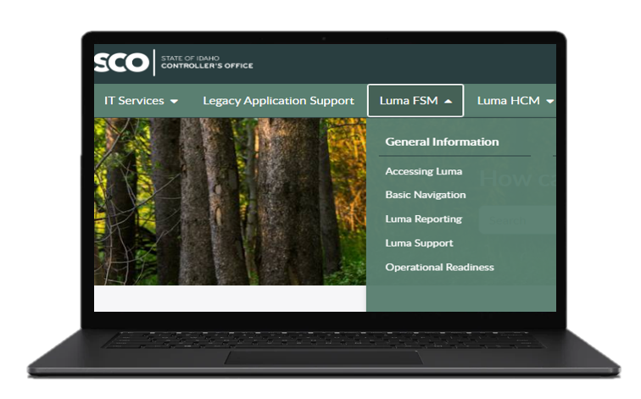
DUO / Service Desk Changes Announcement
Quick Reference Guides for Basic DUO/Service Desk
How to Access Service Desk
How to Register DUO MFA & Sign In
How to Access ED – New User
How to Access ED – Established User
How to Access to ED – Reset Password
Coming soon! Videos of Basic Navigation and Service Desk
ADDITIONAL RESOURCES
Tours of Service Desk available now
14

Slide 15
Coming Soon!
Tool # 7 | Item | Tool name: Coming Soon! Employee and Manager Role Workshop Recordings
 | Focus | Response
 | Why is this important? | Luma Role Workshops are virtual events and video recordings that provide an opportunity for State of Idaho staff to learn about role-specific changes and impacts associated with the Luma implementation prior to formal training. Four (4) Role Workshops have been released thus far and can be found on the Luma Role Workshop webpage: Finance Professionals, Procurement Professionals, Recruiter, and HR Generalist. The Employee and Manager Role Workshop recordings are scheduled to be released the week of April 10th.
 | Who is the target audience? | All State of Idaho Managers and Employees.
 | What is the objective? | The workshops reiterate the statewide value of Luma, what the employee will do in Luma, what changes they can expect, and the timeline for training/Go-Live.
 | What are some suggested communication/distribution channels? | Email, Agency newsletters.
 | Recommended timing: | Following the release of the Employee and Manager Role Workshop recordings.
15

Slide 16
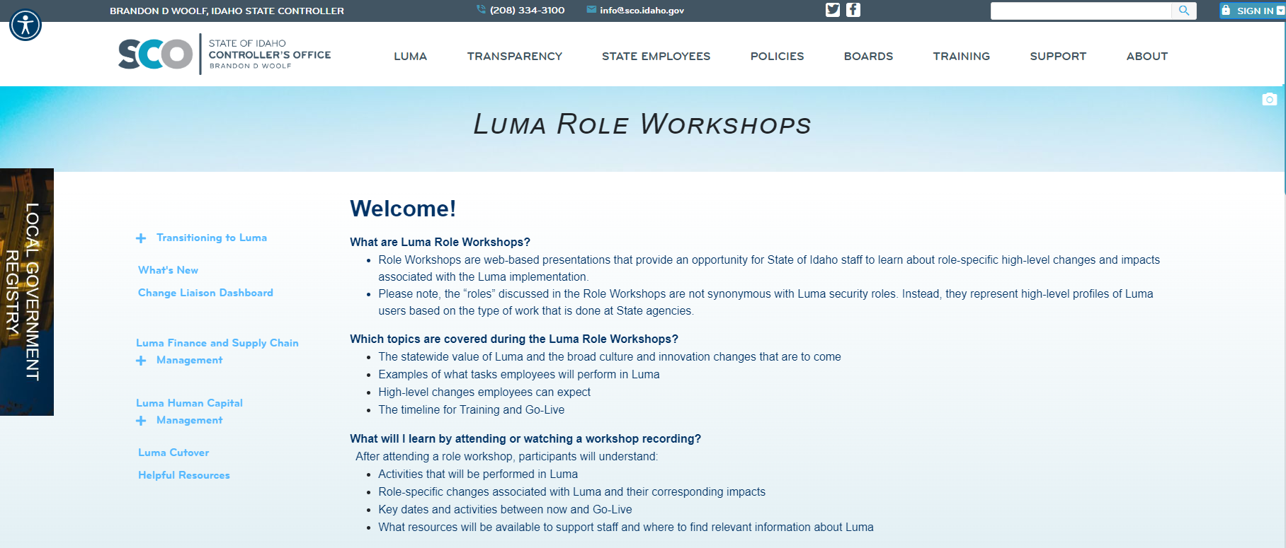
Coming Soon! Manager and Employee Role Workshop Recordings
Be on the lookout for the Employee and Manager Role Workshop recordings, to be released the week of April 10th.
In the meantime, you can find links and resources to all Role Workshops on the Luma webpage.
16

Slide 17
Toolkit Overview
What is this communications toolkit?
This communications toolkit is a package of communications materials and resources (template emails, presentations, flyers, graphics, etc.) to help Change Liaisons communicate consistently about important topics.
Why am I receiving this communications toolkit?
As each agency has unique communications practices and channels, you are encouraged to use the toolkit as it best fits your agency’s needs. We hope that this resource supports you in your role as a Change Liaison and helps champion Luma across the State.
How do I leverage this toolkit?
Each item in the toolkit is accompanied with guidance on how to share messages with agency personnel. However, you know your agency best and we encourage you to customize the language provided in the tools. Also, consider how information is disseminated at your agency. Do you use Slack? Newsletters? A private website? Any channel that facilitates employee awareness of Luma is appropriate.

Slide 18
About Each Tool: How to Use
Each item in this toolkit is preceded by this table, which provides guidance on how to use the tool.
Tool # | Item | Tool name goes here
 | Focus | Response
 | Why is this important? | This field explains the importance of the tool, and why it should be used.
 | Who is the target audience? | This field identifies who the target audience is, if applicable, for the accompanying tool. The audience(s) identified is not exhaustive, and you can further tailor this to your agency as applicable.
 | What is the objective? | This field explains the objective, or the intent, of the tool, and why we are sharing it.
 | What are some suggested communication/distribution channels? | This field provides examples of suggested channels or ways to distribute to utilize in communicating/using this tool. Please further tailor these suggestions as you apply your group expertise as you are able.
 | Recommended timing: | This field, as applicable, provides a recommended timeframe as to when this tool could be used/shared to your agency.

Slide 19
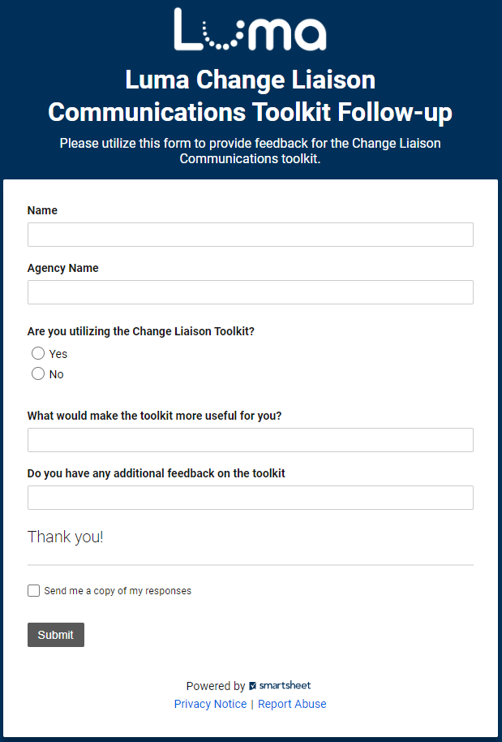
Share your feedback!
Let us know what you think of the toolkit!
Share your feedback on the easy-to-complete form anytime.
Access the form online here.

Slide 20
Resources
Have questions? Please contact or access the following:
Agency Advocate – our Agency Advocates sit within the State Controller’s Office and are dedicated to a subset of agencies. They’re here to support you and your staff as we cross the finish line to Go-Live.
Krystal Griffith
kgriffith@sco.idaho.gov
208-332-8861
Chris Lehosit
clehosit@sco.idaho.gov
208-332-8887
Elijah Stearns
estearns@sco.idaho.gov
208-332-8871
Danielle Stevens
dstevens@sco.idaho.gov
208-332-8868
Revisit Existing Communication Channels – familiarize yourself with information already available about the Luma Project by visiting the Luma Website and the Luma YouTube Page.

Slide 21
Terminology and Acronyms
The following is a list of terminology and acronyms you will see in Luma Project communications and their meaning:
Term / Acronym | Definition
CRA | Change Readiness Assessment: A survey sent to a broad sample of agency employees to measure how informed Stakeholders feel about the Luma project. Forthcoming CRAs will be deployed in January and May.
FSM | Finance and Supply Chain Management. Formerly Phase 1, entails all finance and procurement modules.
HCM | Human Capital Management. Formerly Phase 2, entails all human capital management, payroll, and time modules.
JSIT | Joint System Integration Testing: intended to confirm that FSM and HCM business processes perform as designer across an integrated set of modules and that the system meets critical State business requirements at Go-Live.
Role Workshop | Role Workshops will be open to all staff and will be aligned to specific security roles. The workshops reiterate what the employee will do in Luma and what changes they can expect. Planned for February and March.
User Experience (UX) Simulations | UX Simulations will mimic users being inside the Luma system, wherein employees will be guided with instructions on how to complete common scenarios.
Luma Labs | Luma Labs are intended to grow confidence in Luma by providing selected agencies and individuals an opportunity to experience the Luma configuration. In-Progress from February to late March.
Operational Readiness Program (ORP) | A toolset that will be provided to agencies to enable self-discovery of unique impacts and subsequent plans based on the unique agency needs.
Readiness Checklist | As part of the ORP, checklists highlight activities an agency needs to complete throughout their implementation efforts, covering activities related to people, technology, data, and process readiness.

