Slide 1
Change Liaison Communication Toolkit
February 2023

Slide 2
Toolkit Table of Contents
Toolkit | Description
February Communications Toolkit focus: | Share activities and resources that will be introduced in the month of February to assist your agency as Idaho transitions to Luma.
What to accomplish with this Toolkit: | Familiarize and or share components within this toolkit, which are designed to prepare agency employees to understand the change impacts to roles, responsibilities, and tasks.
Tool # | Description | Slide Numbers
1 | Joint System Integration Testing Dashboard | 3-4
2 | Media: Luma Winter Employee Journey Map | 5-6
3 | Operational Readiness Assessment (ORA) Updates | 7-8
4 | Luma Highlight Videos Poster | 9-10
5 | Coming Soon - Luma Role Workshops! | 11-12
6 | Coming Soon – Luma Labs! | 13-14
- | Appendix – Resources, Toolkit Instructions | 15-19
2

Slide 3
JSIT Dashboard
Tool # 1 | Item | Tool name: JSIT Dashboard
 | Focus | Response
 | Why is this important? | For agencies participating in Joint System Integration Testing (JSIT), the JSIT Dashboard is a one-stop shop for information on JSIT, including the testing schedule and agency tester packets.
 | Who is the target audience? | Agency testers participating in Joint System Integration Testing.
 | What is the objective? | Provide a centralized location for agency testers to access helpful information on JSIT.
 | What are some suggested communication/distribution channels? | Email, Agency newsletters.
 | Recommended timing: | First week of JSIT (Week of February 6).
3

Slide 4
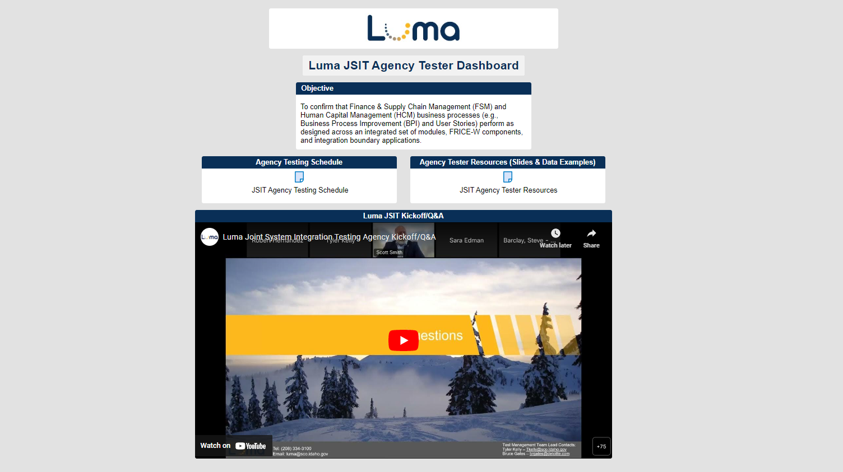
JSIT Dashboard
The Luma JSIT Dashboard provides agency testers with resources to use during testing.
The dashboard can be accessed here.
*Smartsheet will require you to make an account and start a 30-day trial. The trial will not actually end and you will continue to have access.
4

Slide 5
Winter Employee Journey Map
Tool # 2 | Item | Tool name: Luma Winter Employee Journey Map
 | Focus | Response
 | Why is this important? | This visual tool portrays a role-based path of actionable steps Idaho employees can participate in from January – April 2023 as they prepare for Luma.
 | Who is the target audience? | Agency Directions, Managers / Supervisors, and Agency Employees.
 | What is the objective? | This provides an easily digestible visual of Luma activities that will be available for all Idaho employees to engage with from January to March. Managers are encouraged to leverage this tool in conversations with their teams and level set expectations regarding level of involvement anticipated for Luma workforce transition activities. It can also be printed as a poster and displayed in common areas.
 | What are some suggested communication/distribution channels? | Email, Agency newsletters, Team meetings.
 | Recommended timing: | ASAP.
5

Slide 6
Winter Employee Journey Map
The Winter Employee Journey Map was shared on January 20 and 27 in the Luma PMO Weekly Update.
You can also access and download it here.
6

Slide 7
Operations Readiness Assessment
Tool # 3 | Item | Tool name: Operational Readiness Assessment Overview
 | Focus | Response
 | Why is this important? | The Operational Readiness Assessment is a guided process for agencies to systematically review how the upcoming transition to Luma will impact their current business processes.
 | Who is the target audience? | Agency Leaders will guide this multi-month process.
 | What is the objective? | To raise awareness about this upcoming activity beginning on the February 23 Kickoff.
 | What are some suggested communication/distribution channels? | Support your agency leadership in this initiative, and when notified, follow-up with them to make sure they received the invitation to the kick-off. If they cannot attend, help them make sure that your agency is represented with agency leaders who can receive the important information.
 | Recommended timing: | Early-mid February 2023
7

Slide 8
Operations Readiness Assessment
Overview
What is an Operations Readiness Assessment (ORA)?
An agency ORA is based on the idea that each agency will experience the Luma transition with unique opportunities and challenges operationally. The assessment will help agencies identify specific areas to focused on to achieve a successful go-live.
Why consider an Operations Readiness Assessment?
An Operations Readiness Assessment will prepare you and your team for the impacts the Luma implementation may have on agency operations and personnel. Your agency will be aligned for go-live and better prepared post go-live.
Who participates in Operations Readiness Assessment?
Agency leaders will guide the conversation and support the program being responsible, accountable and consistently informed of the analysis results.
Bureau Chiefs and leaders will perform and manage the analysis.
Kick-off
2/23/23
March
Continue assessment
April
Recommend change plans
Timeline
March
Office Hour
February
Begin assessment
March
Assess Change Impacts
April
Assess and document
April
Office Hours
More information to be released!
8

Slide 9
Luma Highlight Videos Poster
Tool # 4 | Item | Tool name: Newly Released Luma Highlight Videos Poster
 | Focus | Response
 | Why is this important? | Luma Highlight videos provide a first look to end-users into the Luma interface and demonstrate features of Luma. Previously released videos have been redone to orient to how the system will run, and new videos have been released.
 | Who is the target audience? | All agency employees.
 | What is the objective? | To increase end-user awareness about Luma functionality and generate excitement among agency employees about using Luma in their day-to-day activities. The poster can be shared digitally or printed and posted in common areas.
 | What are some suggested communication/distribution channels? | Agency Newsletters, Agency Intranet sites, existing Agency monthly meetings.
 | Recommended timing: | At Change Liaison discretion.
9

Slide 10
Luma Highlight Videos Poster
The Luma Highlight video poster can be accessed on the Change Liaison Dashboard found here.
Please share this poster with your colleagues!
10

Slide 11
Luma Role Workshops
Tool # 5 | Item | Tool name: Coming Soon! Luma Role Workshops
 | Focus | Response
 | Why is this important? | Luma Role Workshops are content-specific presentations for employees based on their current jobs and activities and how those will change with Luma. Details of work with Luma will include tasks performed in Luma, as well as a discussion of changes and impacts associated with the employees’ role.
 | Who is the target audience? | We will be offering six (6) role workshops. All employees should plan to attend the Employee Role Workshop. Based on their position they may attend more than one role workshop, For example, employees who work in recruitment and supervise others would be invited to three Role Workshops: Employee, Recruiter, and Manager.
 | What is the objective? | The workshops reiterate the statewide value of Luma, what the employee will do in Luma, what changes they can expect, and the timeline for training/Go-Live.
 | What are some suggested communication/distribution channels? | Email, Agency Newsletters, Agency meeting announcements.
 | Recommended timing: | Share with your agency once registration is opened; Change Liaisons will receive notification when registration is live.
11

Slide 12
Coming Soon! Luma Role Workshops
All employees, regardless of their agency will be invited to attend the Employee Role Workshop:
Depending on their position, employees may also be invited to attend a Workshop for the following roles:
Manager
Procurement
HR Generalist
Recruiter
Finance
12

Slide 13
Luma Labs
Tool # 6 | Item | Tool name: Coming Soon! Luma Labs
 | Focus | Response
 | Why is this important? | Luma Labs will provide selected Idaho agency employees an opportunity to experience their COA data, org structure, and a sample of basic processes in their future state prior to go-live of the Luma system.
 | Who is the target audience? | Participants will include FSM users and Core HCM users. All agencies will participate in Luma Labs, even if they participated in JSIT
 | What is the objective? | Increase awareness of Luma Labs.
 | What are some suggested communication/distribution channels? | Share via email, agency newsletters, and at agency meetings.
 | Recommended timing: | Mid-February 2023.
13

Slide 14
Coming Soon! Luma Labs
Why do we need Luma Labs?
The goals of Luma Labs are to:​
Increase the number of agencies / individuals who have an opportunity to experience Luma
Advance stakeholder understanding of future state
Gain insights into and capture the questions stakeholders will have about Luma
Who participates in Luma Labs?
Participants will be identified based on their role in FSM, Procurement, or HCM.
All agencies will participate in Luma Labs.
What are Luma Labs?
Luma Labs will provide Idaho agency employees an opportunity to experience their COA data, org structure, and sample of basic processes & configuration prior to go-live in Summer 2023.​
When will I find out more?
More information will be released in February 2023.
Luma Labs will begin on February 27.
14

Slide 15
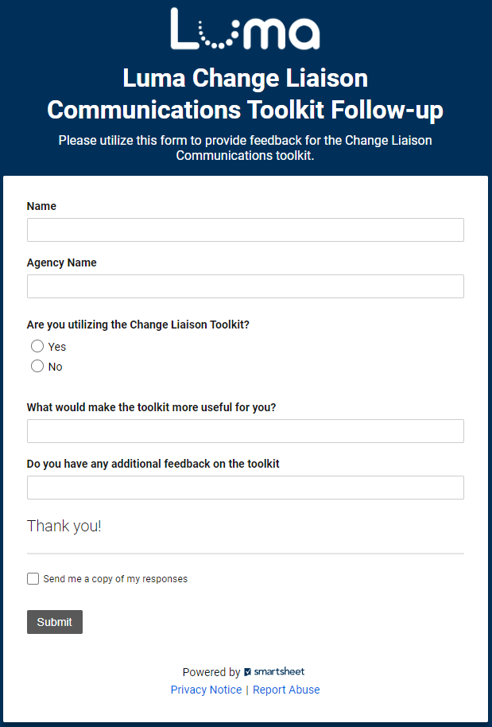
Share your feedback!
Let us know what you think of the toolkit!
Share your feedback on the easy-to-complete form anytime.
Access the form online here.
15

Slide 16
Resources
Have questions? Please contact or access the following:
Agency Advocate – our Agency Advocates sit within the State Controller’s Office and are dedicated to a subset of agencies. They’re here to support you and your staff as we cross the finish line to Go-Live.
Krystal Griffith
kgriffith@sco.idaho.gov
208-332-8861
Chris Lehosit
clehosit@sco.idaho.gov
208-332-8887
Elijah Stearns
estearns@sco.idaho.gov
208-332-8871
Danielle Stevens
dstevens@sco.idaho.gov
208-332-8868
Revisit Existing Communication Channels – familiarize yourself with information already available about the Luma Project by visiting the Luma Website and the Luma YouTube Page.
16

Slide 17
Terminology and Acronyms
The following is a list of terminology and acronyms you will see in Luma Project communications and their meaning:
Term / Acronym | Definition
CRA | Change Readiness Assessment: A survey sent to a broad sample of agency employees to measure how informed Stakeholders feel about the Luma project. Forthcoming CRAs will be deployed in January and May.
FSM | Finance and Supply Chain Management. Formerly Phase 1, entails all finance and procurement modules.
HCM | Human Capital Management. Formerly Phase 2, entails all human capital management, payroll, and time modules.
JSIT | Joint System Integration Testing: intended to confirm that FSM and HCM business processes perform as designer across an integrated set of modules and that the system meets critical State business requirements at Go-Live. Agency testing is planned for 2/13-3.17.
Role Workshop | Role Workshops will be open to all staff and will be aligned to specific security roles. The workshops reiterate what the employee will do in Luma and what changes they can expect. Planned for February and March.
User Experience (UX) Simulation | UX Simulations will mimic users being inside the Luma system, wherein employees will be guided with instructions on how to complete common scenarios. Planned for February through April.
Luma Labs | Luma Labs are intended to grow confidence in Luma by providing selected agencies and individuals an opportunity to experience the Luma configuration. Planning In-Progress.
Operational Readiness Toolkit | A toolset that will be provided to agencies to enable self-discovery of unique impacts and subsequent plans based on the unique agency needs. Details forthcoming.
Go-Live Readiness Checklist | Describes activities an agency needs to complete throughout their implementation efforts, covering activities related to people, technology, data, and process readiness. Details forthcoming.
17

Slide 18
Toolkit Overview
What is this communications toolkit?
This communications toolkit is a package of communications materials and resources (template emails, presentations, flyers, graphics, etc.) to help Change Liaisons communicate consistently about important topics.
Why am I receiving this communications toolkit?
As each agency has unique communications practices and channels, you are encouraged to use the toolkit as it best fits your agency’s needs. We hope that this resource supports you in your role as a Change Liaison and helps champion Luma across the State.
How do I leverage this toolkit?
Each item in the toolkit is accompanied with guidance on how to share messages with agency personnel. However, you know your agency best and we encourage you to customize the language provided in the tools. Also, consider how information is disseminated at your agency. Do you use Slack? Newsletters? A private website? Any channel that facilitates employee awareness of Luma is appropriate.
18

Slide 19
About Each Tool: How to Use
Each item in this toolkit is preceded by this table, which provides guidance on how to use the tool.
Tool # | Item | Tool name goes here
 | Focus | Response
 | Why is this important? | This field explains the importance of the tool, and why it should be used.
 | Who is the target audience? | This field identifies who the target audience is, if applicable, for the accompanying tool. The audience(s) identified is not exhaustive, and you can further tailor this to your agency as applicable.
 | What is the objective? | This field explains the objective, or the intent, of the tool, and why we are sharing it.
 | What are some suggested communication/distribution channels? | This field provides examples of suggested channels or ways to distribute to utilize in communicating/using this tool. Please further tailor these suggestions as you apply your group expertise as you are able.
 | Recommended timing: | This field, as applicable, provides a recommended timeframe as to when this tool could be used/shared to your agency.
19

