Slide 1

Change Liaison Communication Toolkit
March 2023

Slide 2
Toolkit Table of Contents
Toolkit | Description
March Communications Toolkit focus: | Showcase events and newly released resources on the Luma webpage that promote a greater understanding of how day to day activities will change with Luma, give end users a view into the Luma system, and communicate important dates associated with Cutover.
What to accomplish with this Toolkit: | Familiarize yourself and/or share components within this toolkit, which are designed to prepare agency employees to understand the change impacts to their roles, responsibilities, and tasks.
Tool # | Description | Slide Numbers
1 | Luma Role Workshops FAQ Webpage | 3-4
2 | Operational Readiness Program (ORP) Update | 5-6
3 | User Experience (UX) Simulations | 7-8
4 | Cutover Information | 9-10
- | Appendix – Resources, Toolkit Instructions
2

Slide 3





Role Workshops Webpage
Tool # 1 | Item | Tool name: Luma Role Workshops Webpage
 | Focus | Response
 | Why is this important? | Luma Role Workshops are virtual events scheduled from late February through March that provide an opportunity for State of Idaho staff to learn about role-specific changes and impacts associated with the Luma implementation prior to formal training. The Role Workshop webpage acts as a repository of recordings, FAQs, and slides from the presentations.
 | Who is the target audience? | As of March 6th ,content specific to Procurement and Finance professionals is available. By the end of March, content specific to Recruiters, HR Generalists, Managers and Employees will be posted.
 | What is the objective? | Provide a centralized location for stakeholders to access and view Role Workshop content.
 | What are some suggested communication/distribution channels? | Email, Agency newsletters.
 | Recommended timing: | At agency discretion.
3

Slide 4

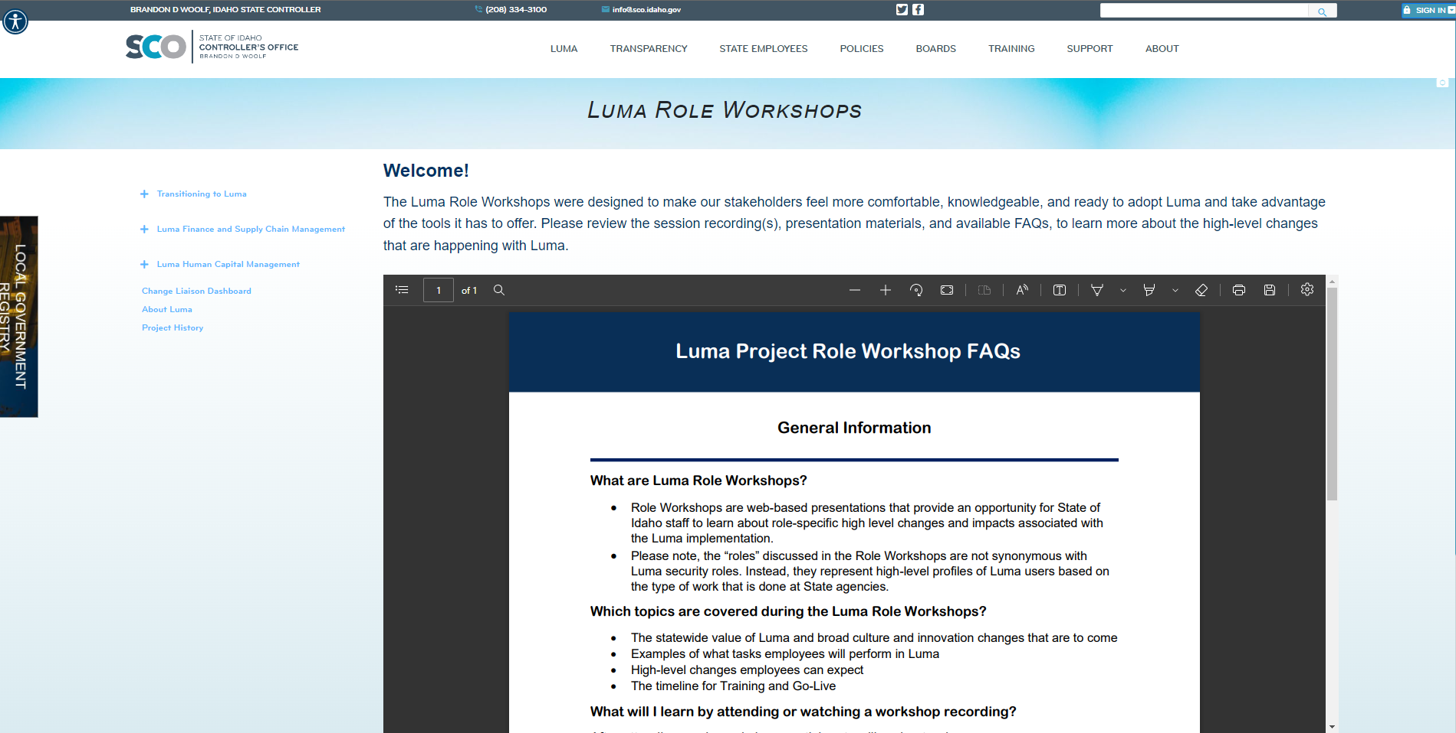
Role Workshops Webpage
The Luma Role Workshops Webpage can be accessed on the Change Liaison Dashboard found here.
Please share this link with Finance and Procurement staff in your agency!
4

Slide 5
Operational Readiness Program (ORP) Updates
Tool # 2 | Item | Tool name: Operational Readiness Program Updates
 | Focus | Response
 | Why is this important? | The Operational Readiness Program is a guided process for agencies to systematically review how the upcoming transition to Luma will impact their current business processes. The ORP Kickoff, scheduled for March 9th, will provide agency leaders and Change Liaisons with additional information.
 | Who is the target audience? | Agency Leaders will guide this multi-month process.
 | What is the objective? | To provide Change Liaisons a timeline of expected ORP activities.
 | What are some suggested communication/distribution channels? | Support your agency leadership in this initiative, and when notified, follow-up with them to make sure they received the invitation to the kick-off. If they cannot attend, help them make sure that your agency is represented with agency leaders who can receive the important information.
 | Recommended timing: | Not applicable to this tool.
5

Slide 6
Operational Readiness Program Updates
What is an Operational Readiness Program (ORP)?
An agency ORP is based on the idea that each agency will experience the Luma transition with unique opportunities and challenges operationally. The ORP has various tools to assist agencies in their assessment in identifying specific areas to focus on to achieve a successful go-live.
Who participates in an Operational Readiness Program (ORP)?
Agency leaders will guide the conversation and support the program by being responsible, accountable, and consistently informed of the results.
Bureau Chiefs and leaders will perform and manage the program. Change liaisons will support and inform teams.
Timeline
Kickoff
3/9/2023
March
Monthly
Office Hours
April
Monthly
Office Hours
May
Monthly
Office Hours
June
Monthly
Office Hours
July
Monthly
Office Hours
August
Monthly
Office Hours
September
Monthly
Office Hours
March
Use tools for assessment
April
Use tools for assessment
May
Use tools for assessment
June-July
Use tools for assessment
August-September
Use Sustainment tools for continued assessment
6

Slide 7
User Experience (UX) Simulations
Tool # 3 | Item | Tool name: UX Simulations
 | Focus | Response
 | Why is this important? | UX Simulations are interactive web-based experiences that mimic users being inside the system and guide them through common processes relevant to their roles.
 | Who is the target audience? | Agency Employees, Managers, and HR Generalists.
 | What is the objective? | To introduce users to the look and feel of Luma. Please note, the objective of the simulations is not to train staff bur to demystify the system prior to formal training.
 | What are some suggested communication/distribution channels? | Email, Agency newsletters.
 | Recommended timing: | At your earliest convenience.
7

Slide 8

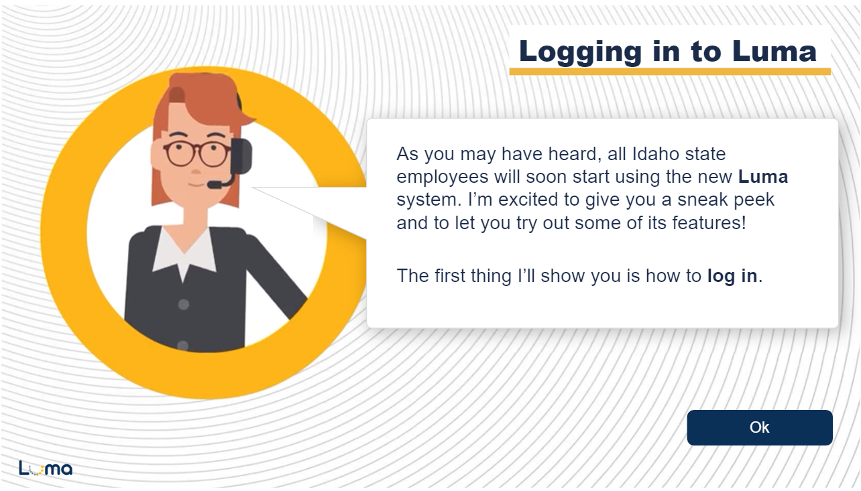
User Experience (UX) Simulations
You can now access UX Simulations for three roles:
Employee
Manager
HR Generalist
8

Slide 9
Cutover Details on the Luma Webpage
Tool # 4 | Item | Tool name: Cutover Details Webpage
 | Focus | Response
 | Why is this important? | The Cutover webpage on the Luma website provides information to prepare agencies and state employees to begin transacting in Luma.
 | Who is the target audience? | Change Liaisons, Agency leadership.
 | What is the objective? | Ensure Change Liaisons are ready to take appropriate steps to discontinue legacy system usage and begin successfully transacting in Luma with minimal disruption to operations.
 | What are some suggested communication/distribution channels? | Agency meetings, newsletters, and message boards.
 | Recommended timing: | At your earliest convenience.
9

Slide 10

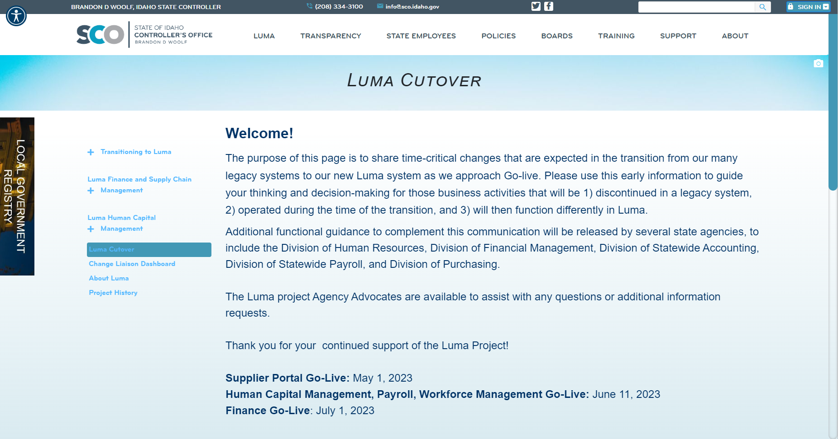
Cutover Details – Available on the Luma Website!
The Luma Cutover page will be a one-stop shop for stakeholders to access information on upcoming freeze and cut-off dates as we approach Go-Live.
10

Slide 11

Toolkit Overview
What is this communications toolkit?
This communications toolkit is a package of communications materials and resources (template emails, presentations, flyers, graphics, etc.) to help Change Liaisons communicate consistently about important topics.
Why am I receiving this communications toolkit?
As each agency has unique communications practices and channels, you are encouraged to use the toolkit as it best fits your agency’s needs. We hope that this resource supports you in your role as a Change Liaison and helps champion Luma across the State.
How do I leverage this toolkit?
Each item in the toolkit is accompanied with guidance on how to share messages with agency personnel. However, you know your agency best and we encourage you to customize the language provided in the tools. Also, consider how information is disseminated at your agency. Do you use Slack? Newsletters? A private website? Any channel that facilitates employee awareness of Luma is appropriate.
11

Slide 12
About Each Tool: How to Use
Each item in this toolkit is preceded by this table, which provides guidance on how to use the tool.
Tool # | Item | Tool name goes here
 | Focus | Response
 | Why is this important? | This field explains the importance of the tool, and why it should be used.
 | Who is the target audience? | This field identifies who the target audience is, if applicable, for the accompanying tool. The audience(s) identified is not exhaustive, and you can further tailor this to your agency as applicable.
 | What is the objective? | This field explains the objective, or the intent, of the tool, and why we are sharing it.
 | What are some suggested communication/distribution channels? | This field provides examples of suggested channels or ways to distribute to utilize in communicating/using this tool. Please further tailor these suggestions as you apply your group expertise as you are able.
 | Recommended timing: | This field, as applicable, provides a recommended timeframe as to when this tool could be used/shared to your agency.
12

Slide 13
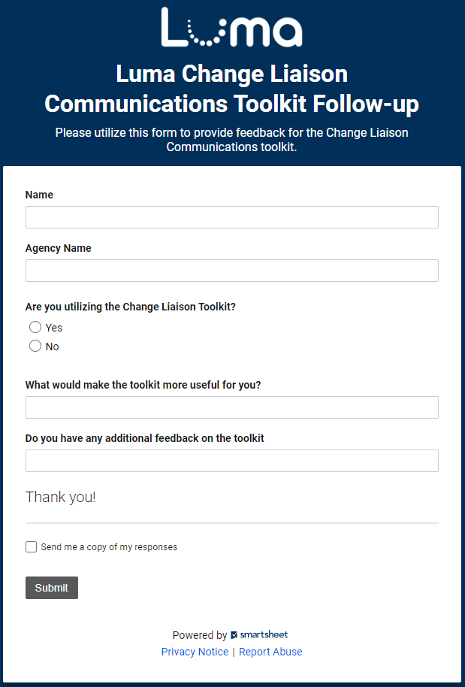
Share your feedback!
Let us know what you think of the toolkit!
Share your feedback on the easy-to-complete form anytime.
Access the form online here.
13

Slide 14



Resources
Have questions? Please contact or access the following:
Agency Advocate – our Agency Advocates sit within the State Controller’s Office and are dedicated to a subset of agencies. They’re here to support you and your staff as we cross the finish line to Go-Live.
Krystal Griffith
kgriffith@sco.idaho.gov
208-332-8861
Chris Lehosit
clehosit@sco.idaho.gov
208-332-8887
Elijah Stearns
estearns@sco.idaho.gov
208-332-8871
Danielle Stevens
dstevens@sco.idaho.gov
208-332-8868
Revisit Existing Communication Channels – familiarize yourself with information already available about the Luma Project by visiting the Luma Website and the Luma YouTube Page.
14

Slide 15
Terminology and Acronyms
The following is a list of terminology and acronyms you will see in Luma Project communications and their meaning:
Term / Acronym | Definition
CRA | Change Readiness Assessment: A survey sent to a broad sample of agency employees to measure how informed Stakeholders feel about the Luma project. Forthcoming CRAs will be deployed in January and May.
FSM | Finance and Supply Chain Management. Formerly Phase 1, entails all finance and procurement modules.
HCM | Human Capital Management. Formerly Phase 2, entails all human capital management, payroll, and time modules.
JSIT | Joint System Integration Testing: intended to confirm that FSM and HCM business processes perform as designer across an integrated set of modules and that the system meets critical State business requirements at Go-Live.
Role Workshop | Role Workshops will be open to all staff and will be aligned to specific security roles. The workshops reiterate what the employee will do in Luma and what changes they can expect. Planned for February and March.
User Experience (UX) Simulations | UX Simulations will mimic users being inside the Luma system, wherein employees will be guided with instructions on how to complete common scenarios.
Luma Labs | Luma Labs are intended to grow confidence in Luma by providing selected agencies and individuals an opportunity to experience the Luma configuration. In-Progress from February to late March.
Operational Readiness Program (ORP) | A toolset that will be provided to agencies to enable self-discovery of unique impacts and subsequent plans based on the unique agency needs.
Readiness Checklist | As part of the ORP, checklists highlight activities an agency needs to complete throughout their implementation efforts, covering activities related to people, technology, data, and process readiness.
15

