Slide 1
Change Liaison Communication Toolkit
May 2023

Slide 2
Toolkit Table of Contents
Toolkit | Description
May Communications Toolkit focus: | Generate awareness and engagement around the following topics: Human Capital Management terms, Frequently Asked Questions, Training Resources, and other topics.
What to accomplish with this Toolkit: | Familiarize and/or share components within this toolkit, which are designed to prepare agency employees to successfully understand and adopt Luma.
Tool # | Description | Slide Numbers
1 | Human Capital Management (HCM) Glossary | 3-4
2 | Frequently Asked Questions | 5-6
3 | Luma Training Resources Demo | 7-8
4 | Luma Showcase Timeline | 9-10
5 | ORP: April Readiness Checklist and Support Sessions | 11-12
6 | Luma Supplier Portal Go-live | 13-14
- | Appendix – Resources, Toolkit Instructions
2

Slide 3
Human Capital
Management (HCM) Glossary
Tool # 1 | Item | Tool name: Human Capital Management (HCM) Glossary
 | Focus | Response
 | Why is this important? | Luma comes with a specific set of terms that are unique to the system. Becoming familiar with this new terminology will allow employees to navigate the system more effectively and confidently.
 | Who is the target audience? | All employees.
 | What is the objective? | Provide definitions for commonly used words/phrases in Luma Human Capital Management.
 | What are some suggested communication/distribution channels? | Agency newsletters, intranet sites, and message boards.
 | Recommended timing: | At your earliest convenience.
3

Slide 4
Human Capital Management (HCM) Glossary
The new Human Capital Management glossary provides the Luma term, the purpose, the module the term relates to, and the legacy equivalent.
This document can be found on the Service Desk Knowledge Base.
4

Slide 5
Frequently Asked Questions
Tool # 2 | Item | Tool name: Frequently Asked Questions
 | Focus | Response
 | Why is this important? | As agencies transition from operating in legacy environments to Luma, we expect agency personnel to have lots of questions. This document is meant to be a one-stop shop for those questions to be answered before sending an email.
 | Who is the target audience? | All employees
 | What is the objective? | Provide agencies with answers to popular questions and reduce the amount of time it takes to get an answer.
 | What are some suggested communication/distribution channels? | Agency meetings, newsletters, and message boards.
 | Recommended timing: | Not applicable to this tool.
5

Slide 6
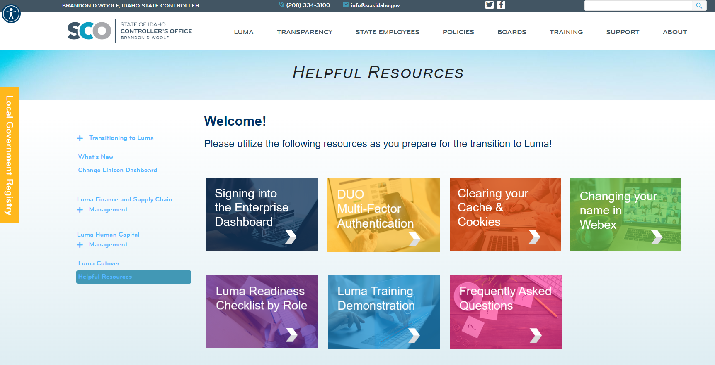
Frequently Asked Questions
The Frequently Asked Questions document can be found on the Luma Helpful Resources page.
6

Slide 7
Training Resources Demo
Tool # 4 | Item | Tool name: Training Resources Demo
 | Focus | Response
 | Why is this important? | This short video will provide agency employees with a demonstration of how to access Luma Training, register for training, and how to use the resources that are available to prepare for training.
 | Who is the target audience? | All Agency Employees doing Luma Training
 | What is the objective? | Prove agency users with information and a demonstration of how to access Luma Training and the accompanying resources.
 | What are some suggested communication/distribution channels? | Agency meetings, emails, newsletters, and message boards.
 | Recommended timing: | Not applicable to this tool.
7

Slide 8
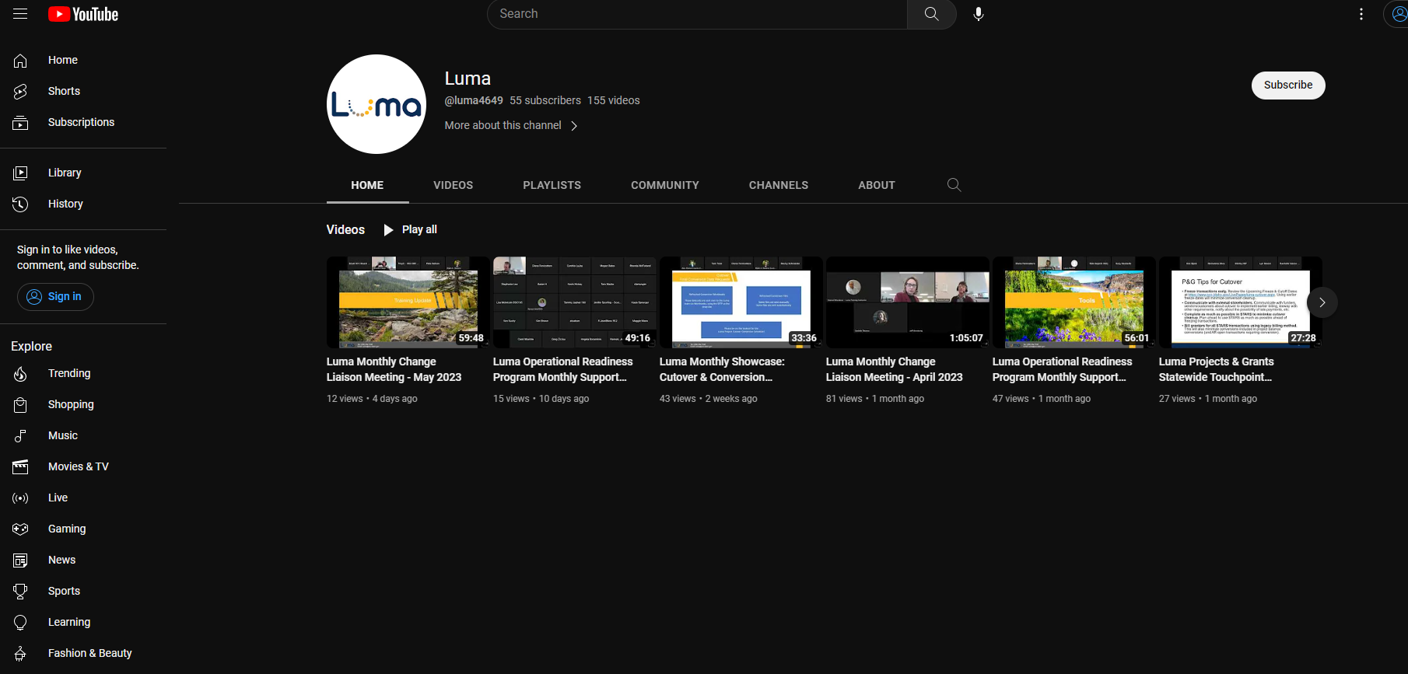
Luma Training
Resources Demo
You can view this Training Demonstration on the Luma YouTube Channel found here.
12

Slide 9
Luma Showcase Timeline
Tool # 3 | Item | Tool name: Luma Showcase Timeline & Topics
 | Focus | Response
 | Why is this important? | Due to requests for increased touchpoints and greater visibility into the Luma transition, we are planning a series of Luma Monthly Showcase Sessions for Change Liaisons. Each session will be led by a subject matter expert (SME) who will speak on the topic at hand followed by Q&A.
 | Who is the target audience? | Change Liaisons and any colleagues they would like to invite.
 | What is the objective? | Provide an overview of planned Luma Showcase topics and tentative dates.
 | What are some suggested communication/distribution channels? | Not applicable to this tool.
 | Recommended timing: | Not applicable to this tool.
9

Slide 10
Luma Showcase Timeline
April
May
June
July
Cutover and Conversion Workbooks
Reports
Technology- Mingle (formerly Enterprise Dashboard) & Service Desk
Sustainment
MONTHLY TOPIC
SME
Cutover Team
Luma OCM
CSC
Sustainment Team
Address cutover freeze dates and procedures.
Provide support in completing conversion workbooks.
Support agencies with report submissions.
Offer tutorial on how to access Mingle and Service Desk.
Post go-live session to support the adoption of the Luma system.
OBJECTIVES
DATE
4/19
5/17
TBD
TBD
Contact your Agency Advocate for meeting invitations.
10

Slide 11
ORP: May Resources and Activities
Tool # 4 | Item | Tool name: ORP – May Resources and Activities
 | Focus | Response
 | Why is this important? | The Operational Readiness Program is a guided process for agencies to systematically review how the upcoming transition to Luma will impact their current business processes. The Luma Project team will be continuously updating ORP tools throughout the month of May and is facilitating the next monthly ORP Support Session on May 25th.
 | Who is the target audience? | Agency Leaders will guide this multi-month process.
 | What is the objective? | To provide Change Liaisons details of expected ORP resources and activities for the month of May.
 | What are some suggested communication/distribution channels? | Support your agency leadership in this initiative, and when notified, follow-up with them to make sure they received invitations to Support Sessions. If they cannot attend, help them make sure that your agency is represented with agency leaders who can receive the important information.
 | Recommended timing: | Not applicable to this tool.
11

Slide 12
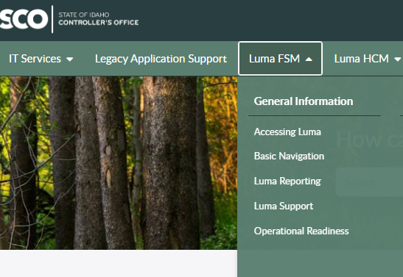
ORP: MAY Resources and Activities
You can find the following resources on the Service Desk Tile in the Enterprise Dashboard:
Leadership Readiness Checklist for May/June
Readiness Checklist by Role
HCM Impact Statements – new information!
Monthly Support Session: 5/25 at 11:00 AM (invitations sent)
12

Slide 13
Supplier Portal Go-live
Tool # 6 | Item | Tool name: Supplier Portal Go-live
 | Focus | Response
 | Why is this important? | The Supplier Portal went live on Friday, May 5th! The updated Supplier Portal is a part of the new Enterprise Resource Planning system, Luma, that the State of Idaho is currently implementing. The current eProcurement system powered by Jaggaer will now be powered by Luma. The look and feel will be different, but just as easy to navigate and use.
 | Who is the target audience? | All Employees and Suppliers using the Supplier Portal.
 | What is the objective? | To ensure agencies are aware of the new Supplier Portal being live.
 | What are some suggested communication/distribution channels? | Email, agency newsletter.
 | Recommended timing: | As soon as possible.
13

Slide 14
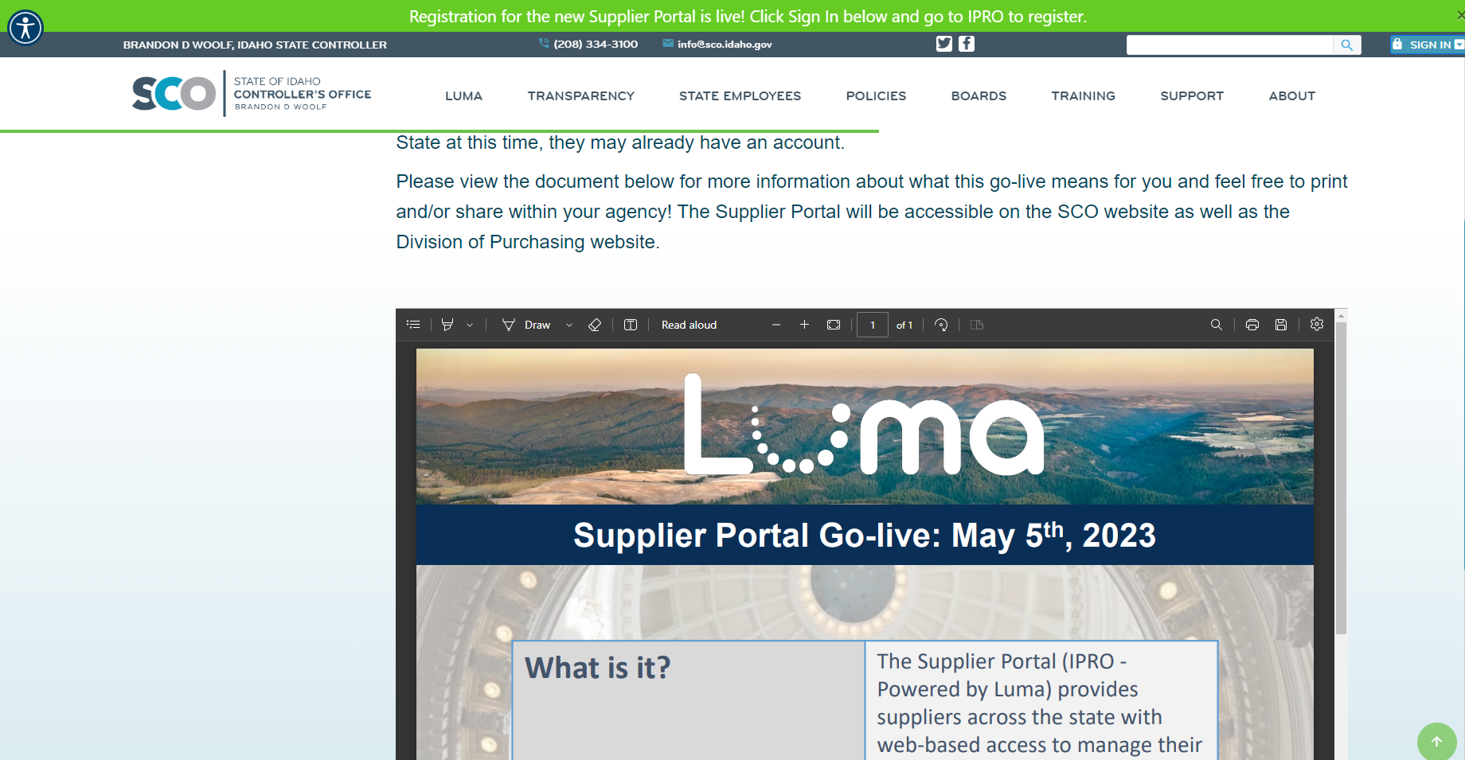
Supplier Portal Go-live
A document with more information about what this means for you can be found here!
We are excited to announce that a new Supplier Portal Powered by Luma is live!
The Supplier Portal Powered by Luma will allow for the seamless integration of procurement and payment activities. Here are just a few exciting benefits to be aware of:
Expedited vendor payments
Greater visibility into invoices
A single source for bidding opportunities posted by State agencies
We encourage Suppliers to register as soon as possible! Please note that if they are doing business with the State at this time, they may already have an account.
14

Slide 15
Toolkit Overview
What is this communications toolkit?
This communications toolkit is a package of communications materials and resources (template emails, presentations, flyers, graphics, etc.) to help Change Liaisons communicate consistently about important topics.
Why am I receiving this communications toolkit?
As each agency has unique communications practices and channels, you are encouraged to use the toolkit as it best fits your agency’s needs. We hope that this resource supports you in your role as a Change Liaison and helps champion Luma across the State.
How do I leverage this toolkit?
Each item in the toolkit is accompanied with guidance on how to share messages with agency personnel. However, you know your agency best and we encourage you to customize the language provided in the tools. Also, consider how information is disseminated at your agency. Do you use Slack? Newsletters? A private website? Any channel that facilitates employee awareness of Luma is appropriate.
15

Slide 16
About Each Tool: How to Use
Each item in this toolkit is preceded by this table, which provides guidance on how to use the tool.
Tool # | Item | Tool name goes here
 | Focus | Response
 | Why is this important? | This field explains the importance of the tool, and why it should be used.
 | Who is the target audience? | This field identifies who the target audience is, if applicable, for the accompanying tool. The audience(s) identified is not exhaustive, and you can further tailor this to your agency as applicable.
 | What is the objective? | This field explains the objective, or the intent, of the tool, and why we are sharing it.
 | What are some suggested communication/distribution channels? | This field provides examples of suggested channels or ways to distribute to utilize in communicating/using this tool. Please further tailor these suggestions as you apply your group expertise as you are able.
 | Recommended timing: | This field, as applicable, provides a recommended timeframe as to when this tool could be used/shared to your agency.
16

Slide 17
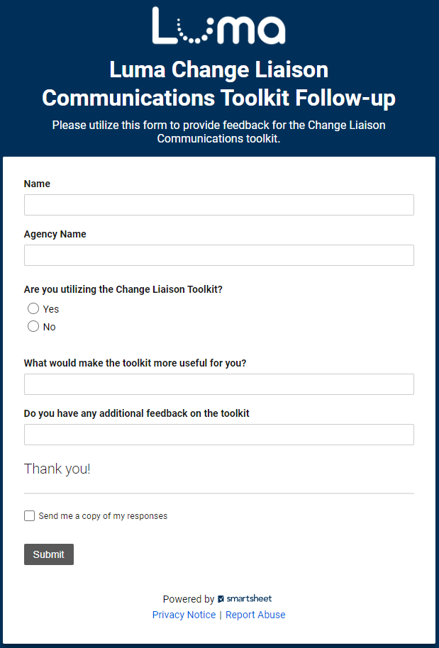
Share your feedback!
Let us know what you think of the toolkit!
Share your feedback on the easy-to-complete form anytime.
Access the form online here.
17

Slide 18
Resources
Have questions? Please contact or access the following:
Agency Advocate – our Agency Advocates sit within the State Controller’s Office and are dedicated to a subset of agencies. They’re here to support you and your staff as we cross the finish line to Go-Live.
Krystal Griffith
kgriffith@sco.idaho.gov
208-332-8861
Chris Lehosit
clehosit@sco.idaho.gov
208-332-8887
Elijah Stearns
estearns@sco.idaho.gov
208-332-8871
Danielle Stevens
dstevens@sco.idaho.gov
208-332-8868
Revisit Existing Communication Channels – familiarize yourself with information already available about the Luma Project by visiting the Luma Website and the Luma YouTube Page.
18

Slide 19
Terminology and Acronyms
The following is a list of terminology and acronyms you will see in Luma Project communications and their meaning:
Term / Acronym | Definition
CRA | Change Readiness Assessment: A survey sent to a broad sample of agency employees to measure how informed Stakeholders feel about the Luma project. Forthcoming CRAs will be deployed in January and May.
FSM | Finance and Supply Chain Management. Formerly Phase 1, entails all finance and procurement modules.
HCM | Human Capital Management. Formerly Phase 2, entails all human capital management, payroll, and time modules.
JSIT | Joint System Integration Testing: intended to confirm that FSM and HCM business processes perform as designer across an integrated set of modules and that the system meets critical State business requirements at Go-Live.
Role Workshop | Role Workshops will be open to all staff and will be aligned to specific security roles. The workshops reiterate what the employee will do in Luma and what changes they can expect. Planned for February and March.
User Experience (UX) Simulations | UX Simulations will mimic users being inside the Luma system, wherein employees will be guided with instructions on how to complete common scenarios.
Luma Labs | Luma Labs are intended to grow confidence in Luma by providing selected agencies and individuals an opportunity to experience the Luma configuration. In-Progress from February to late March.
Operational Readiness Program (ORP) | A toolset that will be provided to agencies to enable self-discovery of unique impacts and subsequent plans based on the unique agency needs.
Readiness Checklist | As part of the ORP, checklists highlight activities an agency needs to complete throughout their implementation efforts, covering activities related to people, technology, data, and process readiness.
19

