Slide 1
FY 2017 Budget Development
Matt Warnick
Division of Financial Management
August 13, 2015
Notes:
David Fulkerson will provide details on the Governor’s FY 2017 budget outlook. I will be discussing the Budget Development Manual with a focus on the changes for FY 2017.

Slide 2
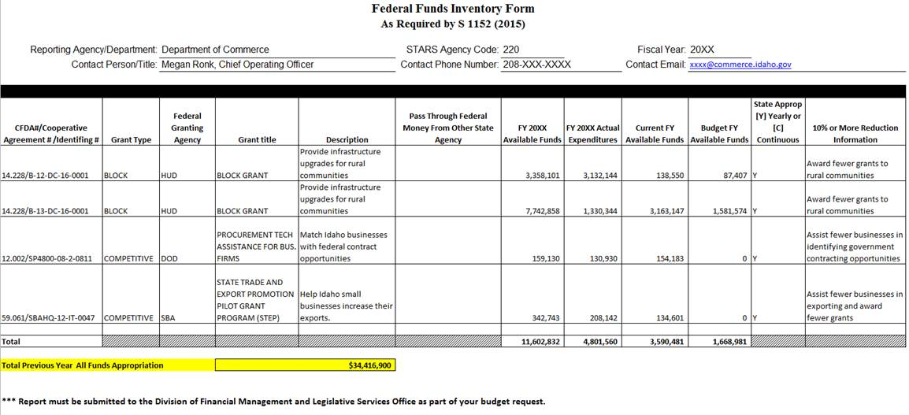
Federal Funds Inventory Form
S 1152 – Officially part of budget request
Standardized years so it’s clear which data to include
Notes:
Federal Funds Inventory Form was previously required by Executive Order 2014-3. S 1152 makes it officially part of the budget request. Nearly identify to FY 2015 form. Some confusion about which years to report last year; corrected for this year.

Slide 3
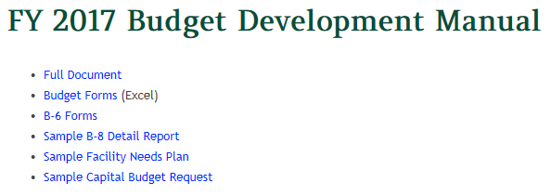
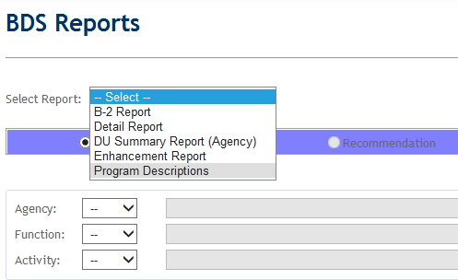
Division Descriptions
Sometimes get overlooked; please update on B-3 forms and in BDS
Notes:
B-3 Form can be accessed on the DFM website at link supplied by Yvonne on July 15th
BDM says update division descriptions in BDS, but they are only editable by DFM. Nevertheless, you can review the descriptions by clicking on the Reports button, the selecting Program Descriptions. If they are out-of-date, please send a revised description to DFM and we will update it in the system.

Slide 4
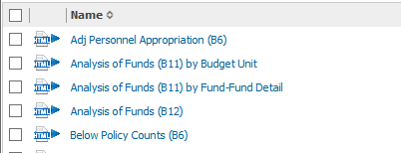
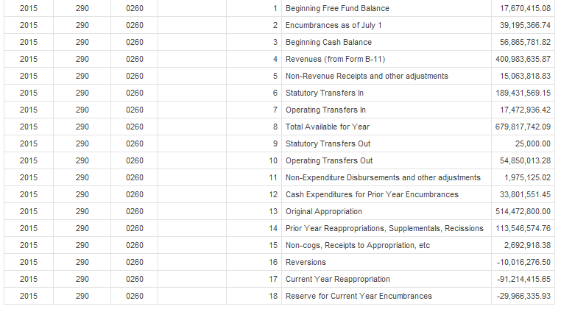
B-11 and B-12 Reports
Reports available on IBIS will simplify process
B-11 Revenue Report available by Budget Unit or Fund/Fund Detail
Let DFM and LSO know if reports don’t tie out
Notes:
In IBIS, go to Statewide Reports > Budget Development/Position Control
Reports will match B-11 and B-12 Forms line by line (example)
B-11 Form provided in two different formats
Let LSO and DFM know if B-12 does not tie out to correct numbers - Look for missing non-revenue receipts or non-expenditure reimbursements

Slide 5
B-6 Form: 27th Payroll
27th payroll automatically calculated in DU 10.64
One-time CEC costs for 27th payroll calculated in
DU 10.65
Group costs for 27th payroll should be requested as a line-item if needed
Notes:
27th Payroll has its own column that uses 1/26th of cost of filled position salary, plus 1/26th of salary portion of adjustments; variable benefits are calculated in DU 10.64
CEC Calculation is 1% for calculation purposes, as usual; 27th payroll CEC is calculated separately in DU 10.65
Health increase is $340/FTP ($11,200 > $11,540) for tier 1, $130/FTP for tier 2 ($9,240 > $9,370), no PERSI increase
Group costs are assumed to be variable—some only occur in summer, so they are not given by default. Need to request as line-item if needed.

Slide 6
B-6 Form: Adjustments Section
Use Adjustments section to add back vacant positions agency has a plan to fill
Use Other Adjustments section for increases or reductions in group hours, changes in employee pay
Notes:
Intent of adjustment section is to show how you will pay for ongoing personnel costs within existing base appropriation.
Vacant positions should only be reconciled if the agency has a plan to fill them. Do not keep vacant positions indefinitely.
Use other adjustments section for increases or reductions in group hours, changes in employee salary since the time of the Wage and Salary Report, etc. For example, if employee $5,000 received pay increase since WSR, it should be reflected in adjustments since it is part of agency’s ongoing costs

Slide 7


B-6 Form: Adjustments Section
New indicator comparing Personnel Costs to Base Appropriation
Must have zero or positive variance
Form can be used to identify needed base adjustments, fund shifts, etc.
If agency has insufficient PC agross all funds, indicator codes must be removed from reconciled positions
Notes:
Intent of adjustment section is to show how you will pay for ongoing personnel costs within existing base appropriation.
If budget unit/fund shows negative variance, adjustments need to be made including FTP/fund adjustments, program transfers, etc.
If agency has insufficient PC across all funds, health and variable benefit increases will not be provided beyond a zero variance of appropriation. Remove indicator codes from reconciled positions for which there isn’t sufficient funding.

