Slide 1
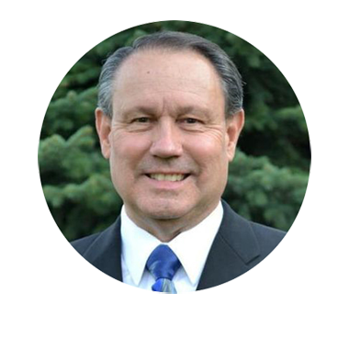

Idaho State Treasurer’s Office - eBank
Ron G. Crane, Treasurer
Angela Bonaminio
Banking Division Manager

Slide 2
TATRS
The Treasurer’s Office is converting the software used for processing and accounting for statewide transactions to a new platform. The name of the new system is TATRS, an acronym for Treasurer’s Accounting and Transaction Reporting System.
A component of this conversion will change how agencies receive information from the Treasurer’s Office. This new component is called eBank and will be accessed through an internet browser.
We anticipate that the new system will be ready to implement by July 1, 2016.

Slide 3
New Process
Current Process
The current process primarily consists of sending emails with attachments to alert agencies of transactions received and processed by the Treasurer’s Office.
The new process allows agencies to access information for their agency online.
The information online would include:
    Cash/Check Deposits
    Credit Card deposits (MIDs)
    EFT’s
    County Receipts
    Return Checks

Slide 4
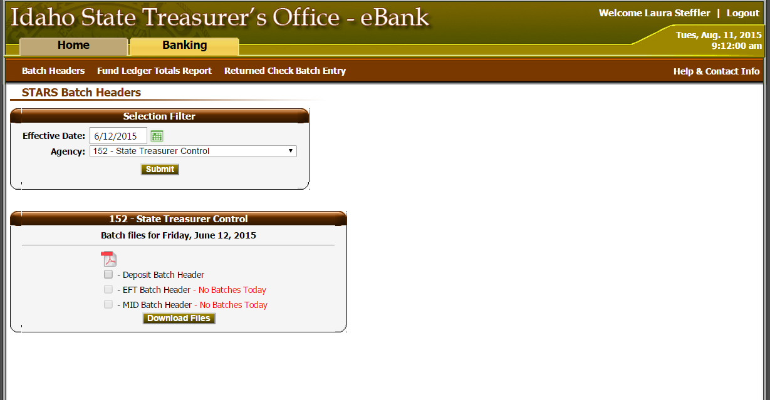
Sample of website page to view or download batch headers created by the Treasurer’s Office for an agency.

Slide 5
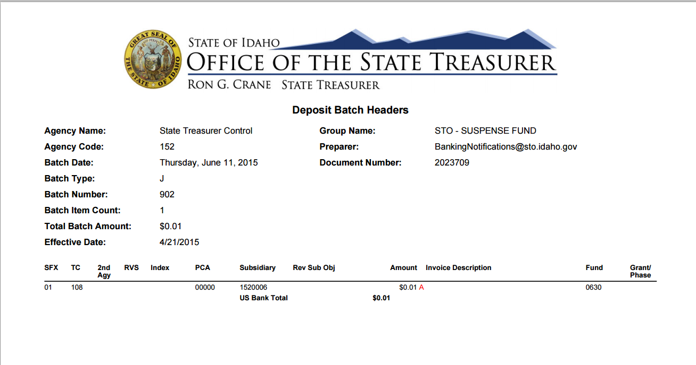
Sample of Batch Header Report for Agency Records

Slide 6
Pilot Agencies
If you are interested in helping the STO pilot the new system, please contact Angela Bonaminio.
  Angela.Bonaminio@sto.Idaho.gov
  (208) 332-2998
We anticipate to pilot the eBank portion of the system from March to June of 2016.

Slide 7
Credit Card Service (MIDs) Provider
Request for Bid
The Treasurer’s Office will be requesting bids for state agency credit card processing and upgrading equipment to accommodate the new EMV chip technology by December 31, 2015.
If your agency has special needs or requirements for file delivery or reporting, please contact Angela Bonaminio.
  Angela.Bonaminio@sto.Idaho.gov
  (208) 332-2998

Slide 8
Questions and Answers

