Slide 1
Change Liaison Meeting
March 2nd, 2022

Slide 2
Welcome!
Thank you for being here!
Expectations:
Please give presenters your full attention.
Please utilize the chat functionality (bottom right) to ask questions, or wait until the end of the presentation to come off of mute and ask.
This meeting is being recorded and will be provided in the follow-up email.

Slide 3
Phase 1 Update
Phase 1 Activities
Phase 2 Update and Timeline
Phase 2 Activities
Engagement Opportunities
Training Instructor Update
Key Takeaways
AGENDA

Slide 4
Luma Phase 1 Update

Slide 5
Phase 1 Timeline
Activities | March
SIT3
Training
Cutover & Agency Testing (Approx. start May)
System Validation / Prep
3/25
Dem Build / Test Prep
3/7
SIT3 Test Planning
Course Development
3/28
Cutover Planning
Project and Grants Workbooks and Project Beginning Balances
4/25
5/13
Pristine Build
5/16
5/20
Mock
Cutover
4/4
5/23
Agency Test Planning

Slide 6
Luma Phase 1 Activities

Slide 7
Workbook Refresh
Upcoming action items for agencies: March – April
The OCM team is compiling a list of relevant Phase 1 workbooks that will need to be refreshed/validated for mock cutover.
Please be on the lookout for workbook refresh requests in the near future.

Slide 8
Agency Dossier
The Agency dossiers will be a regularly updated, agency-specific document aimed at helping agency leadership and decision-makers to better understand their agency’s path to Luma go-live.
The dossier will list any outstanding items to be completed by the agency, their achievements to date, the agency identified issues or barriers to go live, the activities the agency will be participating in until go-live, and the workload/time commitment associated with those activities.
The Agency dossiers are going through a final executive review and will be provided to select agencies soon.

Slide 9
MHC Printing Invoice Validation
What is MHC?
MHC Billing Express is the printing software used in Luma for AR and Billing
Dunning Letters
Billing Invoices
Customer Statements
Who is this impacting?
The 39 agencies with the need to print and send invoices.
Agencies previously filled out a survey indicating that they required AR and Billing printables.
Draft invoice validation: Please submit feedback by Friday, March 4th
If you would like your Agency-specific logo to be used instead of the Idaho State seal, please submit an original high-resolution file to your Agency Advocate.

Slide 10
Luma Phase 2 Update

Slide 11
JUL
AUG
SEP
OCT
NOV
DEC
JAN
FEB
MAR
APR
→
Infor Orientations
50+ BPR sessions
P2 Scope
Defined
Infor 7.2 WFM
Multi-Tenant
Government
Jan 27, 2022
Sprints
started
1/18
Phase 2 Luma Base Configure
Schedule Refinements
In Final Review
Configuration
Workshops
Sprint 1
Sprint 2
Sprint 3
User Validation of Luma Functions
Early Phase 1, technical information
gathering, surveys, and analysis
Practice Conversion
Conversion Building
Interface Building
Interface Testing
Get End User Needs/Change Impacts

Slide 12
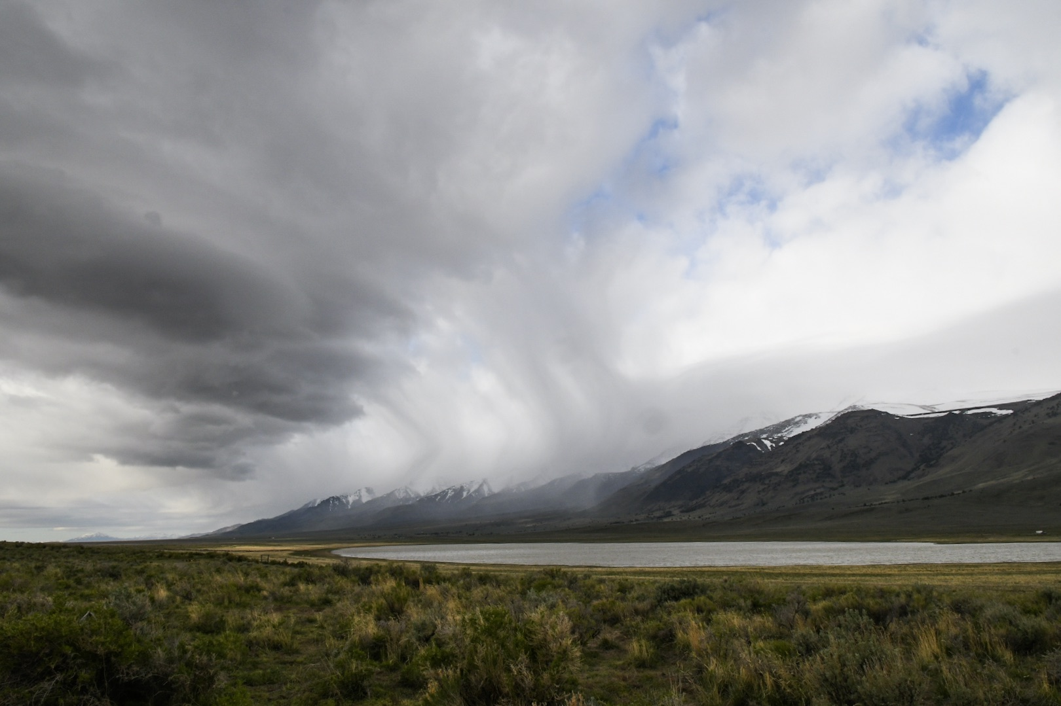
Luma Phase 2 Activities

Slide 13
Phase 2 Interface and Data Conversion Meetings
Thank you to everyone who has participated in meetings thus far. We may be reaching out in the coming weeks for additional follow-ups and meetings.
For Agencies that have met with us, if you have received a disposition please sign and return it.

Slide 14
Phase 2 Agency HR Org Unit Workbooks
What is an hr org unit?
How is it different than the finance org unit?
What will this require from you?
Upcoming workshop dates

Slide 15
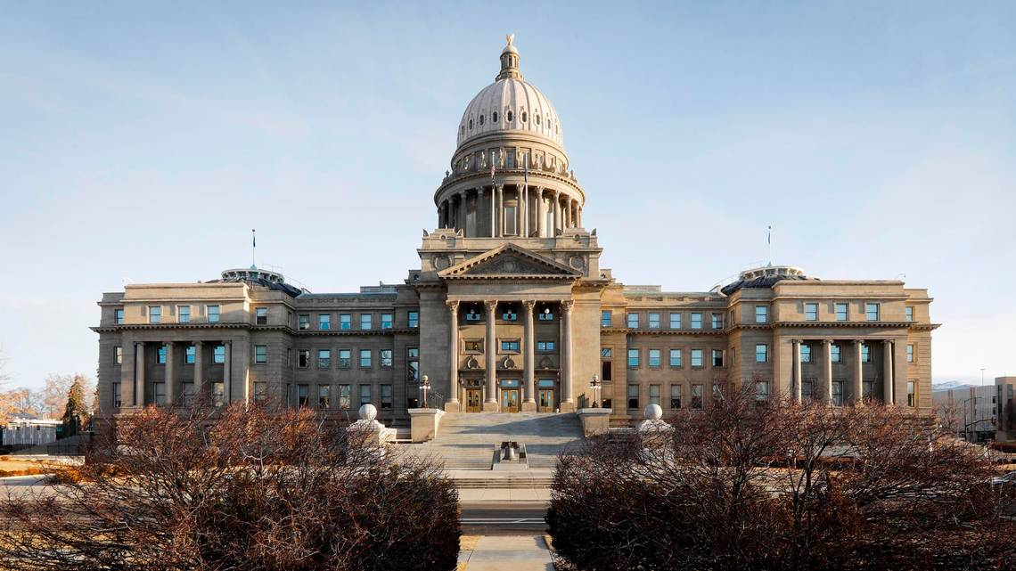
Leadership Alignment Meetings

Slide 16
Leadership Alignment Meetings
Completed Leadership Alignment Meetings:
Labor
SDE
IDJC
ISP
IDOPL
DHW
DEQ
Agency leadership takeaways:
Path to Go-live (Training & Cutover)
Resource Constraints
Phase 1 & Phase 2 “stacking”
Luma System Exposure
Sustainment
Post Go-live Enhancement & Interface Requests
Overall Support of the Project
IDL
Commerce
IDPR
IDFG
PERSI
Tax
IIC

Slide 17
Engagement Opportunities

Slide 18
Engagement Opportunities
Upcoming engagement opportunities to learn more about Luma. Please help us spread the word!
Type of Engagement | Date | Time | Topic
Procurement Learning Lab Option # 1 | March 8th | 2:00 pm | Contract Demonstration
Procurement Learning Lab Option # 2 | March 10th | 10:00 am | Contract Demonstration
Phase 2 HR Org Unit Workbook Workshop | March 9th | 1:00 pm – 3:00 pm | HR Org Unit Workbooks
Luma Showcase | March 15th | 10:00 am – 11:00 am | TBD
Luma Showcase | March 17th | 1:00 pm – 2:00 pm | TBD

Slide 19
Training Instructor Update

Slide 20
Luma Training Instructor Update
Thank you to everyone for their help in finding Training Instructors!
13 applicants were interviewed!

Slide 21
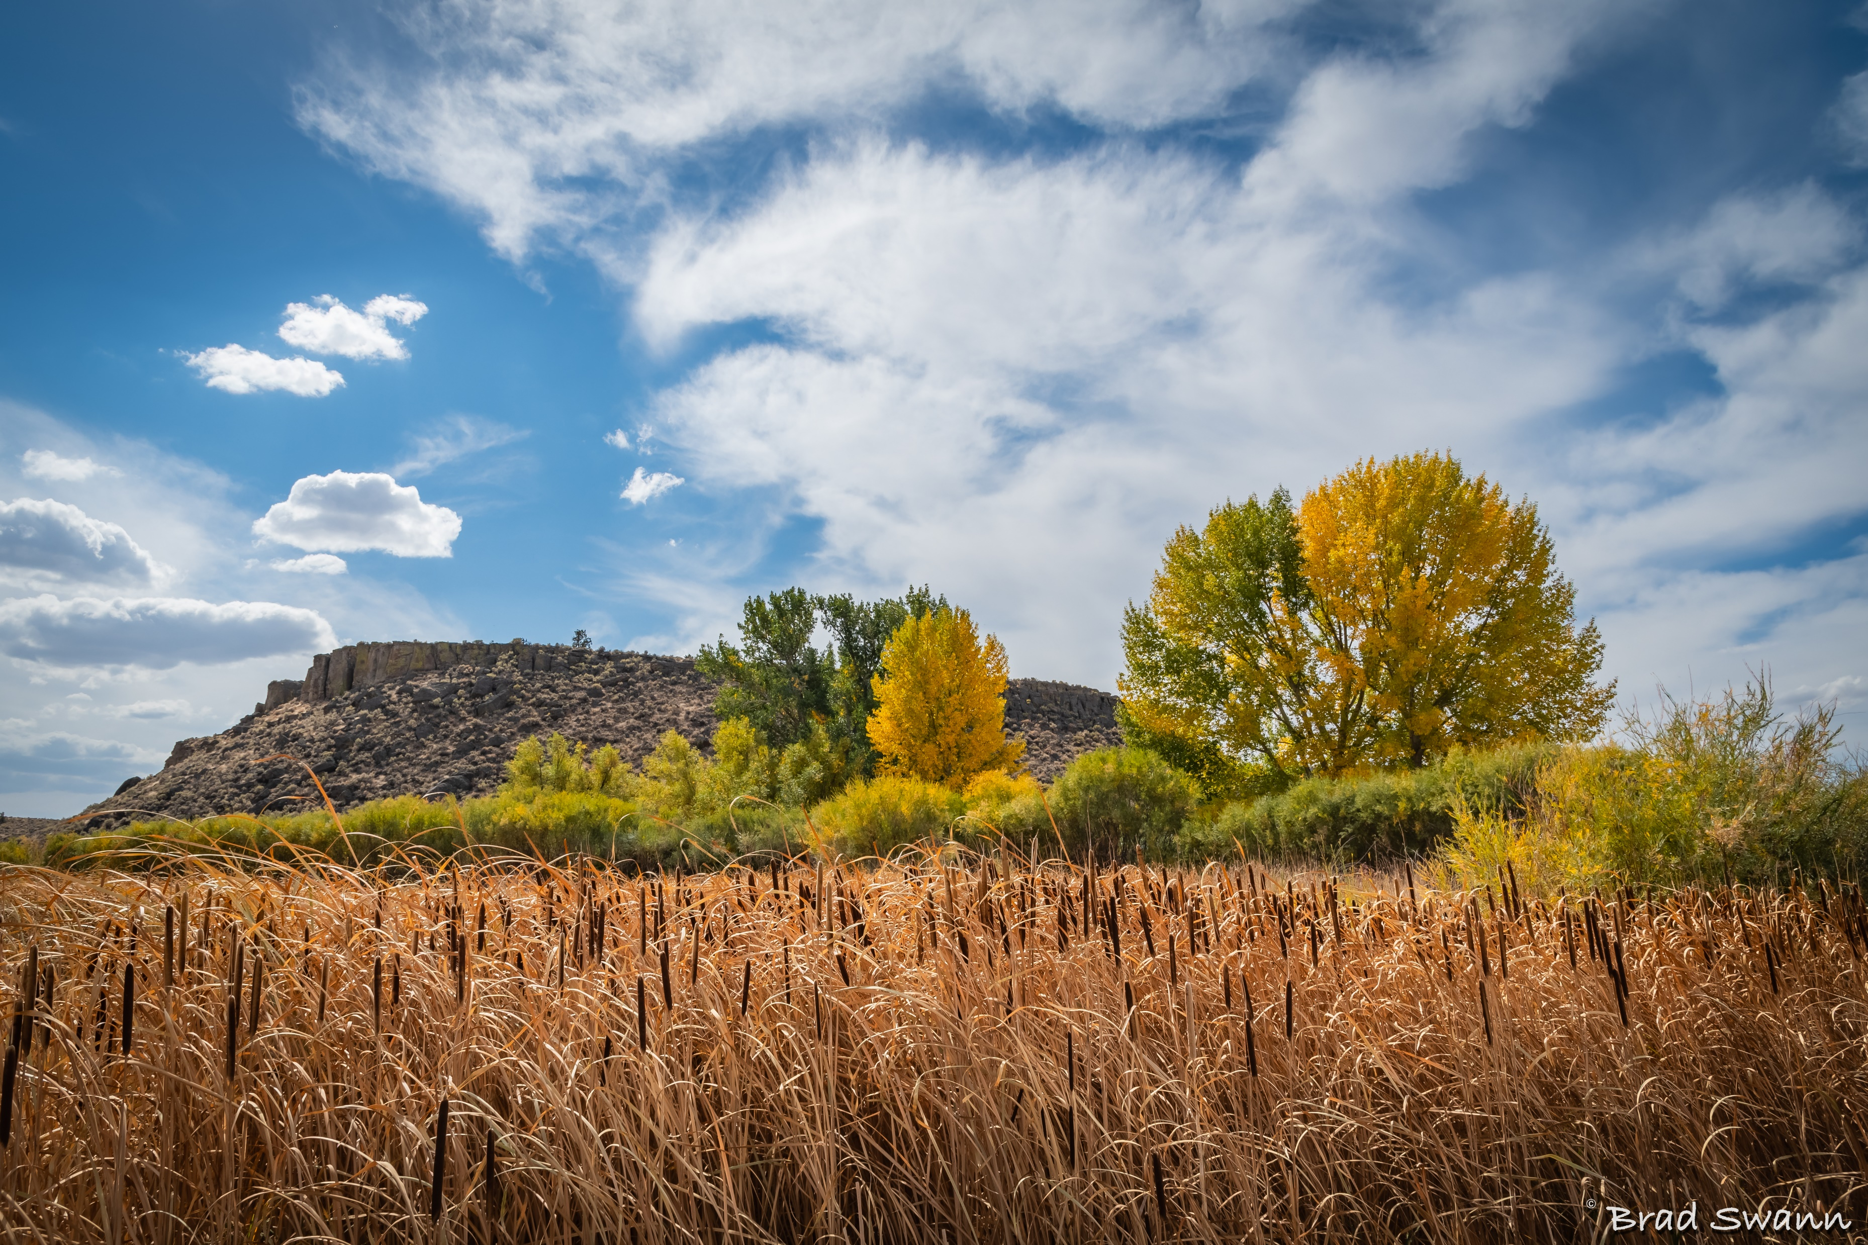
Key Takeaways

Slide 22
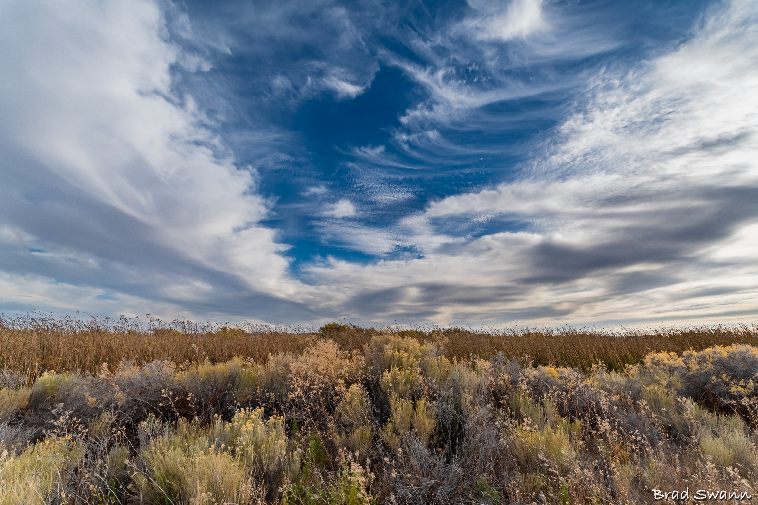
Thank You!
Sheena Coles
SColes@sco.Idaho.gov
208-334-3100
Alex Doench
adoench@sco.Idaho.gov
208-332-8841
Tina Fuller tfuller@sco.Idaho.gov 208-332-8867
Chris Lehosit clehosit@sco.Idaho.gov 208-332-8887
Elijah Stearns
estearns@sco.idaho.gov 208-332-8871
Danielle Stevens dstevens@sco.Idaho.gov
208-332-8868

