Slide 1




Change Liaison Meeting
May 11, 2020

Slide 2
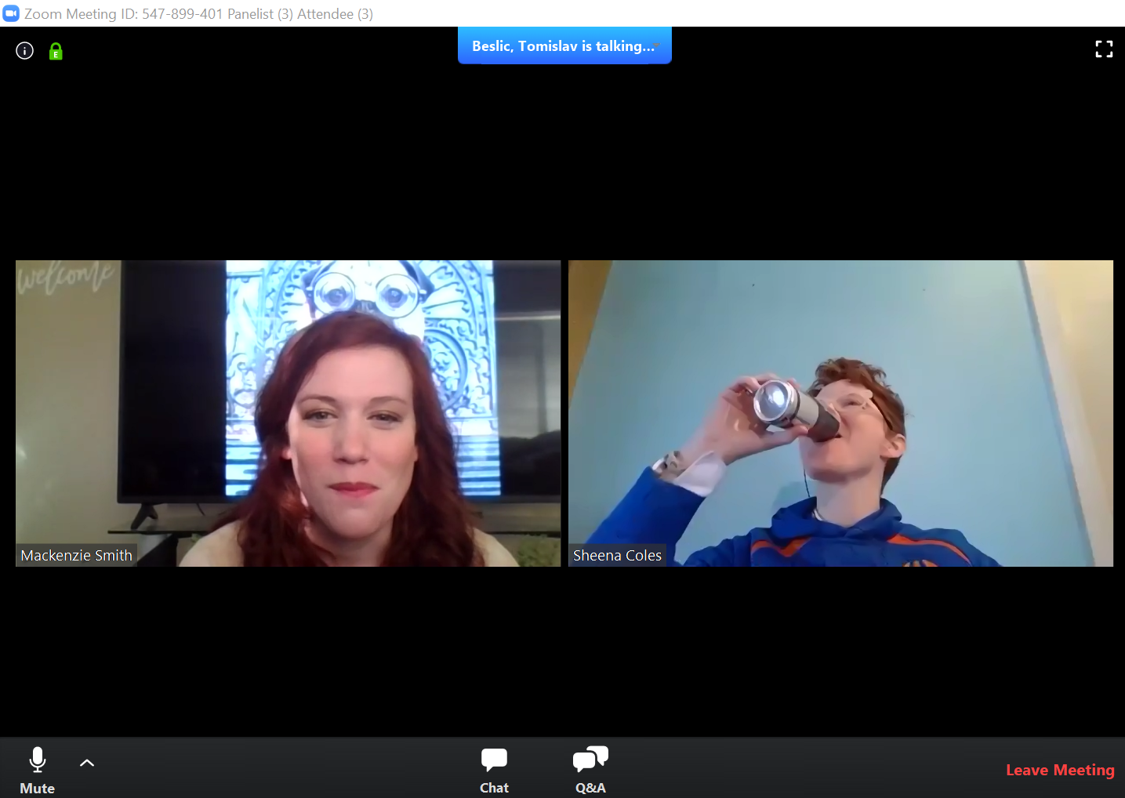


Recorded Zoom Meeting
2
Notes:
Sheena or Brandon

Slide 3

AGENDA
Agency Advocate Introduction
Introduction to Agency Cohorts
Cohort Overview
Luma Timeline and Upcoming Activities
Questions

Slide 4

Agency Advocates
4

Slide 5
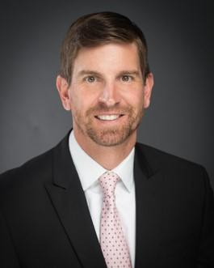
Heath Ribordy
Heath recently moved to Idaho from Texas where he served as the Director of Agency Services at The Central Texas Food Bank. After moving to Idaho, Heath became the Director of Partnerships and Programs for The Idaho Foodbank. He is excited to join the public sector and believes the experience gained in the non-profit world will benefit him as an Agency Advocate.
Board of Accounting | Commission on Aging
Department of Agriculture | Division of Career-Technical Education
Department of Education | Department of Finance
Division of Financial Management | Health District 2
Health District 4 | Health District 5
Health District 7 | Division of Human Resources
Independent Living Council | Department of Lands
Outfitters and Guides Licensing Board | Department of Parks and Recreation
Board of Pharmacy | Veterans Services
Division of Vocational Rehabilitation | Board of Veterinary Medicine
Email: hribordy@sco.Idaho.gov

Slide 6

Danielle Blackmer
Danielle was employed by the State Controller's Office as a front office assistant when she applied for the Agency Advocate position. She recently obtained her Bachelor's degree in Criminal Justice with a minor in Psychology at Boise State University. She is excited to utilize her background to help agencies prepare for the changes coming with Luma.
Bureau of Occupational Licenses | Idaho State Treasurer's Office
Commission of Pardons and Parole | Judicial Branch
Department of Administration | Office of the Attorney General
Health District 1 | Office of Drug Policy
Health District 3 | Office of Energy and Mineral Resources
Health District 6 | Office of Species Conservation
Idaho Correctional Industries | Racing Commission
Idaho Department of Corrections | State Appellate Public Defender's Office
Idaho Department of Juvenile Corrections | State Brand Inspector
Idaho State Police | State Public Defense Commission
Email: dblackmer@sco.Idaho.gov

Slide 7
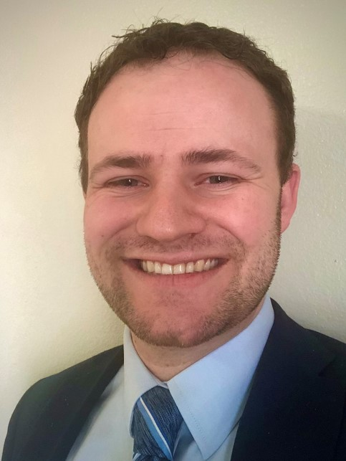
Chris Lehosit
Chris joins the Luma team after working with the Meridian Library District and managing the Overland Park Cinema. With his experience building engagement opportunities at the library, he is excited to take on the new task of helping agencies engage with the Luma project.
Code Commission | Commission for the Blind and Visually Impaired
Soil and Water Commission Conservation | Board of Dentistry
Department of Environmental Quality | Department of Fish and Game
Office of the Governor | Department of Health and Welfare
Idaho Commission on Hispanic Affairs | House of Representatives
Office of Information and Technology Services | State Insurance Fund
Department of Insurance | Lava Hot Springs Foundation
Legislative Services Office | Idaho Commission for Libraries
Office of the Lieutenant Governor | Board of Medicine
Board of Nursing | Idaho Public Television
Idaho Senate | Water Resources
Email: clehosit@sco.Idaho.gov

Slide 8

Tina Fuller
Tina comes to the project from the Ada County Sheriff's Office where she served as a Geographic Information Systems (GIS) analyst shortly after the office went live with a new Computer Aided Dispatching (CAD) software program. She is excited to utilize her experience with the implementation and sustainment of the CAD program to benefit the Luma system.
Idaho Commission on the Arts | Military Division
Division of Building Safety | Office of Performance Evaluations
Idaho Commerce | PERSI (Public Employees Retirement System of Idaho)
State Board of Education | Public Utilities Commission
Endowment Fund Investment Board | Idaho Real Estate Commission
Professional Board of Engineers and Land Surveyors | STEM Action Center
Idaho State Historical Society | Tax Appeals
Industrial Commission | Tax Commission
Department of Labor | Idaho Department of Transportation
Idaho State Liquor Division | Idaho Workforce Development Council
Idaho State Lottery Commission | Secretary of the State
Email: tfuller@sco.Idaho.gov

Slide 9
Introduction to Cohorts
9

Slide 10
What are Cohorts?
Cohorts provide a logical way to break up the state into agencies with similar workloads. The project team will be able to focus resources to each cohort as they are given unique tasks and timelines.
Current State
Cohort Approach
Future State
C1
C2
C3
C4
C5
C6
C7
Strict adherence to cohort due dates will be crucial to ensure that Luma Project milestones are met.

Slide 11
Why are Cohorts Necessary?
Cohorts allow the Luma project team to utilize resources more effectively by managing specific agency needs at every stage of the project. The approach eliminates project background noise and alleviates agency burden as the project team continues Luma launch preparations.
Identify Critical Activities and Set Completion Timeline
Promote Efficient use of Resources and Time
Tailor a Focused Approach
to Agency Workload and Needs

Slide 12
Cohort Overview
12

Slide 13
Cohort 1
Cohort 1 includes agencies whose data will be used in Sprints.
Commonality: Luma Project Team representation, Chart of Accounts (COA) readiness, mix of types of agencies for comprehensive Sprints, and includes a majority agencies with conversions (conversion owners).
Department of Commerce | Department of Labor
Department of Correction | Department of Veteran’s Services
Department of Fish and Game | Idaho State Liquor Division
Department of Health and Welfare | Idaho State Police
Department of Juvenile Corrections | Industrial Commission
Military Division | Office of the State Controller
Tax Commission
Notes:
Talk about what “included in sprints” means.
Broad scope of transactions that are general and mainstream to test before we test extraordinary data needs.
Make the point that there are 2 agencies who own statewide systems that will be built with Cohort 1 so all conversion programs are completed at the same time but the other agency specific items will be completed in their assigned cohort. (Admin and DHR)

Slide 14
Cohort 2
Commonality: Cohort 2 includes larger agencies – as well as medium and smaller agencies with interface items.
Treasurer’s Office | Department of Water Resources
Bureau of Occupational Licenses | Division of Financial Management
Department of Environmental Quality | Division of Vocational Rehabilitation
Department of Finance | Idaho State University
Department of Lands | Lewis-Clark State College
Boise State University | Public Television
Department of Parks and Recreation | State Insurance Fund
University of Idaho | Idaho Transportation Department
Department of Administration*
* Conversions for Department of Administration will be completed in Cohort 1 and their interfaces with Cohort 2.

Slide 15
Cohort 3
Commonality: Cohort 3 includes small and agencies with interface items.
Board of Medicine | Idaho State Historical Society
Board of Nursing | Idaho State Lottery Commission
Commission for the Blind and Visually Impaired | Independent Living Council
Health District 2 (NORTH CENTRAL) | Legislative Services Office
Health District 5 (SOUTH CENTRAL) | PERSI (Public Employees Retirement System of Idaho)
Idaho Commission on the Arts | Professional Board of Engineers and Land Surveyors
Idaho Real Estate Commission | Correctional Industries

Slide 16
Cohort 4
Commonality: Cohort 4 includes large and medium agencies.
Department of Agriculture | Health District 4 (CENTRAL)
Division of Building Safety | Health District 7 (EASTERN)
State Department of Education | House of Representatives
Health District 1 (PANHANDLE) | Judicial Branch
Health District 3 (SOUTHWEST) | Office of Attorney General

Slide 17
Cohort 5
Commonality: Cohort 5 includes small sized agencies.
Division of Human Resources | Commission on Aging
Career Technical Education | Office of the Governor
Office of Species Conservation | Health District 6 (SOUTHEASTERN)
Office of Soil and Water Conservation | Office of Information Technology Services
Board of Dentistry | Lava Hot Springs Foundation
Department of Insurance | Idaho Commission for Libraries
State Board of Education

Slide 18
Cohort 6
Commonality: Cohort 6 includes small agencies.
Code Commission | Lieutenant Governor’s Office
Office of Drug Policy | Outfitters and Guides Licensing Board
Endowment Fund Investment Board | Commission of Pardons and Parole
Office of Energy and Mineral Resources | Board of Pharmacy
Commission on Hispanic Affairs | Public Utilities Commission
State Racing Commission | Secretary of State
Senate | State Appellate Public Defender’s Office
Brand Inspector

Slide 19
Cohort 7
Commonality: Cohort 7 includes small agencies.
Board of Veterinary Medicine | State Board of Accountancy
Office of Performance Evaluations | State Public Defense Commission
STEM Action Center | Tax Appeals
Workforce Development

Slide 20
Luma Timeline and Upcoming Activities

Slide 21
Luma Project Timeline
Luma Phase 1 – Finance, Budget, Procurement
Luma Phase 2 – Human Capital Management, Payroll
2019 |  |  |  |  | 2020 |  |  |  |  |  |  |  |  |  |  |  | 2021 |  |  |  |  |  |  |  |  |  |  |  | 2022 |  |  |  |  |  |  |  |  |  |  |  | 2023
8 | 9 | 10 | 11 | 12 | 1 | 2 | 3 | 4 | 5 | 6 | 7 | 8 | 9 | 10 | 11 | 12 | 1 | 2 | 3 | 4 | 5 | 6 | 7 | 8 | 9 | 10 | 11 | 12 | 1 | 2 | 3 | 4 | 5 | 6 | 7 | 8 | 9 | 10 | 11 | 12 | 1 | 2 | 3 | 4 | 5 | 6
IMAGINE
DELIVER
RUN
IMAGINE
DELIVER
RUN
Plan
Architect
Configure & Prototype
Validate
Deploy
Support
Luma Phase 1 Kick-off
Plan
Architect
Configure & Prototype
Validate
Deploy
Support
Plan
Luma Phase 1 Kick-off
Discovery & Preparation
Project Team Training
Discovery & Preparation
Project Team Training
Enterprise Design
Enterprise Design Update
Technical Design (FRICE-W)
Technical Design (FRICE-W)
Sprint 1-3
Sprint 1-3
System Integration Testing 1 & 2 (SIT)
Parallel PR 1 – 3 (S.I.T.)
Mock Data Conv. 1 & 2
User Acceptance Testing
Mock Data Conv. 1 & 2
User Acceptance Testing
Design Updates
Design Updates
Training Dev.
Training
Training Dev.
Training
Budget Go-Live
Go-Live
WFM Go-Live
HR/PR Go-Live
21
Notes:
Talk about what Sprints are and why they are important
Talk about data conversion, what is it and why is it important in Sprint 1-3?

Slide 22
What are Sprints?
A Sprint is a 4 week time period where the project team runs mock State data through scenarios to see if the system’s execution of tasks will follow the configured process.
Use Lessons Learned to update System Configuration
Data used in System Tests
Mock State Data
What makes a sprint successful? User stories that pass acceptance criteria of a scenario.
Notes:
Talk about how FRICE-W are used in Sprints.

Slide 23
What are Configurations?
Baseline system process mapping and set-up are known as configurations. State agencies have already been heavily involved in configuration building by attending business process redesign sessions, completing their Chart of Account dimension build-out, and responding to system surveys.

Slide 24
FRICE-W: The What and Why
In order to successfully accomplish the workload of Sprints, the project team has been capturing agency FRICE-W items in preparation for configuration and testing. What is FRICE-W and why is it important to you?
Forms
Reports
Integration
Conversions
Enhancements
Workflows
Purpose
Provide Data
Exchange Data
Load Data
Add Functionality
Authorize Activity
Collect Data
Example
Add a Vendor
Fixed Asset Listing
Budgets & Actuals
Active Projects
Cash Edit
Approve a Requisition

Slide 25
How will you Aid in Interface Building?
Agencies have identified systems that will interface into the Luma system. Interfaces enable the transfer and exchange of data and information between two or more systems. The project team will work with agencies to build out interfaces.

Slide 26
What is Data Conversion?
The formatting and movement of data from your agency-specific programs to the Luma system. Agencies with conversions will be given templates to format their data to the Luma system. Conversion may involve manual corrections and changes to data, in order to make it fit the new system.
Extract Agency Data
Format Data to the Luma System
Test Formatted Data in Luma System
*Conversions for systems replaced by Luma will happen once, right before go-live. Interfaces continue to move data between systems on a regularly scheduled interval.

Slide 27
What are Workflows?
Workflows enable work to be done automatically in the background without manual effort. An example of workflow would be an employee signing their timesheet and it is then moved via workflow to a manager for approval.
Workflows enable both multi-step processes or single step tasks. Agencies will hear from Luma about designing workflows when their cohort is scheduled to begin.

Slide 28
Upcoming Due Dates by Cohort
Cohort | Agencies | COA Due Date | Finance Configurations Due* | Procurement Configuration Due* | Conversion Program Mapping | Conversion Data Mapping | Interface Functional Specifications Due | Interface Technical Specifications Due | Interface Development Due
1 | 13 | 5/15/2020 | 5/15/2020 | 5/15/2020 | 5/29/2020 | 5/29/2020 | 6/30/2020 | 8/15/2020 | 9/30/2020
2 | 17 | 6/15/2020 | 6/30/2020 | 7/15/2020 | N/A | 7/30/2020 | 6/30/2020 | 9/15/2020 | 10/30/2020
3 | 14 | 7/15/2020 | 7/30/2020 | 8/31/2020 | N/A | 8/31/2020 | 6/30/2020 | 10/15/2020 | 11/15/2020
4 | 10 | 7/30/2020 | 8/30/2020 | 9/15/2020 | N/A | 9/30/2020 | N/A | N/A | N/A
5 | 14 | 8/30/2020 | 9/15/2020 | 9/30/2020 | N/A | 10/15/2020 | N/A | N/A | N/A
6 | 15 | 9/15/2020 | 9/30/2020 | 10/15/2020 | N/A | 10/31/2020 | N/A | N/A | N/A
7 | 7 | 9/30/2020 | 10/15/2020 | 10/31/2020 | N/A | 11/15/2020 | N/A | N/A | N/A
The project team will be leading the creation of all configurations, you will be asked to crosswalk current data into a predefined format. Nobody at your agency will be required to gain training on the conversion of data or building interfaces.

Slide 29
Questions
29

Slide 30
Thank You for Coming!
Sheena Coles scoles@sco.Idaho.gov 208-332-8703
Mackenzie Smith
msmith@sco.Idaho.gov
208-332-8712
Heath Ribordy hribordy@sco.Idaho.gov
Danielle Blackmer scoles@sco.Idaho.gov
Chris Lehosit clehosit@sco.Idaho.gov
Tina Fuller tfuller@sco.Idaho.gov
Luma: luma@sco.idaho.gov
30

