Slide 1
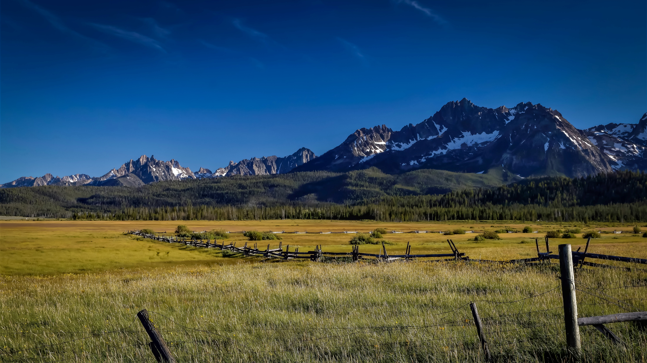
Change Liaison Meeting
September 7th, 2022

Slide 2
Welcome!
Thank you for being here!
Expectations:
Please give presenters your full attention.
Please utilize the chat functionality (bottom right) to ask questions, or wait until the end of the presentation to come off of mute and ask.
This meeting is being recorded and will be provided in the follow-up email.

Slide 3
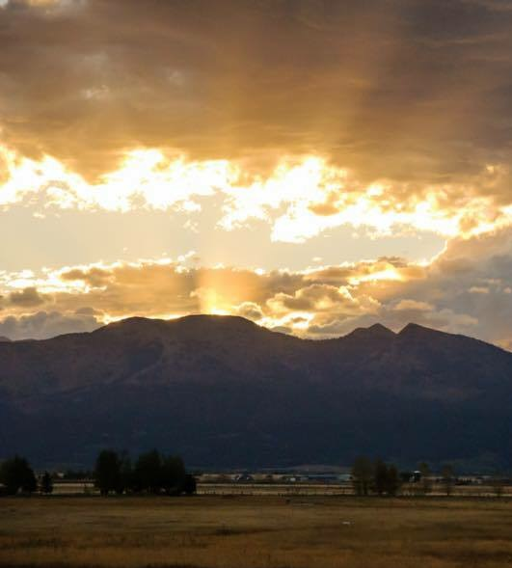
Phase 1 Update
Phase 2 Update
Key Takeaways
AGENDA
Notes:
Intro - Elijah
Phase 1 Update – Sheena/Scott
Phase 2 Update - Greg
Phase 2 Activities - Greg
Training – Krystal/Sara
Key Takeaways - Sheena

Slide 4
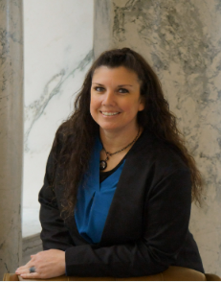
Krystal Griffith
State Controller’s Office
Functional Team: Organizational Change Management
Email: kgriffith@sco.idaho.gov
Favorite Way to Spend a Saturday: My favorite ways to spend Saturdays is camping with my family. We like to venture out to new places as often as we can.
Fun Fact: I have backpacked through the Andes

Slide 5
Luma Phase 1 Update

Slide 6
Phase 1 Path Forward
Key Points:
We are taking the responsible route and delaying Phase 1 launch so that everyone is prepared for the system when it goes live.
Our path forward is to clearly lay out the scope of work that needs to be completed prior to choosing a go-live date to ensure the work drives the timeline.
This delay is not a failure but rather an opportunity to ensure Agencies are as prepared and knowledgeable prior to go-live as possible.
From Day 1, we have said we would not go live with a system that is not ready and we are following through on that promise.
Our commitment is to the State of Idaho.
Go Live

Slide 7
Luma Phase 1 Project Plan
Configured Operating System
System Testing
Launch Readiness
Aug 1
Aug 8
Aug 15
Aug 22
Aug 29
Sep 5
Sep 12
Sep 19
Cont. …
Finalize BPIs
System Integration Test
160+ Interfaces
250+ Scenarios
Testing (Unit)
Configuration & Build
Cutover/Conversions
Workbooks & Data Files Due
Workbooks Due
System Preparation
(Data and Configuration)
Milestone 1
Operating System Complete & Test Initiation
NOW
Key
System Ready
BPI’s
FRICE-W
Workbooks
PAST
FUTURE

Slide 8
Change Liaisons and ServiceNow Tickets
Defects identified in SIT that are applicable to agencies will be entered into the ServiceNow Portal.
Agency Change Liaisons will be included in the “watch list” and receive notification of the Defect.
Log into ServiceNow Portal to View Watch List and Notifications.

Slide 9
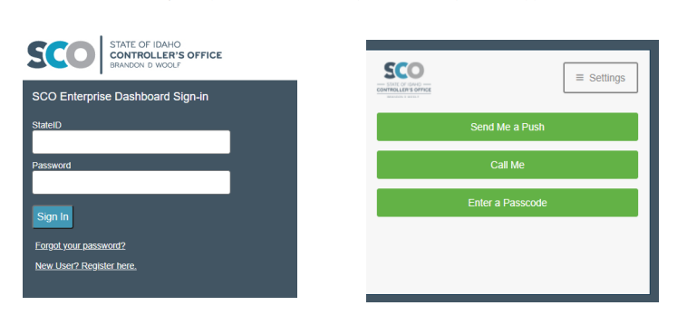
Change Liaisons and ServiceNow Tickets
Visit https://auth.sco.idaho.gov/ in your web browser. Google Chrome and Microsoft Edge are recommended.
Enter your State ID number as the username and your password. Click the Sign In button.
You will be presented with a second page for Multi-Factor Authentication. Select an option and acknowledge the push or call, or enter a passcode from your Duo app.

Slide 10
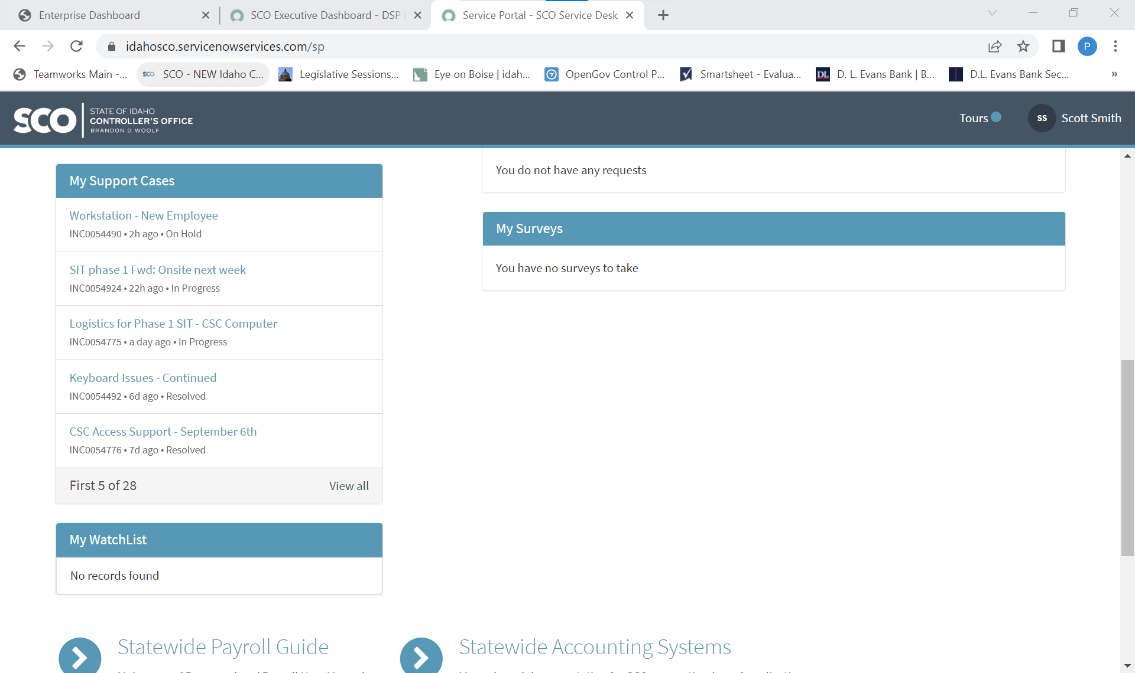
Change Liaisons and ServiceNow Tickets
Watch List

Slide 11
Change Liaisons and ServiceNow Tickets
Defects identified in SIT will be worked by the functional team leads and invite agency personnel as needed.
Agency Change Liaisons can access the request and view status.
Agency CL’s can review and actively support based on comments entered.
Make sure to reply to emails from service request to include comments in ServiceNow

Slide 12
GL Balance Validation
Identify who will do the validation in Luma
Send full name and email address by EOB 09/02/22
Individual will obtain role access to Luma on 09/07/22
Open office hours for questions and support
Friday 09/09/22 9:00-10:00 am
Friday 09/16/22 9:00-10:00 am
GL balance validation will be due by EOB 09/23/22
Sign off - Smart Sheet Digital Form: https://app.smartsheet.com/b/form/d45e5e423c28494f9134ca04c68dc33d
Report roadblocks/issues/concerns via email

Slide 13
Luma Phase 2 Update

Slide 14
Phase 2 (HCM)
September 7, 2022
Milestone #1
Start Testing
✓
#2 Complete
SIT 2 & Pay Compare 1
#3 Validated
HCM Build
#4 Decision!
GO Training / Go Live
#5 Stable
Operations
Training Development
User Training
JUL
AUG
SEP
OCT
NOV
DEC
JAN
FEB
MAR
APR
MAY
JUN
11
18
25
1
8
15
22
29
5
12
19
26
3
10
17
24
31
7
14
21
28
5
12
19
26
2
9
16
23
30
6
13
20
27
6
13
Production Cut Over Fri 3/17 to Wed 3/23
20
27
3
6
13
20
✓
System Integration
Test 1
✓
Phase 1 Delivery:
>9 P&G/COA
finance structure
MC 1
Mock
CutOver
MC 2
MC 3
Dress Rehearsal Cut Over
UAT
System Integration
Testing 2
System Integration
Testing 3
Preparation/Readiness
Pay/Time Compare 1
Pay/Time
Compare 1
Pay/Time
Compare 2
Pay/Time
Compare 3

Slide 15
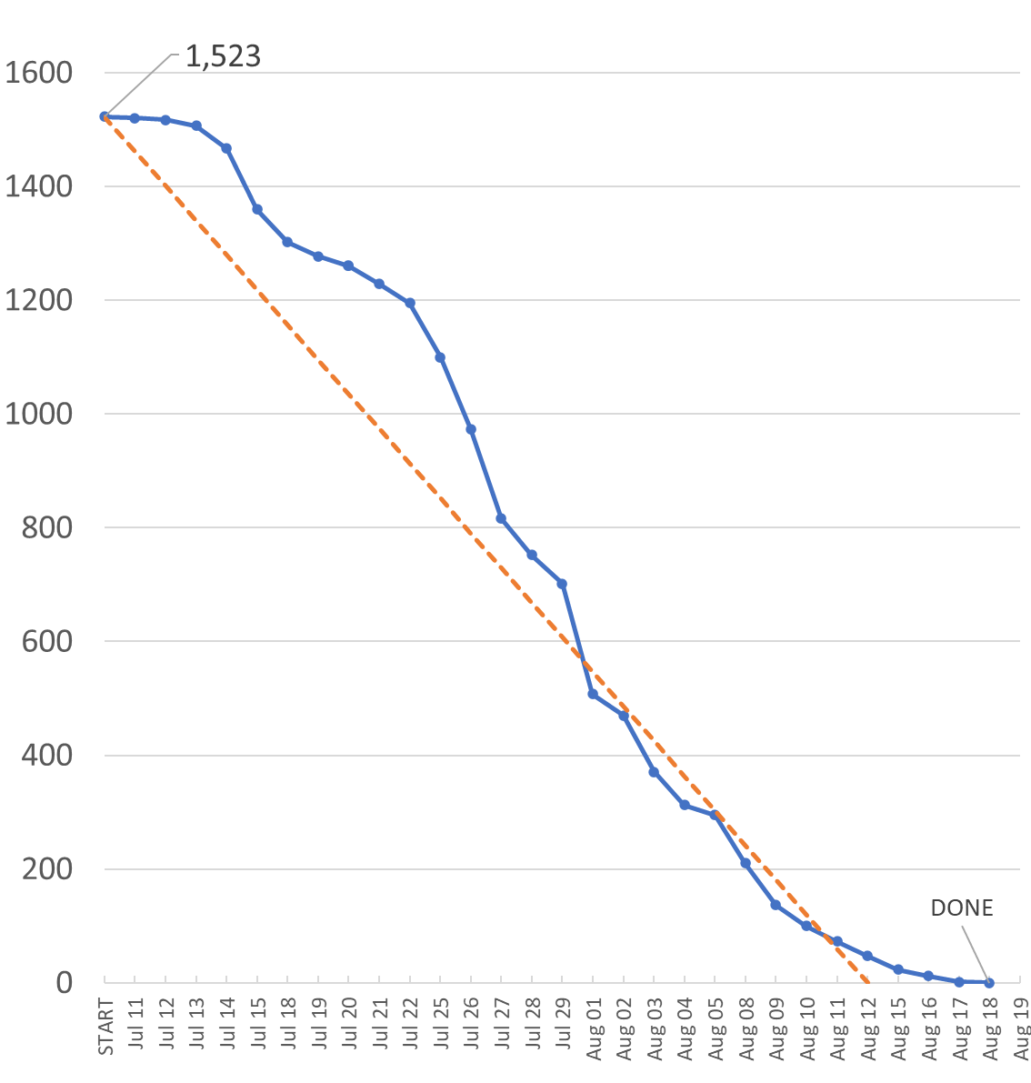
Phase 2 (HCM)
Successfully completed six-week SIT 1 (burndown to the right)
Discovered, documented, and worked to resolve 372 found defects
Engaged all 1,523 test scripts over all 51 employee types
Passed 89% of tests (exit criteria was ≥ 85%)
Successfully ran on/off cycle payrolls, including ITD interface
Exited SIT 1 with 19 Open Defects; all Low or Medium severity
Passed 73% of 112 HCM business processes (32+50 = 82/112)
Untested scripts, open defects, and needed tests moving to SIT 2
Received P1 finance structure on schedule (8/22) for P2 testing
Accomplishments
Second cycle (SIT & P/C concurrent) planned, resourced, and executed
Time-related functional (WFM) integrations with Luma
Security roles – not established in SIT 1
Low confidence HR functions – working on executive demos
Work Force Transition content – Exec Accelerator; 6 Roles; Simulation
Out of Scope list by September 27 – what HCM will not go live
Challenges
Remaining Edge Entity’s (4 of original 13) need design, build, and test
Phase 2 Infor critical functionality: Gov Cloud JAB (BSI)
Mock CutOver 1 completion adequate to support SIT2/Pay Compare 1
Phase 1 go live in January to keep Phase 2 go-live in April on schedule
Risks

Slide 16
Key Takeaways

Slide 17
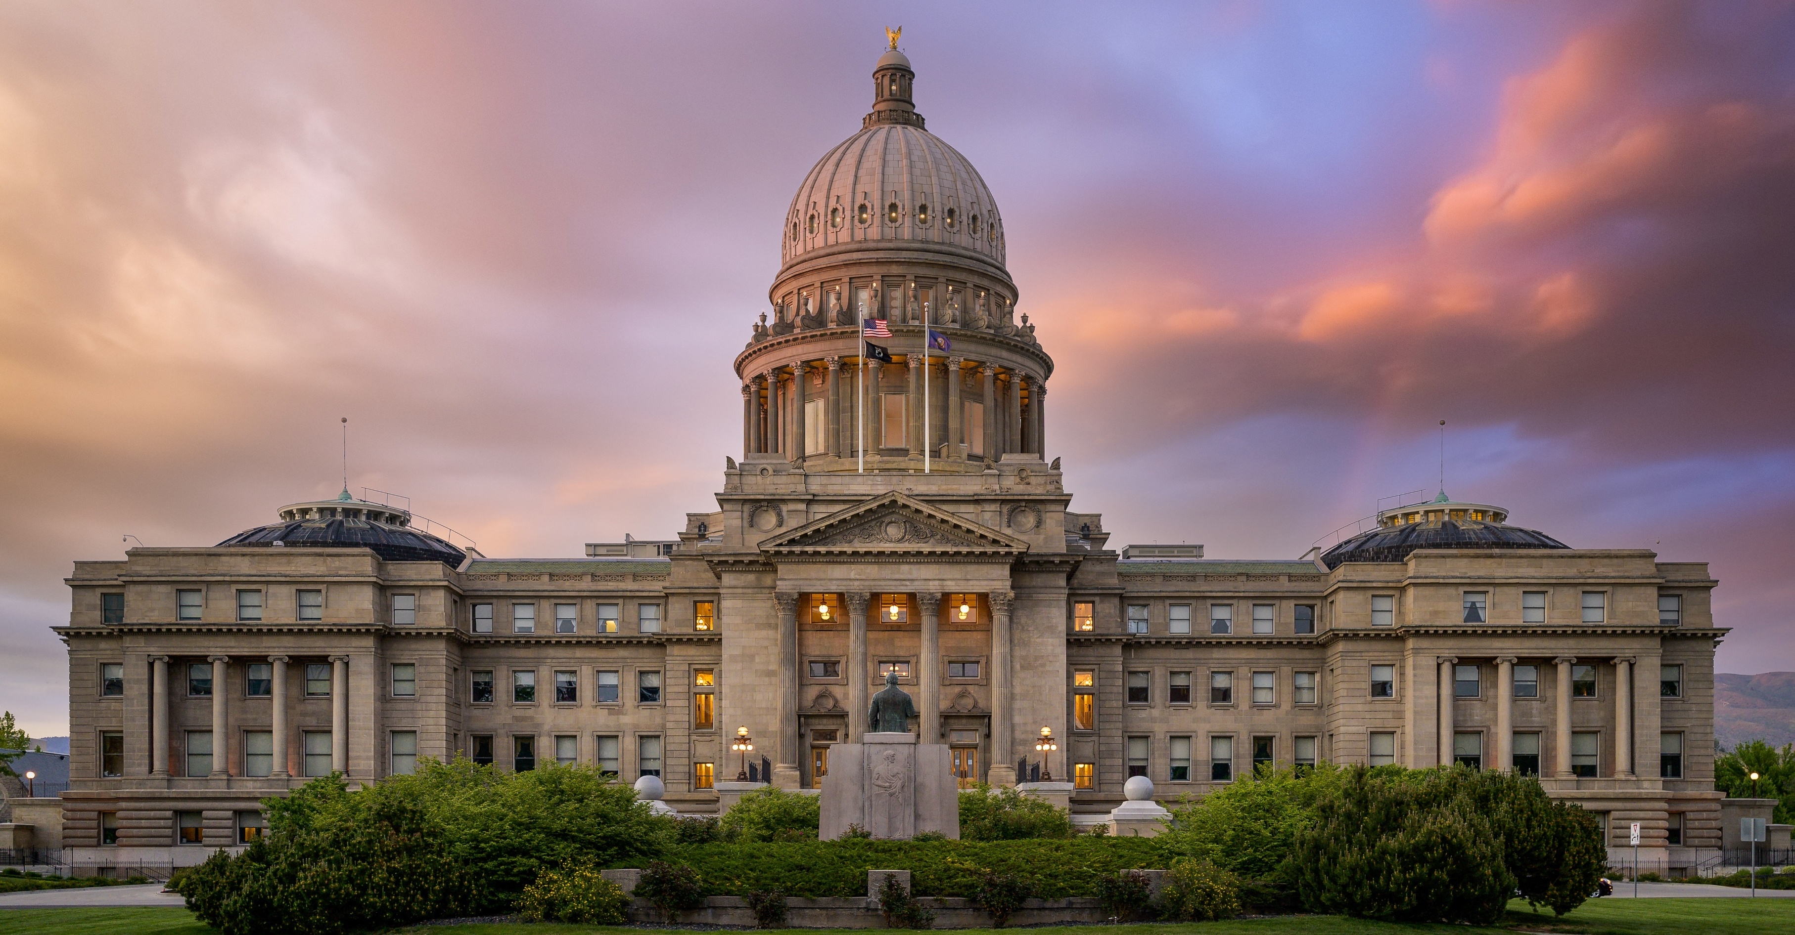
Thank You!
Sheena Coles
SColes@sco.Idaho.gov
208-334-3100
Alex Doench
adoench@sco.Idaho.gov
208-332-8841
Chris Lehosit clehosit@sco.Idaho.gov 208-332-8887
Elijah Stearns
estearns@sco.idaho.gov 208-332-8871
Danielle Stevens dstevens@sco.Idaho.gov
208-332-8868

