Slide 1
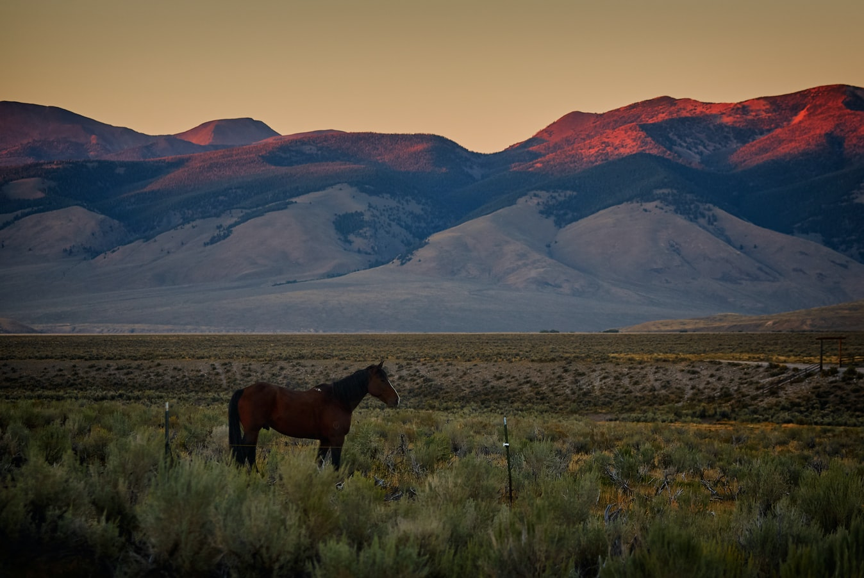
Change Liaison Meeting
September 1st, 2021

Slide 2
Welcome!
Thank you for being here!
Thank you all for your flexibility during these unprecedented times!
Expectations:
Please give presenters your full attention.
Please utilize the chat functionality (bottom right) to ask questions, or wait until the end of the presentation to come off of mute and ask.
This meeting is being recorded and will be provided in the follow-up email.

Slide 3
Budget Update
Phase 1 Update
Phase 1 Activities
Phase 2 Update
Phase 2 Activities
Engagement Opportunities
Phase 1 & 2 Know Do Share Reports (K.D.S.R.)
AGENDA

Slide 4
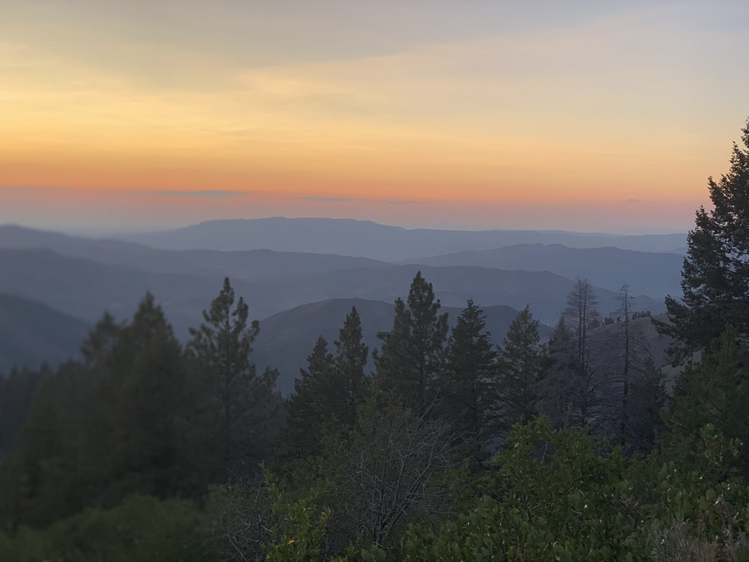
Luma Budget Update

Slide 5
Budget Update
Reminder
If you have questions, please submit a Service Desk ticket by emailing ServiceDesk@sco.Idaho.gov
Happy Budget Submission day!!
As of 12:30 pm today, 54 agencies had submitted their budgets!

Slide 6
Luma Phase 1 Update

Slide 7
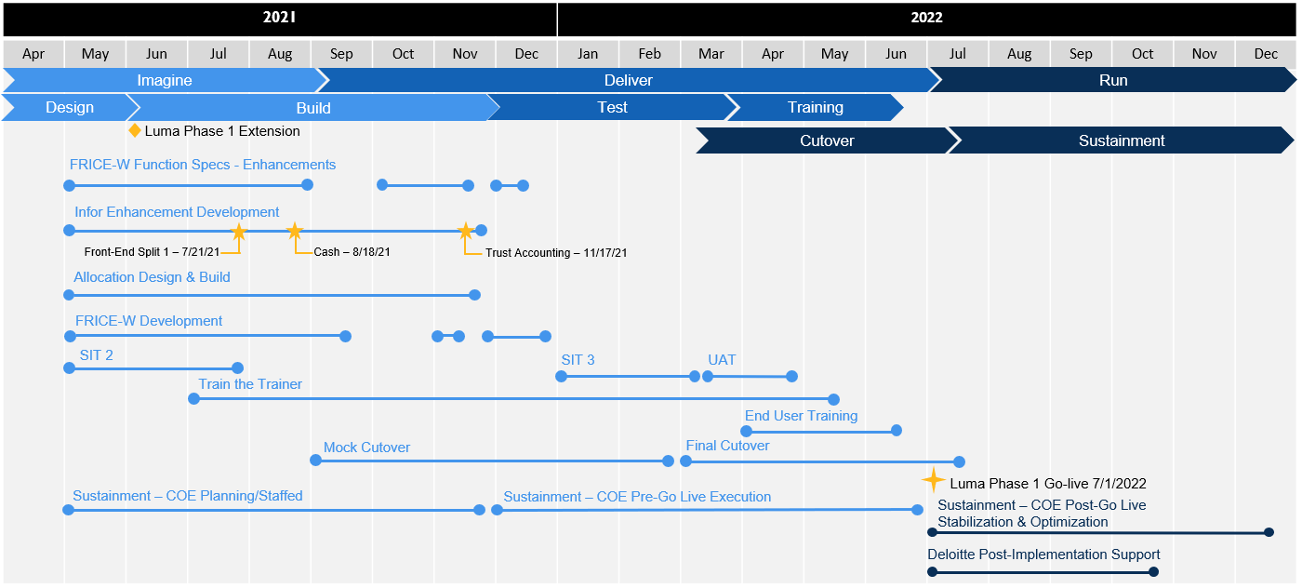
Phase 1 Timeline

Slide 8
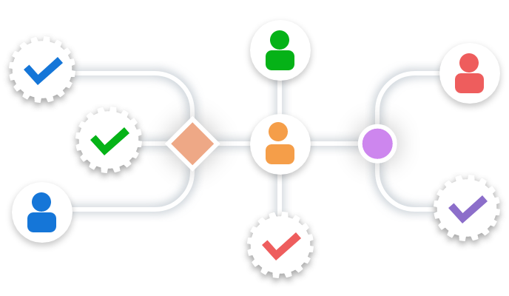
Phase 1 Update - Approval Workflows
The workflow determines how a document flows, or routes, through the system by showing who must complete a task, make a decision, or approve a document.
Agencies will populate the fields in the Approval Workflows Workbook which then be used to inform Luma on who/where to route tasks.
Example: purchase requisition under $25k go to Sam Jones and over $25k to Leslie Smith.

Slide 9
Phase 1 Update - Approval Workflows
The workflow determines how a document flows, or routes, through the system by showing who must complete a task, make a decision, or approve a document.
Workflows Approvals are now planned to be distributed to Agencies in September
Approval Workflows complexity will be based on a “T-Shirt” Size
Trying to change the format from a Workbook to a Survey

Slide 10
Phase 1 – Security Roles
Security Roles
Roles
Security Roles
Security Roles
Security Roles
Security Roles
Roles
Security Roles
Security Roles
Security Roles
Roles
Security Roles
Security Roles
Security Roles
Roles
Security Roles
Security Roles
Security Roles
Roles
Security Roles
Security Roles

Slide 11
Luma Phase 1 Activities

Slide 12
Phase 1 - Learning Labs
The Luma Project is excited to kick off our new Luma Learning Labs! These Learning Labs will provide an in-depth look at a process in the Luma system. The goal of these Learning Labs is to review topics or processes that will be helpful to the end-users in the future as a reference not only throughout training but after go-live. The intention is to eventually do one learning lab a month for both Finance and Procurement.
This first Learning Lab will focus on the Punchout and EDI aspects of Procurement in Luma. Please the following link to RSVP!
https://app.smartsheet.com/b/form/62a46cfe227b4676a628fd3ab15a0b3a

Slide 13
Luma Phase 2 Update

Slide 14
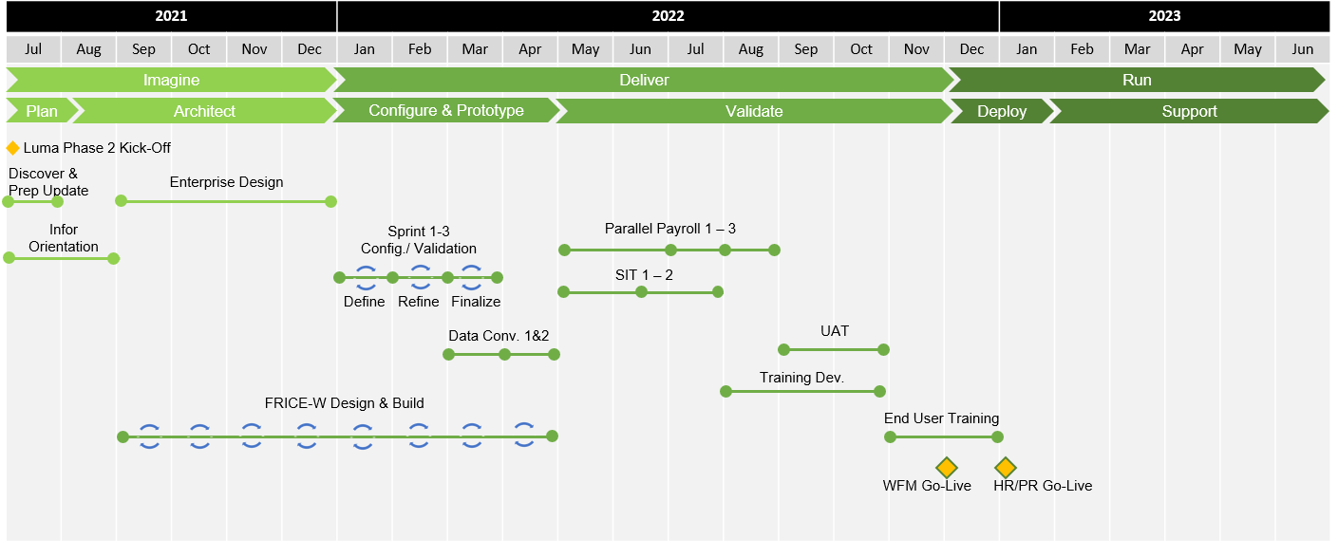
Phase 2 Timeline

Slide 15
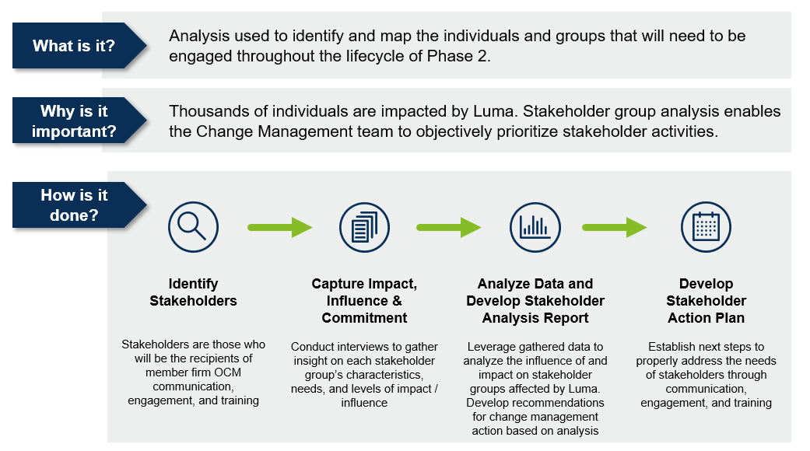
Phase 2 Stakeholder Assessments
Over the past week, the Luma Organizational Change Management (OCM) team has been conducting interviews with Phase 2 stakeholders from agencies to gather insight on each stakeholder group’s unique characteristics, needs, and level of impact/influence.
These interviews will continue the rest of this week.

Slide 16
Phase 2 Ecosystem Survey Next Steps
Survey in preparation for the RFP
Systems IDed in Luma Phase 1 that are applicable to Phase 2
Phase 2 Ecosystem Survey
Analyze information from Ecosystem survey and previously IDed agency systems
Complete draft list of Phase 2 interfaces and conversions
Begin reaching out to Agencies to start the interfaces and conversions
Late Sept
Mid Sept
Early Sept
August
2020
2018

Slide 17
Luma Phase 2 Activities

Slide 18
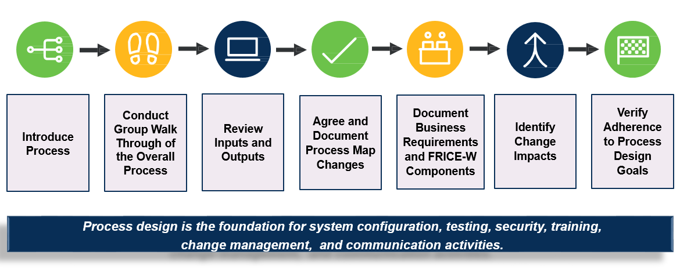
Phase 2 Business Process Redesign

Slide 19
Engagement Opportunities

Slide 20
Engagement Opportunities
Upcoming engagement opportunities to learn more about Luma. Please help us spread the word!
Type of Engagement | Date | Time | Topic
Statewide Showcase | September 14th & 16th | 1:00 PM | Accrual Accounting
September Learning Lab Option #1 | September 7th | 10 am – 11 am | EDI & Punchout
September Learning Lab Option #2 | September 9th | 2 pm – 3 pm | EDI & Punchout
Notes:
!

Slide 21
Know Do Share Report
(K.D.S.R.)

Slide 22
Phase 1 K.D.S.R.
KNOW
DO
SHARE
REPORT
Read Luma Project news and updates in this column.
Meet with employees and leadership in your agency to discuss these messages or action items.
Please share this information or engagement opportunities with your Agency
Report feedback to the project team or complete action items the Luma project team is requesting from your agency.
Phase 1 Go-live: Phase 1 of the Luma Project will go live on July 1st, 2022 with the Finance and Procurement modules.
Agency Approval Workflows:
Approval workflow complexity is going to be based on a “T-Shirt”. The Approval Workflows workbook or Survey is planned to be distributed in September.
Statewide Showcase:
What: Accrual Accounting
When: September 14th & 16th 1 – 2 pm
Where: Virtual meeting. Your Agency Advocate will send out a meeting invite!
Luma Learning Labs:
What: EDI & Punchout
When: September 7th 10-11 AM
September 9th 2-3 PM
Where: Virtual meeting. Use the link below to RSVP!
If your agency is currently working with the Luma Project team on an interface or conversion, please maintain momentum to bring those to completion.
Internal Meetings: Please let us know if you have an upcoming internal meetings that we can present to your staff! We want every state employee to know about the Luma, the changes coming, and exciting benefits of a modern system.
RSVP Here
September 1st, 2021

Slide 23
Phase 2 K.D.S.R.
KNOW
DO
SHARE
REPORT
Read Luma Project news and updates in this column.
Meet with employees and leadership in your agency to discuss these messages or action items.
Please share this information or engagement opportunities with your Agency
Report feedback to the project team or complete action items the Luma project team is requesting from your agency.
Phase 2 Go-live: Phase 2 of the Luma project will go live with Workforce Management/Time in December of 2022 and Payroll as well as Human Capital Management on January 1st, 2023.
Stakeholder Assessments: Agency Advocates and OCM team have been conducting interviews with agency stakeholders.
Luma Phase 2 BPR Sessions: HR and Payroll personnel from across the state have been invited to participate in the Luma Phase 2 BPR Sessions.
Phase 2 Luma Webpage:
Payroll: Luma Payroll Module (idaho.gov)
Human Capital Management: Luma Human Capital Management (idaho.gov)
Internal Meetings: Please let us know if you have an upcoming internal meetings that we can present to your staff! We want every state employee to know about the Luma, the changes coming, and exciting benefits of a modern system.
September 1st, 2021

Slide 24
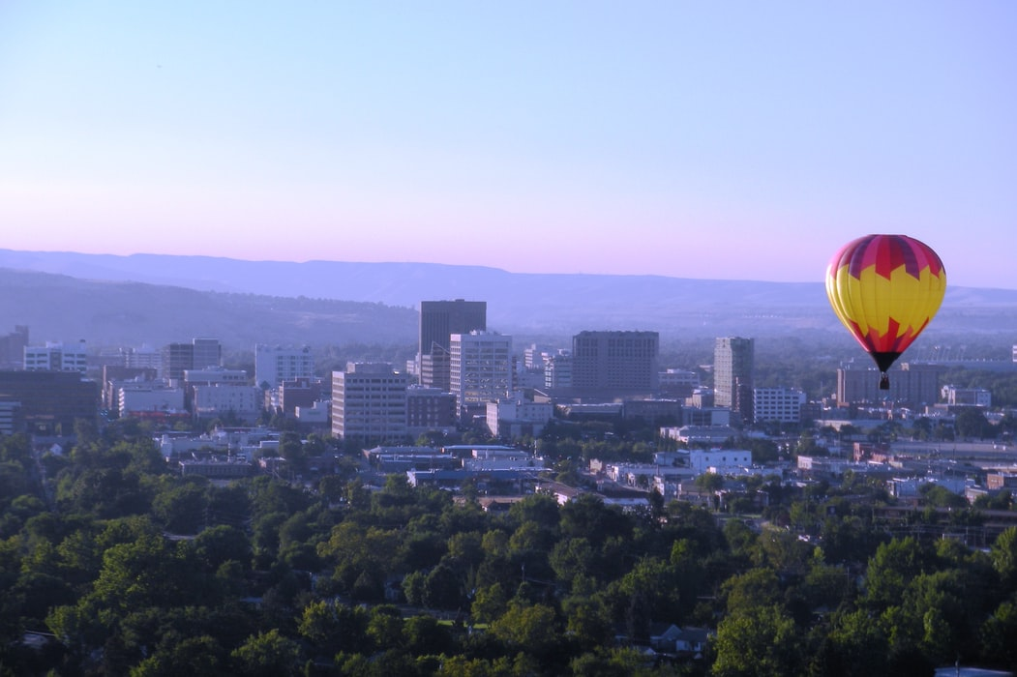
Questions

Slide 25
Thank You!
Sheena Coles
SColes@sco.Idaho.gov
208-334-3100
Alex Doench
adoench@sco.Idaho.gov
208-332-8841
Tina Fuller tfuller@sco.Idaho.gov 208-332-8867
Chris Lehosit clehosit@sco.Idaho.gov 208-332-8887
Elijah Stearns
estearns@sco.idaho.gov 208-332-8871
Danielle Blackmer dblackmer@sco.Idaho.gov
208-332-8868

