Slide 1




Default Values
&
Payroll Crosswalk Workbooks

Slide 2

Expected Outcomes of this Kick-off
Luma Chart of Accounts Default and Payroll Workbooks
Payroll Crosswalk Purpose
Instructions
Luma Mapping
Mass Updates
IPOPS Example
I-Time Example
Recap
Resources
Lunch & Learn Reminder
Q&A
AGENDA

Slide 3
Expected Outcomes of this Kick-off

Slide 4
Expected Outcomes of this Kick-off
Introduction to concept of setting up default values in Luma.
Walk-through of how to set up default values.
Introduction to what payroll will look like in the interim between Phase 1 and Phase 2 go-live.
Explanation of the need to maintain a Payroll crosswalk during the interim.
Walk-through of how to complete the Payroll crosswalk for your agency.
Walk-through of how to setup PCN defaults for your agency to mass update upon Phase 1 go-live.

Slide 5
Luma Chart of Accounts (COA) Default Workbooks
& Payroll Workbook

Slide 6
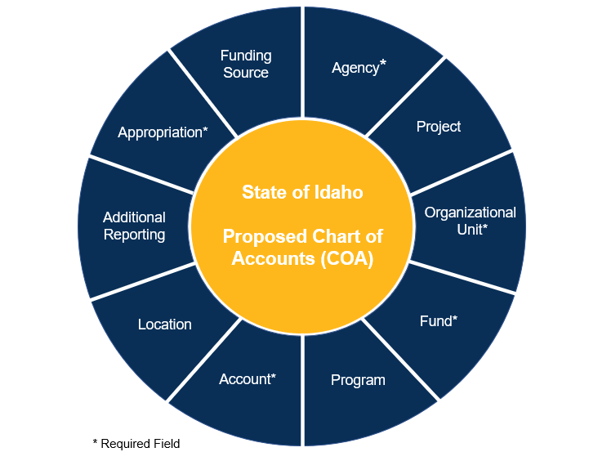
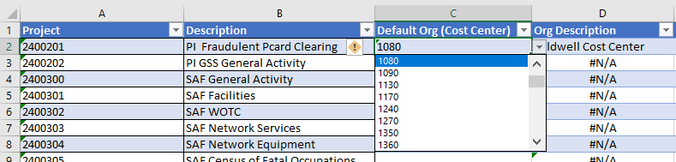
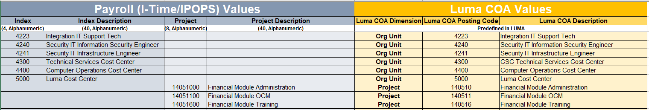
Luma Chart of Accounts Default
& Payroll Crosswalk Workbooks
Chart of Accounts Default Workbook
  Setting up defaults for Project, Org Unit, and Program posting codes.
Payroll Crosswalk Workbook
  Payroll-Luma Crosswalk – Payroll Codes (Index, PCA, and Project) mapped to a Luma dimension and posting code.
  Position Distribution Default – Mass Updates (in place of IPOPS actions)

Slide 7
Default Workbook

Slide 8
Default Workbook
LUMA can “default” chart of account values in “downstream” fields on a transaction
Agencies will identify which fields can be defaulted to what values for all entries
This set-up is for ALL default values for your agency, not just payroll defaults.
Luma General Ledger Distribution String
Agency | Project | Org Unit | Fund | Program | Account | Location | Additional Reporting | Approp -riation | Funding Source
Notes:
Default Value workbook is for all Luma coding.
Payroll Crosswalk workbook is only for codes that can be applied to payroll costs.
By setting up your defaults in the system first, it will help simplify your Payroll Cross-walk, since agencies will be able to leverage the defaulting in LUMA to complete the COA GL string for payroll.

Slide 9
Default Workbook – Step A – Project
For each Project Posting Code (Column A) indicate in columns C, E, G I, K, or M and LUMA posting values that can be defaulted using the Project Posting Code.
If no value can be defaulted, leave the field blank.
Notes:
Valid pairs will be set up later. For now we are just capturing any LUMA posting values that can be defaulted.
Think of defaults as “always”; This project always charges to that fund, in this cost center.

Slide 10
Default Workbook
Repeat the process for Org on the Step B - Org tab
Repeat for Program on Step C - Program
Follow the instructions on the “Instructions” tab in the workbook
Save your completed workbook to your SFTP drop site and send an email to your Agency Advocate and the following Luma Team Members
  gsmith@sco.idaho.gov, cpeterman@sco.idaho.gov, stisdale@soc.idaho.gov, abrown@sco.idaho.gov, bpurcell@sco.idaho.gov
Notes:
If you are unfamiliar with the process for using the SFTP drop site, please reach out to your Agency Advocate for directions

Slide 11
Questions?

Slide 12
Payroll Crosswalk

Slide 13
Payroll Crosswalk Purpose
STARS – No longer available after July 1, 2021
Payroll-Luma Crosswalk will be built by each agency providing a source for Index, PCA and Project distribution codes.
Agencies will maintain the Payroll-Luma Crosswalk until Luma phase 2 goes live.
EIS Payroll will use the Index, PCA, and Project codes from the new Payroll-Luma Crosswalk instead of STARS.

Slide 14
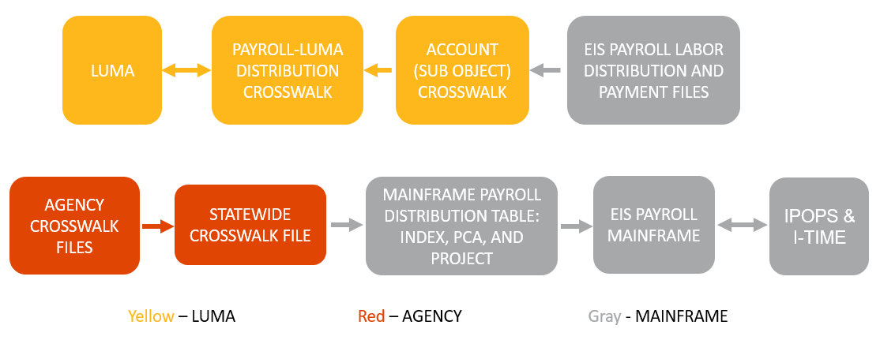
Payroll-Luma Crosswalk Flow Chart
The data received in the Payroll-Luma Crosswalk will be imported into the EIS Mainframe Payroll system for payroll processing and into IPOPS and I-Time for distribution overrides on earnings and time entry.
After payroll processes, interface files are created which will go back through an Account Crosswalk and the Payroll-Luma Crosswalk before importing into Luma to post to the General Ledger and Accounts Payable.

Slide 15
Instructions

Slide 16
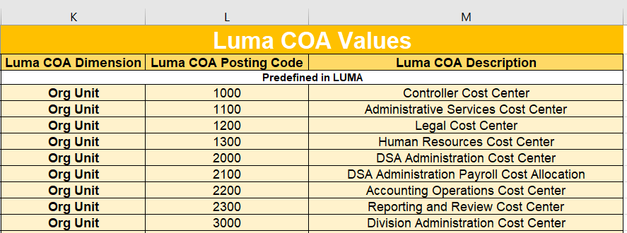
Payroll-Luma Crosswalk
STEP 1: Complete the Luma Default workbook FIRST
  There are Reference Sheets provided in the Default workbook that contain the values setup in the Luma Chart of Accounts dimensions.
STEP 2: The Reference Sheets can be used to bring in the Luma dimension, positing codes, and descriptions values to the Payroll-Luma Crosswalk.
  Only codes that apply to payroll costs need to be on the crosswalk.
Notes:
Default Value workbook is for all Luma coding.
Payroll Crosswalk workbook is only for codes that can be applied to payroll costs.

Slide 17
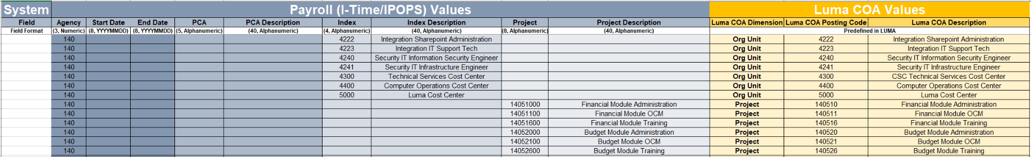
Payroll-Luma Crosswalk
Step 3: Map Payroll Values to Luma Values
The Payroll-Luma Crosswalk will be the source for the Index, PCA, and Project codes used for payroll processing.
The Index, PCA, and Project codes can remain similar to what is currently used or they can be repurposed to work with your new Luma Chart of Account Values.
Each agency is different and can have a unique setup to the Payroll-Luma Crosswalk.
Formatting in row 3 must be followed for the Payroll (I-Time/IPOPS) Values.
Start and End Dates are optional – leave blank if the do not apply.
Notes:
Depending on how each agency setup their new Chart of Accounts, some agencies can utilize their current Index, PCA, and/or Projects codes to map to their new Luma codes. Other agencies will need to do the opposite, and will create new Index, PCA, and/or Projects codes to map to their new Luma codes.

Slide 18

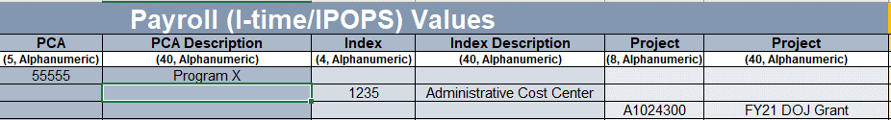
Each Row can have only one PCA, Index or Project Code:

Slide 19

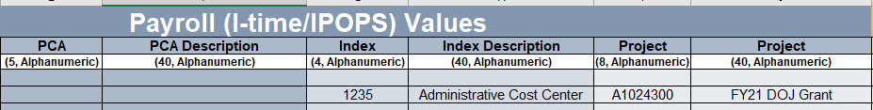
You may not have BOTH a PCA and Index code on the same row…

Slide 20

You may not have BOTH a PCA and Index code on the same row…

Slide 21
Luma Mapping

Slide 22
Index/PCA/Project to Luma Mapping
An Index, PCA or Project CAN be used to map to more than one Luma Dimension:
  PCA 10000
-BUT-
The same Index, PCA or Project CANNOT be used to map to more than one Luma value in a given dimension:
  PCA 10000
Luma Org Unit 1000
Luma Project 100123456
Luma Org Unit 1000
Luma Org Unit 1001

Slide 23
Position Distribution Defaults - Mass Updates

Slide 24
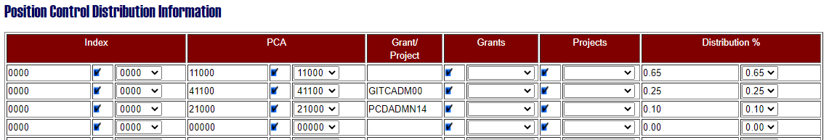
Position Distribution Defaults – Mass Updates
In IPOPS, default distribution codes are assigned to a position so all payroll expenses are applied to the distribution defaults unless they are overridden on the time or earnings entry.

Slide 25
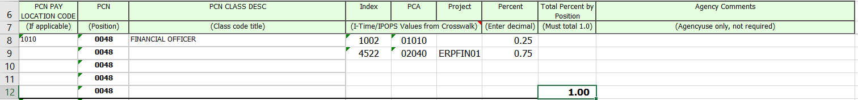
Position Distribution Defaults – Mass Updates
For Luma, the Position Distribution Default spreadsheet can be used for a one-time mass update to positions for phase 1 go-live (instead of using IPOPS).
Optional - Some agencies can use the same Index, PCA, and Project distribution codes on their Payroll-Luma Crosswalk and may not need to update their Position Distribution Defaults.
Many agencies created a new structure when building their Luma Chart of Accounts and may need to update Position Distribution Defaults based on the new Index, PCA, and Project codes they setup on their Payroll-Luma Crosswalk.

Slide 26
IPOPS Example

Slide 27
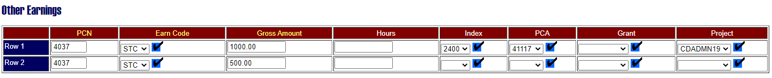
IPOPS Examples of Overrides for Earnings
IPOPS – Other Earnings, Special Payments, Deduction Adjustments, and Separation Payoffs
The first STC entry does have an Index, PCA, Grant or Project override coded so it will not use the default.
The second STC entry does not have a PCA, Grant or Project coded so it will use the Position Distribution Default.

Slide 28
I-Time Example

Slide 29
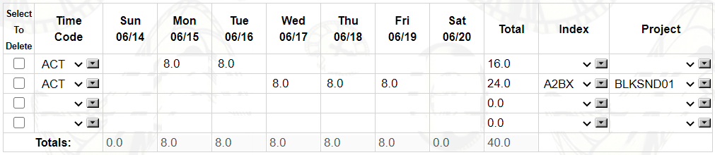
I-Time Examples of Overrides for Earnings
I-Time – Employee Time Sheet
The first ACT entry does not have an Index or Project coded so it will use the Position Distribution Default
The second ACT entry does have an Index and Project override coded so it will not use the default.
If your agency uses Cost Accounting in I-Time, you can request an Index, PCA, or Project be required before the time sheet can be submitted.

Slide 30
Recap

Slide 31
Resources
Resources will be available on our Luma web site:
The recording for this meeting.
Link to open office hours for support and questions:
  Thursdays 11:00 am to 12:00 pm
Contacts:
Glenda Smith – gsmith@sco.Idaho.gov COA Defaults Workbook
Amber Brown – abrown@sco.Idaho.gov Payroll Crosswalk Workbook

Slide 32
Lunch & Learn
Today, Nov. 17th from 12:00 PM – 1:00 PM
Join the Luma Organizational Change Management team for our Lunch and Learn series.
This Lunch and Learn will provide a High-Level Luma and Chart of Accounts Overview

Slide 33
Questions?

Slide 34
Thank you!

