Slide 1
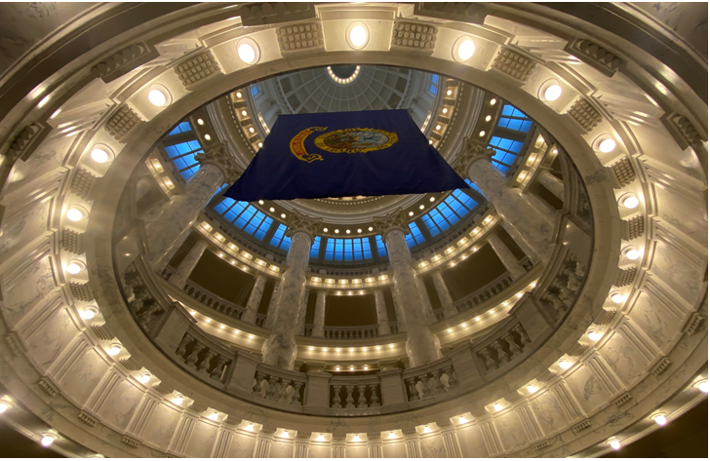
PY-010 Process Payroll

Slide 2

Agenda
Introductions/Roles
Change Starts Now
Ground Rules
User Stories
Expected Outcomes
SWOT Playback
Process Maps Review
Recap

Slide 3
Workshop Roles
Role | Description
Primary Facilitator (State) | Walk through process and facilitate discussions
Primary Facilitator (Deloitte) | Methodology, demo system, facilitate discussions
Scribe/Timekeeper | Documents all updates to be made to the process maps, take notes, and record attendance
Process Owner | Owns the business process and will confirm final decisions
Subject Matter Expert (SME) | Provides feedback and insight into the business process(es)
Organizational Change Management (OCM) | Document change impacts and training requirements
Security | Capturing security and separation of duty requirements
Technical | Capturing FRICE-W and any other technical requirements

Slide 4
Change Starts Now
Top Issues Organizations Face During Enterprise Resource Planning
Change Management
16%
Internal Staff Adequacy
8%
Project Team
7%
Training
7%
Prioritization/Resource Allocation
6%
PEOPLE 62%
Top Management Support
6%
Consultants
5%
Ownership (of benefits to others)
4%
Issues/Obstacles Until Now
Discipline
2%
Program Management
8%
Process Reengineering
4%
PROCESS 16%
Stage/Transition
2%
Benefit Realization
1%
Software Functionality
4%
TECHNOLOGY 9%
Application Portfolio Management
3%
Enhancements/Upgrades
2%
Data
2%
KNOWLEDGE ASSETS 3%
Reporting
1%
Notes:
Key takeaway is that the People part of technology projects is critical to success and has much more influence of the success of a go live than the technology itself. Change starts now and involves EVERYONE. Its not just a responsibility of the “Change and comms” team, but every team member and everyone who has a role on the project on in the organization has a responsibility to help make the project a success.

Slide 5
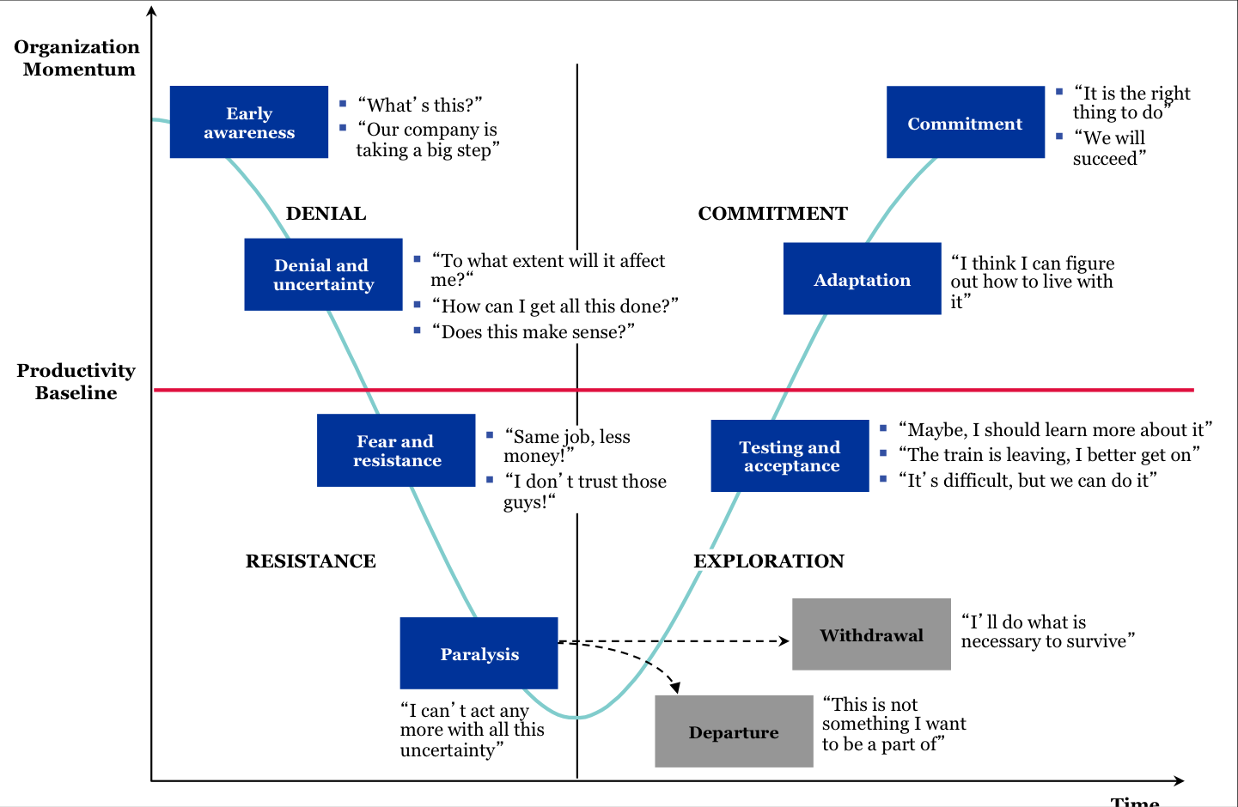
Change Curve
While some changes may seem straightforward, change can be uncomfortable, and people naturally embrace a path of least resistance.
Notes:
While some changes may seem straightforward, change can be uncomfortable, and people naturally embrace a path of least resistance. Organizational Change Management (OCM) is critical to helping employees embrace changes and minimize disruption to business operations. As we go through this project, every person involved will be cycling through this “Valley of Despair”. Please pay attention to the perspective of everyone involved and help to system the change process and move to the “other side of the Valley”!

Slide 6
Ground Rules
Give your undivided attention and time
Think and speak openly, candidly, and constructively. If participating on WebEx, unmute and participate.*
Ask questions and provide feedback on design team recommendations. There are no “silly” questions!
Minimize side conversations
Allow one speaker at a time
Leverage the diverse agency representation to collaborate and identify an integrated approach to the future state design
The Scribe will keep us on track and conduct periodic time checks to allow for break periods and lunch
*The WebEx chat will not be monitored

Slide 7

User Stories
User-centered approach
User stories are written from the point-of-view of the end user, they encourage us to embrace a user-centered approach
Moments That Matter
User stories link personas and moments that matter and delivers a better user experience and desired business values
Stakeholder Alignment
Aligns stakeholders on the future state solution requirements and drives development of the right solution
Sprints
The quality of the user stories directly impacts the effectiveness and value of sprints
Notes:
***Provide a brief recap of user story training as it relates to buying a house. Encourage team to think about user story creation as we walk through the process maps. Have them jot down ideas for review during the user story workshops. Emphasize the importance of user stories and how they correspond to the requirements needed to build the system successfully.

Slide 8
Expected Outcomes
Security
Security Roles
Role to Position Mapping
Technical
Forms
Reports
Interfaces
Conversions
Enhancements
Business Process Redesign Sessions
OCM
Communications
Training
Workforce Transition
Process
Moments that Matter
Personas
User Stories

Slide 9
SWOT Playback
Process | S / W / O / T | Description
PY-010-010: Maintain Payroll Policy | Strength | Tax Withholding Tables are maintained by year so historical corrections are taxed accordingly
 | Strength | One tax table (Annual) for both Judicial and Biweekly
 | Strength | Updates are immediate - can be updated same day as payroll processing
 | Strength | Earnings and Deductions easy to add to mainframe directories
 | Strength | Bank routing numbers typed into the mainframe - fast, easy, secure
 | Strength | Bank routing numbers available to all pay groups that SCO pays
 | Strength | Edit in place to validate routing numbers
 | Weakness | Manually updated - risk of typing errors
 | Weakness | Manually track IRS and taxing states for notification of table updates/changes
 | Weakness | Takes an overnight process before it's available on the web
 | Weakness | New earnings codes often require mainframe programming for payroll processing/overtime/ACA etc.
 | Weakness | When a routing number is added, an overnight process is required before it's available on the web
 | Weakness | Mainframe table limit is 500 bank entries. Requires annual, manual clean up of unused routing numbers.
 | Weakness | If a routing number isn't available in IPOPS, the agency/employee needs to contact SCO to add it to the directory
 | Weakness | When adding a routing number to the system, SCO goes to the federal reserve website to verify bank name/routing number and eligibility to use for ACH

Slide 10
SWOT Playback
Process | S / W / O / T | Description
PY-010-010: Maintain Payroll Policy | Opportunity | Increase accuracy and efficiency by utilizing automated updates to tax tables
 | Opportunity | Eliminate overnight process for web availability when changes are made
 | Opportunity | Increase accuracy and efficiency by utilizing automated updates
PY-010-020: External Benefits Processing | Strength | Rates are kept on the mainframe. Directories can be updated same day as payroll processing if needed.
 | Weakness | Incoming information is largely a manual process via IPOPS documents
 | Weakness | Difficult to balance adjustments
 | Weakness | Workers Comp process delayed and inaccurate - difficult for agencies to anticipate payroll costs to track appropriations
 | Weakness | Employees don't know when health insurance adjustments process until their net pay is short
 | Weakness | OGI doesn't know if employee has sufficient earnings to go against insurance adjustments. Adjustments can take several pay periods/months.
 | Weakness | Rates updated manually - mistakes = withholding incorrect premiums/contributions
 | Weakness | SCO contacts benefit vendors for rate updates via email and updates directories accordingly - contacts change and we have to find the right person to get rates from
 | Opportunity | Utilize file transfers/interfaces to populate rate updates
 | Opportunity | Increase communication between benefit vendors and payroll to pick up employee account changes
PY-010-030: Collect/Process Other Payroll Related Data | Strength | Interface with STARS (finance) to collect taxable meal reimbursements for taxation
 | Strength | Taxable fringe easily captured for W-2 reporting

Slide 11
SWOT Playback
Process | S / W / O / T | Description
PY-010-030: Collect/Process Other Payroll Related Data | Strength | Dedicated batch ranges allow for easy identification of payroll transaction/source (i.e. Itime=70,000 range)
 | Weakness | Recurring taxable fringe (personal use of state vehicle, rent, etc) must be manually entered as an Other Earnings in IPOPS each pay period/month
 | Weakness | If taxed (not paid) through payroll and employee has insufficient earnings, the taxable fringe needs to be re-entered the next pay period earnings are processing
 | Weakness | Easy to enter duplicate Other Earnings in IPOPS
 | Weakness | Upload requires access to the domino database (no mobile option)
 | Weakness | Multiple servers cause replication errors
 | Weakness | Deleting an IPOPS action after upload requires agency to submit Payroll Remarks to also delete the batch that was created.
 | Weakness | Confusion between taxable fringe subject to persi or not subject to persi
 | Weakness | Retro Pay is a lump sum, manually calculated, and manually entered into IPOPS
 | Opportunity | Clarity for agencies and employees on taxable fringe earnings types
 | Opportunity | One system = more efficient
PY-010-040: Collect/Process Employee Time and Attendance Data | Strength | Recognizes when employee is separating because deceased and automatically taxes accordingly.
 | Strength | Able to do as many uploads a day as we want
 | Strength | Able to view individual time sheets from upload screen
 | Weakness | Upload requires access to the domino database (no mobile option)

Slide 12
SWOT Playback
Process | S / W / O / T | Description
PY-010-040: Collect/Process Employee Time and Attendance Data | Weakness | Time sheets go from Web to Domino to Mainframe
 | Opportunity | Collect time and attendance information on one system
PY-010-050: Process Off-Cycle Payroll Transactions | Strength | Off-Cycle Payroll runs twice a year to pick up FY and CY adjustments before year end close
 | Weakness | No off-cycle payrolls requires SCO to write manual paper checks so employees can get paid between on-cycle payroll processing
 | Opportunity | Offer off-cycle payroll each pay period
PY-010-060: Consolidate Pay Period Data | Strength | Audit logs created to balance time sheets uploaded vs time sheets submitted
 | Strength | Ability to look at individual time sheets before uploading
 | Strength | Can run batch jobs as many times as needed. 3320 checks all batches on latest upload. 3325 re-edits all batches that haven't been processed yet.
 | Weakness | Some edits in Itime, IPOPS, but many errors aren't detected until batch jobs are run
 | Weakness | No balancing reports are generated. Balancing happens in excel by picking up amounts from generated preprocessing and final reports.
 | Opportunity | Develop generated balancing reports to improve efficiency and trouble shooting
PY-010-070: Process State Active Duty (SAD) Transactions | Strength | Mainframe upload of pay file, easy, secure, not necessary to submit forms via web.
 | Weakness | A lot of manual work at Military
 | Weakness | Entire file bombs if incorrect date is used
 | Weakness | Difficult to make corrections after file has been uploaded

Slide 13
SWOT Playback
Process | S / W / O / T | Description
PY-010-070: Process State Active Duty (SAD) Transactions | Opportunity | Develop an updated more efficient file build and transfer procedure
PY-010-080: Generate and Review Pre-Register | Strength | Reports available on the mainframe for our review/balancing before we post the final reports to the web.
 | Strength | Preprocessing error messages help agencies identify time sheet errors so they can make the necessary corrections
 | Strength | Ability to lock time so no more time sheets can be submitted for a pay period
 | Weakness | Unable to rerun the Pre-register as many times as needed.
 | Weakness | Gross to net manually created in excel
 | Weakness | No balancing reports are generated. Balancing happens in excel by picking up amounts from generated preprocessing and final reports.
 | Weakness | Pay calc happens during payroll processing which means time sheets often don't match pay stubs.
 | Weakness | Available leave balances are updated during final payroll which means leave balances on future time sheets are not accurate
 | Weakness | Personnel actions post between pre and final, resulting in errors on final payroll
 | Opportunity | Time entered on time sheets will match the payroll register and pay stubs
 | Opportunity | Preprocessing (pre-register) can be run as many times as needed until clean and ready for final processing.
 | Opportunity | The ability to lock payroll so employee changes won't affect payroll processing while maintaining the functionality of choosing specific transactions into payroll for corrections.
PY-010-090: Produce and Distribute Pay | Strength | Works the same every time - tried and true
 | Strength | Pay stubs state how employee will receive pay (warrant or direct deposit)

Slide 14
SWOT Playback
Process | S / W / O / T | Description
PY-010-090: Produce and Distribute Pay | Weakness | Difficult for agencies to see payroll warrant numbers
 | Weakness | Pay stubs do not show employee mailing address - don't know where their warrant is going
 | Weakness | Biweekly ACH direct deposit file errors on upload to bank - current process is to email the file to the bank instead of uploading on their website.
 | Weakness | Net pay warrants are printed a week before pay day and are stored in a locked area until ready to mail - if the right people aren't in the office on the day they should be mailed, they can get forgotten and mailed out late.
 | Opportunity | Print net pay warrants closer to pay day so they can just go directly to the mail.
 | Opportunity | Offer direct deposit on off-cycle payroll corrections
PY-010-100: Close Payroll Post to AP & GL | Strength | Automated out of final payroll processing
 | Strength | Pay stubs available online to employees one week before pay day
 | Strength | Payroll batches don't post into accounting until pay day which gives the agencies time to reconcile and make changes to the cost accounting before posting
 | Weakness | Online pay stubs are not pdf which makes them difficult to save/send.
 | Weakness | Pay stubs do not show employee mailing address - don't know where their warrant is going
 | Weakness | Lag time between payroll running and posting allows for cost distribution changes to happen during that time which causes batches to error in accounting.
 | Weakness | Cost distribution codes (index, pca, project, grant) are fed to Itime from the mainframe so any changes to these codes don't appear in Itime until the next day.
 | Opportunity | Updated pay stubs with additional/clearer information

Slide 15
SWOT Playback
Process | S / W / O / T | Description
PY-010-110: Reconcile Payroll Close | Strength | Reports available on the mainframe for our review/balancing before we post the final reports to the web.
 | Weakness | Balancing sheet and balancing formulas are in Excel
 | Opportunity | More efficient payroll balancing
PY-010-120: Prepare Tax Filing Information | Strength | Fairly straight forward for a large employer
 | Weakness | Tax spreadsheet in Excel is manually updated each payroll with pay period amounts.
 | Weakness | SS and Medicare recalculated (for rounding) on the spreadsheet leaving a surplus in the fund of taxes withheld.
 | Opportunity | Consolidate tax withholding information
PY-010-130: Tax Administration & Reporting | Strength | File build/maintenance for W-2's and 1095's is on the mainframe and easy to run/modify.
 | Weakness | Quarterly withholding tax returns are prepared manually
 | Weakness | Only one taxing state is allowed on an employee record each payroll requiring manual updates of state taxable wages and under/over withholding during the year.
 | Opportunity | Consolidate tax withholding information and generate returns
PY-010-140: Prepare Non-Tax Remittances for AP Processing | Strength | Vendors have the option to sign in to Online Reporting to view the deduction register
 | Strength | Vendors have the option to receive funds via direct deposit
 | Strength | No invoices - payments of deductions withheld generate out of final payroll.
 | Weakness | Sending deduction register that includes employee name/full or partial SSN to vendors with warrant.

Slide 16
SWOT Playback
Process | S / W / O / T | Description
PY-010-140: Prepare Non-Tax Remittances for AP Processing | Weakness | Deductions are manually posted by vendors - can take several months for employees to see it in their account
 | Weakness | Deduction registers are confusing to vendors when payroll adjustments affect the deduction.
 | Opportunity | Provide more opportunity for vendors to receive electronic payments vs mailed warrants
 | Opportunity | More direct deposit lines available to employees = voluntary deductions can be deposited directly into employees account vs mailed warrant and hand posting by vendor
PY-010-160: Maintain Wage Garnishments | Strength | Deductions are already set up and just need to be selected for the most used garnishment types
 | Weakness | Information kept on an Excel spreadsheet.
 | Weakness | Idaho Child Support paid with warrants which causes long lag time in posting/lost warrants.
 | Weakness | Lots of paper.
 | Weakness | Correct calculation on payroll processing requires several fields to be completed in the right order when setting up a new garnishment type.
 | Opportunity | Possible interface with Ada County Sheriff for consumer debt garnishments
PY-010-170: Employee Verification | Strength | Pre-built IBIS reports help with data collection/reporting
 | Strength | We have gone paperless - saved as pdf on shared drive
 | Strength | Shared tracking sheet allows anyone in payroll to search the status of a written verification
 | Strength | Complete written verifications using adobe and pdf instead of hand writing
 | Weakness | The tracking sheet is an excel spreadsheet

Slide 17
SWOT Playback
Process | S / W / O / T | Description
PY-010-170: Employee Verification | Weakness | Fax machines are unreliable - no receipts or tracking
 | Weakness | Manual process
 | Opportunity | Possible automated reports for employees?

Slide 18
PY-010 Process Payroll
PY-010 | Process Payroll | Payroll Administration is the set of activities required to organize the compensation of employees for the hours that have been worked. This may include keeping totals for hours worked by employees, rates of pay and managing payments to employees.
PY-010-010 | Maintain Payroll Policy | Maintain organizational level policies related to payroll setup and processing. Examples are pay groups, earnings and deductions codes, workers comp policies, etc.
PY-010-020 | External Benefits Processing | Process Benefits enrollment data from any third-party administrator, which will update employee benefit deduction amounts prior to payroll processing.
PY-010-030 | Collect/Process Other Payroll Related Data | Collect additional employee time and attendance related data for processing. Examples include expense reimbursements, ad-hoc payments, and one-time deductions.
PY-010-040 | Collect/Process Employee Time and Attendance Data | Collect employee time and attendance data from Workforce Management for processing.
PY-010-050 | Process Off-Cycle Payroll Transactions | Manage off cycle payroll processing, including consolidating all gross employee earnings and deductions to produce net pay.
PY-010-060 | Consolidate Pay Period Data | Consolidate all payroll related data in preparation for processing, including the release of all payroll batches and balancing of all time input data.
PY-010-070 | Process State Active Duty (SAD) Transactions | The payroll process for SAD personnel. Multiple payrolls could occur before separation.

Slide 19
PY-010 Process Payroll
PY-010-080 | Generate and Review Pre-Register | This process can be rerun as many times as needed and takes the Employee's gross pay to net pay, calculating tax and other deductions along with allocating net pay to the active Employee's direct deposit distributions.
PY-010-090 | Produce and Distribute Pay | Create payments, print warrants, and transmit ACH file to the bank.
PY-010-100 | Close Payroll Post to AP & GL | Post all payroll related cost allocations to the appropriate GL accounts and complete post-payroll activities.
PY-010-110 | Reconcile Payroll Close | Complete payroll reconciliation and any quarter/year end activities.
PY-010-120 | Prepare Tax Filing Information | The process by which the Payroll Specialist prepares tax information for the amounts withheld for the tax period. After the applicable tax information is extracted, this process then flows to AP for processing.
PY-010-130 | Tax Administration & Reporting | Generate and balance quarterly tax filings. At year end, generate and balance W-2s and 1099s.
PY-010-140 | Review Non-Tax Remittances for AP Processing | Generate and review reports containing garnishments and other third-party remittance files that were transmitted to Accounts Payable for processing.
PY-010-160 | Maintain Wage Garnishments | Manage the receipt, coordination, and processing of legally required employee deductions including, but not limited to, levies, child support, and tax payments.
PY-010-170 | Employment Verification | Resolution of requests to verify employment details and or history.

Slide 20


Business Process Map Legend
Event (e.g., Start, End)
Subprocess
Swimlane
Process Interface/Link
Task/Activity
AND Rule
Task Connector
OR Rule
Document
XOR Rule – Exclusive OR
MTM
Moment That Matters
Infor system-enabled task / step

Slide 21
PY-010 Process Payroll
Process Definition: Payroll Administration is the set of activities required to organize the compensation of employees for the hours that have been worked. This may include keeping totals for hours worked by employees, rates of pay and managing payments to employees.

Slide 22
PY-010-010 Maintain Payroll Policy
Process Definition: Maintain organizational level policies related to payroll setup and processing. Examples are pay groups, earnings and deductions codes, workers comp policies, etc.

Slide 23
PY-010-020 External Benefits Processing
Process Definition: Process Benefits enrollment data from any third-party administrator, which will update employee benefit deduction amounts prior to payroll processing.

Slide 24
PY-010-030 Collect/Process Other Payroll Related Data
Process Definition: Collect additional employee time and attendance related data for processing. Examples include expense reimbursements, ad-hoc payments, and one-time deductions.

Slide 25
PY-010-040 Collect/Process Employee Time and Attendance Data
Process Definition: Collect employee time and attendance data from Workforce Management for processing.

Slide 26
PY-010-050 Process Off-Cycle Payroll Transactions
Process Definition: Manage off cycle payroll processing, including consolidating all gross employee earnings and deductions to produce net pay.

Slide 27
PY-010-060 Consolidate Pay Period Data
Process Definition: Consolidate all payroll related data in preparation for processing, including the release of all payroll batches and balancing of all time input data.

Slide 28
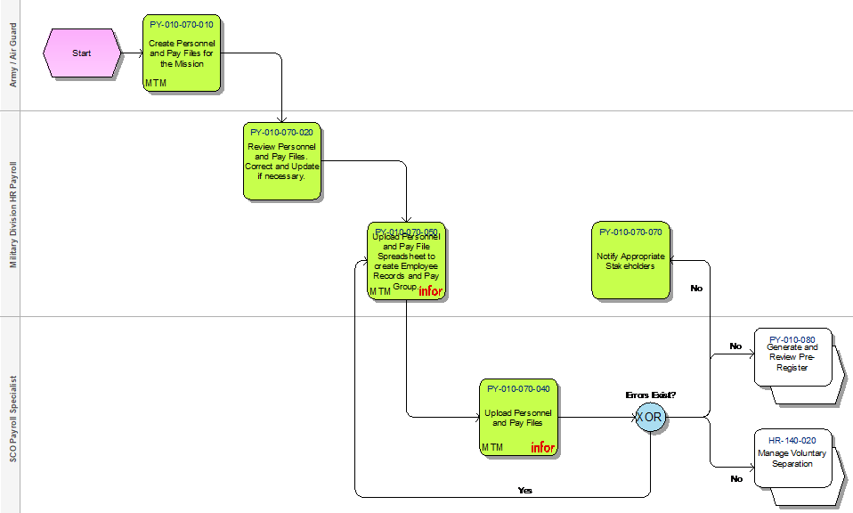
PY-010-070 Process State Active Duty (SAD) Transactions
Process Definition: The payroll process for SAD personnel. Multiple payrolls could occur before separation.

Slide 29
PY-010-080 Generate and Review Pre-Register
Process Definition: This process can be rerun as many times as needed and takes the Employee's gross pay to net pay, calculating tax and other deductions along with allocating net pay to the active Employee's direct deposit distributions.

Slide 30
PY-010-090 Produce and Distribute Pay
Process Definition: Create payments, print warrants, and transmit ACH file to the bank.

Slide 31
PY-010-100 Close Payroll Post to AP & GL
Process Definition: Post all payroll related cost allocations to the appropriate GL accounts and complete post-payroll activities.

Slide 32
PY-010-110 Reconcile Payroll Close
Process Definition: Complete payroll reconciliation and any quarter/year end activities.

Slide 33
PY-010-120 Prepare Tax Filing Information
Process Definition: The process by which the Payroll Specialist prepares tax information for the amounts withheld for the tax period. After the applicable tax information is extracted, this process then flows to AP for processing.

Slide 34
PY-010-130 Tax Administration & Reporting
Process Definition: Generate and balance quarterly tax filings. At year end, generate and balance W-2s and 1099s.

Slide 35
PY-010-140 Review Non-Tax Remittances for AP Processing
Process Definition: Generate and review reports containing garnishments and other third-party remittance files that were transmitted to Accounts Payable for processing.

Slide 36
PY-010-160 Maintain Wage Garnishments
Process Definition: Manage the receipt, coordination, and processing of legally required employee deductions including, but not limited to, levies, child support, and tax payments.

Slide 37
PY-010-170 Employment Verification
Process Definition: Resolution of requests to verify employment details and or history.

Slide 38









Recap
Security
OCM
Technical
Process

