Slide 1






Luma Town Hall
April 21, 2020

Slide 2
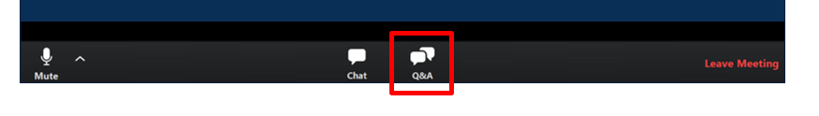
Welcome!
THANK YOU for being here!
Thank you all for your flexibility and willingness to meet virtually during these unprecedented times!
Expectations:
  Please give presenters your full attention.
  All attendees will be muted, please utilize the Q&A functionality to ask questions.
  You will see a chat icon, but the chat functionality has been disabled.
  This meeting is being recorded and will be available at luma.sco.idaho.gov in the near future.
Notes:
Brandon’s Slide

Slide 3
Agenda
Luma Project Update
Overview of Chart of Accounts Development
Introduction of 10 COA Dimensions
What is a hierarchy?
Deconstruction of a PCA and Index Code
Example Completed Dimension Workbook
Q&A
Notes:
Brandon’s Slide

Slide 4
Luma Update
What has the luma project team been up to?
4

Slide 5
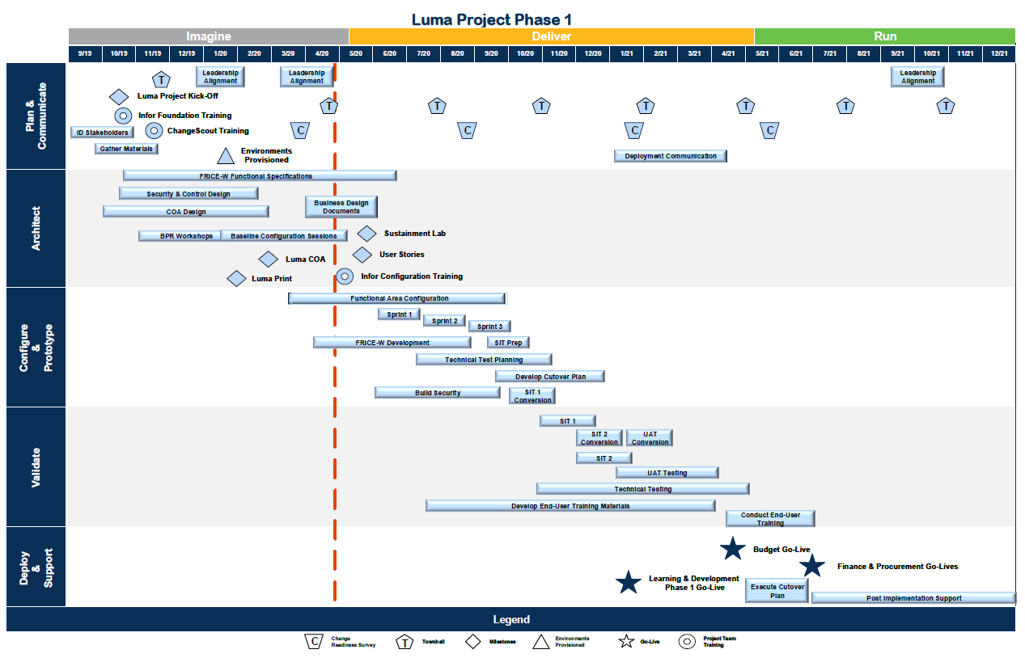
5
Notes:
To be updated based on other project components

Slide 6




Agency Advocates
Agency Advocates serve as the point of contact for agencies, working directly with Agency Change Liaisons, leadership, and subject matter experts (SMEs) during implementation and after go-live to support agencies through awareness and facilitation of project-related tasks.
Heath Ribordy
Danielle Blackmer
Chris Lehosit
Tina Fuller
Notes:
Brandon’s Slide

Slide 7
Overview of Chart of Accounts Development
Learn more about How the Chart of Accounts was designed
7

Slide 8



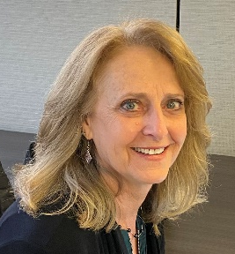




Luma Chart of Accounts Core Team
Brent Stigler
Glen Tuggle
Brandon Purcell
Cathy Jones
Deloitte
Finance
ISG
Finance
State
Finance
Infor
Finance Support
Sandra Tisdale
Carrie Peterman
Tyler Odenath
Dwayne Smith
State
Finance Support
State
Finance Support
Deloitte
Finance Support
Infor
Finance Support
Notes:
Brandon’s Slide

Slide 9
Chart of Accounts Purpose
The State of Idaho uses a Chart of Accounts to define each class of items for which funds are spent or received.
Creates Building Blocks
Maintains Consistency
Enables Reporting
The COA provides the basic building blocks to support the capture of financial and operational information.
The approved dimensions of the COA will be used in a consistent manner by all State agencies.
Allows users to prepare reports that meet a variety of reporting needs using COA data.
Luma’s well-designed COA will increase business value, reduce costs, increase efficiency, and improve customer service.
Notes:
Brent

Slide 10
Chart of Accounts Redesign
Conduct
Business
Requirements
Assessment
Define Key
Dimensions
related to
the COA
Confirm
Resources
Assess
Impacts of
Organizational
Changes
Migrate
historical
data
Address upstream/
downstream impacts
Secure
Stakeholder
Buy-in
COA
Redesign
Perform element clean-up and mapping
COA Leading Practices
Report Driven – Support reporting requirements
Scalable – Flexible to enable growth
Purpose Driven – Single definition, single purpose
Enterprise Driven – Designed for the rule, not the exception
Rationalized – Lean and use fewest dimensions possible
Governed/Controlled – Centralized under a governing body
Notes:
Brent

Slide 11
Chart of Accounts Key Impact Areas
COA Values and Hierarchies
Reporting
Develop child and parent values for each COA dimension. Build account hierarchies in scope for Luma. Financial balances are pre-aggregated at each parent level in the hierarchy, thus allowing fast and robust account inquiry and drill down.
Analyze financial performance and prepare financial reports using COA account data.
COA Values & Hierarchies
Reporting
Mapping Rules
Security Rules
Define, design, and build the mapping rules for the interfacing applications.
Control access to parent and detail values in general ledger (GL) and subledgers.
Security Rules
Chart of Accounts Structure
Mapping Rules
Cross-Validation Rules
Boundary Applications
Assess the impact on boundary applications. Identify, design, and build required process and system changes to support the new COA structure and values.
Prevent invalid values to be combined with other values across different dimensions in COA.
Cross-Validation Rules
Boundary Apps
Allocations
Data Conversions
Allocations
Data Conversions
Identify various rate-based, usage-base, and step-down allocations and validate COA structure to support them.
Prepare the mapping of COA accounts to the new COA accounts to support the data conversions. Determine the data conversion approach to convert subledger transactions and GL balances using the new COA structure and values.
Notes:
Brent

Slide 12

State of Idaho COA Background
Redesigning Idaho’s chart of accounts is one of the most strategically important actions the State will take in preparing for the new Luma ERP system. The redesign of the chart of accounts will be based on leading practices in government and business.
Idaho’s chart of accounts redesign project seeks to:
Emphasize simplicity, expandability, and flexibility for the life of the system.
Manage operations and provide services to its citizens.
Deliver a wide variety of financial and nonfinancial reporting.
Capture financial data at a meaningful level of detail to assist agencies in managing its financial resources.
Meet the needs of both the State’s central control and operating agencies.
The approach used to develop the new COA design for Idaho will include the following activities.
Chart of Accounts Redesign Workgroup – The workgroup will include individuals from a wide variety of State agencies.
Survey Key State Agencies – The survey will capture information about the State’s current COA and its actual use by agencies. It will include questions about “pain points” for agencies regarding the existing COA. If necessary, follow up interviews will be conducted with State agencies to gather additional insights about “pain points”.
Request Feedback from Selected Software Vendor and Integrator on COA design Best Practices – Present the software vendor and integrator with information provided by key State agencies and request feedback on the proposed COA design and its compatibility with their products.
Develop COA Governance Model and Maintenance Process – A new COA governance model and maintenance process will be developed and reviewed by the Luma Governance Board with final approval by the State Controller. COA review considerations include: standardization, consistency of use across agencies, alignment with industry best practices, and flexibility to meet agency requirements.
Develop Final COA Design – The final COA design will present the redesigned COA structural elements and governance approach proposed by the State. Additionally, it will include an overview of the rationale of the COA development.

Slide 13
COA Development Process - Milestones
August 1, 2019
Kick-off Meeting
February 25, 2020
Office of the State Controller’s Final Sign-off on COA Deliverable
October-December 2019
Workgroup meets to develop COA dimension requirements (6 meetings with 18 agency representatives)
February – June 2020
COA Configuration and Set-up
May 2021
FY22 Financial Plan Builds based on COA (TBD)
FY23 State Budget Planning based on COA
January 28, 2020 Presentation to Governance Board
January 2017
Pre-RFP Planning
February 12, 2020 COA Deliverable Deadline
September 29, 2019
Integration with Deloitte Team
February 2020 Configuration Training for COA
January 16, 2020 Proposed dimension presentation to workgroup
June – August 2020
Sprints – configuration testing
July 1, 2021
Go-live!
COA used in all financial transactions
Completed
Future Dates

Slide 14
Question & Answer Session
14

Slide 15
Why Hierarchies Matter
Within Luma, dimension hierarchies are how agencies and the State as a whole will organize data.
Hierarchies allow for robust and dynamic financial reporting on the fly.
They allow agencies and central reporting entities to “slice” through Luma data in ways that were never possible before.
The Luma Finance team has been working with agencies throughout the months of March and April to set up dimension hierarchies that meet the agencies’ operational, reporting, and tracking needs. This effort will continue until all hierarchies have been properly built out.
Notes:
Carrie

Slide 16
________ Level 1 – (Media Types)
BOOKS
__
MOVIES
__
TV SHOWS
__
_______ Level 2 – (Genre)
____________
______
____________
______
____________
______
____________
______
____________
______
_______ Level 3 – (Title)
____________
______
____________
______
____________
______
____________
______
____________
______
____________
______
____________
______
____________
______
____________
______
_______ Level 4 – (Sequels)
____________
______
____________
______
____________
______

Slide 17
________ Level 1 – (Media Types)
BOOKS
MOVIES
TV SHOWS
_______ Level 2 – (Genre)
Fiction
NonFict
Comedy
Fantasy
Dramas
_______ Level 3 – (Title)
____________
______
____________
______
____________
______
____________
______
____________
______
____________
______
____________
______
____________
______
____________
______
_______ Level 4 – (Sequels)
____________
______
____________
______
____________
______

Slide 18
________ Level 1 – (Media Types)
BOOKS
MOVIES
TV SHOWS
_______ Level 2 – (Genre)
Fiction
NonFict
Comedy
Fantasy
Dramas
_______ Level 3 – (Title)
Harry Potter Books
Dune
Dictionary
Intro to Accounting
Step Brothers
NeverEndingStory
Harry Potter Movies
Charmed
Law & Order
_______ Level 4 – (Sequels)
____________
______
____________
______
____________
______

Slide 19
________ Level 1 – (Media Types)
BOOKS
1
MOVIES
2
TV SHOWS
3
_______ Level 2 – (Genre)
Fiction
10
NonFict
11
Comedy
20
Fantasy
21
Dramas
30
_______ Level 3 – (Title)
Harry
Potter
Books
100
Dune
101
Dictionary
110
Intro to Accounting
111
Step Brothers
200
NeverEndingStory
210
Harry Potter Movies
211
Charmed
300
Law & Order
301
_______ Level 4 – (Sequels)
Harry Potter Book 1
1000
Harry Potter Book 2
1001
Harry Potter Movie 1
2110

Slide 20
Chart of Accounts
Agency:
Used to identify the state agency.
Account:
Used to capture the category of all transactions that affect the balance sheet, statement of revenues, expenditures, and changes in fund balance, and other financial statements.
Funding Source
Agency*
Organizational Unit
Project:
Used to capture transactional data on agency-specific activities or efforts usually with a planned end date. May also be used to silo financial activity into a discrete ledger to simplify reconciliation and record-keeping. For example: cost allocation pools, ongoing billings to outside entities for work performed, co-location and rental agreements.
Appropriation*
Fund
Project
State of Idaho
Chart of Accounts (COA)
Location:
Used to record transactions to a specific geographic position.
Additional Reporting
Organizational Unit*
Program
Additional Reporting:
Used to code and track transactions based on agency-specific reporting needs.
Organizational Unit:
Used to identify cost center and its place in an agency’s organizational structure.
Location
Account*
Funding Source
Program
Fund*
Account
Project
Appropriation:
Used to identify a spending control as set by the Legislature for a segment or program of an agency.
Fund:
Used to identify the accounting entity against which a transaction is recorded.
Funding Source:
Used in conjunction with the Project dimension to indicate the source of the money used to fund a project. This could include federal, state, and local grants, outside entities billed for a service or project, or private grants, etc.
Program:
Used to identify ongoing agency activities or functions that occur across the organizational structure.
* - required field

Slide 21
Agency Dimension
Used to identify the state agency.
Funding Source
Agency*
Organizational Unit
Appropriation*
Project
Posting Level (Agency)
Fund
Agency A
Agency B
Agency C
State of Idaho
Chart of Accounts (COA)
Additional Reporting
Organizational Unit*
Program
Location
Posting Level (Agency)
Account*
Funding Source
Program
Fund*
Account
Project
Dept. of Commerce
(220)
Dept. of Labor
(240)
Dept. of H&W
(270)

Slide 22
Project Dimension
Used to capture transactional data on agency-specific activities or efforts usually with a planned end date. May also be used to silo financial activity into a discrete ledger to simplify reconciliation and record-keeping. For example: cost allocation pools, ongoing billings to outside entities for work performed, co-location and rental agreements.
Funding Source
Agency*
Organizational Unit
Summary Level 1 (Project Level 1)
Appropriation*
Project
Summary Project Level
Fund
State of Idaho
Chart of Accounts (COA)
Additional Reporting
Organizational Unit*
Summary Level ∞ (Project Level ∞)
Program
Summary Project Level
Summary Project Level
Location
Account*
Funding Source
Program
Fund*
Account
Project
Posting Level
Project Posting Level
Project Posting Level
Project Posting Level
Project Posting Level
Project Posting Level
Project Posting Level

Slide 23
Organizational Unit Dimension
Used to identify cost center and its place in an agency’s organizational structure.
Summary Level 1 (Division)
Funding Source
Agency*
Organizational Unit
Division
(1)
Appropriation*
Project
Fund
Summary Level 2 (Bureau)
State of Idaho
Chart of Accounts (COA)
Bureau
(10)
Bureau
(11)
Bureau
(12)
Required levels
Additional Reporting
Organizational Unit*
Program
Summary Level 3 (Section)
Section
(100)
Section (110)
Section (120)
Location
Account*
Funding Source
Program
Fund*
Account
Project
Summary Level ∞
Unit
(1100)
Unit
(1101)
Unit
(1102)
Posting Level (Cost Center)
Cost Center (7000)
Cost Center (7001)
Cost Center (7002)
Required level

Slide 24
Fund Dimension
Used to identify the accounting entity against which a transaction is recorded.
Funding Source
Agency*
Summary Level 1 (Fund Type)
Organizational Unit
Appropriation*
Project
Governmental
Proprietary
Fiduciary
Fund
State of Idaho
Chart of Accounts (COA)
Summary Level 2 (Subfund Type)
Additional Reporting
Organizational Unit*
General Fund
Enterprise
Agency
Program
Location
Summary Level 3 (Fund)
Account*
Funding Source
Program
Fund*
Account
Project
Fund (100)
Fund (200)
Fund (300)
Posting Level (Subfund)
Subfund (10001)
Subfund (20001)
Subfund (30001)

Slide 25
Program Dimension
Used to identify ongoing agency activities or functions that occur across the organizational structure.
Funding Source
Agency*
Organizational Unit
Summary Level 1 (Program Level 1)
Appropriation*
Project
Summary Program Level
Fund
State of Idaho
Chart of Accounts (COA)
Additional Reporting
Organizational Unit*
Summary Level ∞ (Program Level ∞)
Program
Summary Program Level
Summary Program Level
Location
Account*
Funding Source
Program
Fund*
Account
Project
Posting Level
Program Posting Level
Program Posting Level
Program Posting Level
Program Posting Level
Program Posting Level
Program Posting Level

Slide 26
Account Dimension
Used to capture the category of all transactions that affect the balance sheet, statement of revenues, expenditures, and changes in fund balance, and other financial statements.
Summary Level 1 (Account Type)
Funding Source
Agency*
Organizational Unit
Assets
Liabilities
Fund Balance
Revenues
Expenditures
Appropriation*
Project
Fund
Summary Level 2 (Account Category)
State of Idaho
Chart of Accounts (COA)
Personnel Costs
Operating Costs
Capital Costs
Trustee and Benefits Costs
Additional Reporting
Organizational Unit*
Program
Summary Level 3 (Summary Account)
Gross Salaries and Wages
Employee Benefits
Location
Account*
Funding Source
Program
Fund*
Account
Project
Summary Level 4 (Account)
Employees (5001)
Shift Differential (5002)
Student
(5003)
Posting Level (Posting Account)
Full-time Employees (500101)
Part-time Employees (500102)

Slide 27
Account Dimension Continued
Used to capture the category of all transactions that affect the balance sheet, statement of revenues, expenditures, and changes in fund balance, and other financial statements.
Summary Level 1 (Account Type)
Funding Source
Agency*
Organizational Unit
Assets
Liabilities
Fund Balance
Revenues
Expenditures
Appropriation*
Project
Fund
Summary Level 2 (Account Category)
State of Idaho
Chart of Accounts (COA)
Current Assets
Non-Current
Assets
Restricted Assets
Other
Assets
Additional Reporting
Organizational Unit*
Program
Summary Level 3 (Summary Account)
Prepaid Items
Due From Other Entities
Location
Account*
Funding Source
Program
Fund*
Account
Project
Summary Level 4 (Account)
Prepaid Rent (1060)
Prepaid Utility
(1061)
Posting Level (Posting Account)
Office Space
(106001)
Retail Store Space (106002)

Slide 28
Location Dimension
Used to record transactions to a specific geographic position. Can be flat or have multiple levels within a hierarchy.
Funding Source
Agency*
Organizational Unit
Summary Level 1 (Location Level 1)
Appropriation*
Project
Summary Location Level
Fund
State of Idaho
Chart of Accounts (COA)
Additional Reporting
Organizational Unit*
Summary Level ∞ (Location Level ∞)
Program
Summary Location Level
Summary Location Level
Location
Account*
Funding Source
Program
Fund*
Account
Project
Posting Level
Location Posting Level
Location Posting Level
Location Posting Level
Location Posting Level
Location Posting Level
Location Posting Level

Slide 29
Additional Reporting Dimension
Used to code and track items based on agency-specific reporting needs. Can be flat or have multiple levels within a hierarchy.
Funding Source
Agency*
Organizational Unit
Summary Level 1 (Additional Reporting Level 1)
Appropriation*
Project
Summary Additional Reporting Level
Fund
State of Idaho
Chart of Accounts (COA)
Additional Reporting
Organizational Unit*
Summary Level ∞ (Additional Reporting Level ∞)
Program
Summary Additional Reporting Level
Summary Additional Reporting Level
Location
Account*
Funding Source
Program
Fund*
Account
Project
Posting Level
Additional Reporting Posting Level
Additional Reporting Posting Level
Additional Reporting Posting Level
Additional Reporting Posting Level
Additional Reporting Posting Level
Additional Reporting Posting Level

Slide 30
Appropriation Dimension
Used to identify a spending control as set by the Legislature for a segment or program of an agency.
Funding Source
Agency*
Organizational Unit
Summary Level 1 (State Goal)
Appropriation*
Project
Fund
General Government
(10)
Public Safety
(20)
Health and Human Services
(30)
Education
(40)
Economic Development
(50)
Natural Resources
(60)
State of Idaho
Chart of Accounts (COA)
Additional Reporting
Organizational Unit*
Program
Summary Level 2 (State Objective)
Objective
(11)
Objective
(12)
Objective
(13)
Location
Account*
Funding Source
Program
Fund*
Account
Project
Posting Level (Appropriation)
Appropriation (ABCD)
Appropriation (AABC)
Appropriation (AABB)
Appropriation (AAAB)
Appropriation (AACC)
Appropriation (AABC)

Slide 31
Funding Source Dimension
Used in conjunction with the Project dimension to indicate the source of the money used to fund a project. This could include federal, state, and local grants, outside entities billed for a service or project, or private grants, etc.
Funding Source
Agency*
Organizational Unit
Summary Level 1 (Funding Source Level 1)
Appropriation*
Project
Summary Funding Source Level
Fund
State of Idaho
Chart of Accounts (COA)
Additional Reporting
Organizational Unit*
Summary Level ∞ (Funding Source Level ∞)
Program
Summary Funding Source Level
Summary Funding Source Level
Location
Account*
Funding Source
Program
Fund*
Account
Project
Posting Level
Funding Source Posting Level
Funding Source Posting Level
Funding Source Posting Level
Funding Source Posting Level
Funding Source Posting Level
Funding Source Posting Level

Slide 32
Sample COA String and Mapping
Dept. of Commerce
220 220206100 3002 34800 220600 511001 220Boise 220FF21 CDAA STEP
Agency
Org Unit
Program
Location
Appropriation
Project
Fund
Account
Additional Reporting
Funding
Source
*
Text - required field
*Dept. of Commerce current STARS data

Slide 33




Sample COA String and Mapping
Dept. of Labor
240 240210410 1012 34831 24010 511001 240Annex 240FF20 EMUI UIFFY20
Agency
Org Unit
Program
Location
Appropriation
Project
Fund
Account
Additional Reporting
Funding
Source
*
Text - required field
*Department of Labor current STARS data and current Cost Accounting System data

Slide 34
Sample COA String and Mapping
Dept. of H&W
270 270500101 1029 22003 27020100 511001 270Burley 270OpPre2020 HWBB TANF
Agency
Org Unit
Program
Location
Appropriation
Project
Fund
Account
Additional Reporting
Funding
Source
*
Text - required field
*Dept. of Health and Welfare current STARS data. Missing (FISCAL) data not shown.

Slide 35
Question & Answer Session
35

Slide 36
Deconstructing PCA Codes
Division
Program
Fund
PCA
Location
Notes:
Sandra

Slide 37
Deconstructing PCA Codes
Division
Organizational Unit Dimension
Program
Fund
PCA
Location

Slide 38
Deconstructing PCA Codes
Division
Organizational Unit Dimension
Program
PCA
Location
Fund
Fund Dimension

Slide 39
Deconstructing PCA Codes
Division
Organizational Unit Dimension
Program
PCA
Fund
Location
Location Dimension
Fund Dimension

Slide 40
Deconstructing PCA Codes
Funding Source Dimension
Division
Program
Project Dimension
Organizational Unit Dimension
Program Dimension
Appropriation Dimension
Fund
Location
Location Dimension
Fund Dimension

Slide 41
Agency Submission and Luma Examples

Slide 42
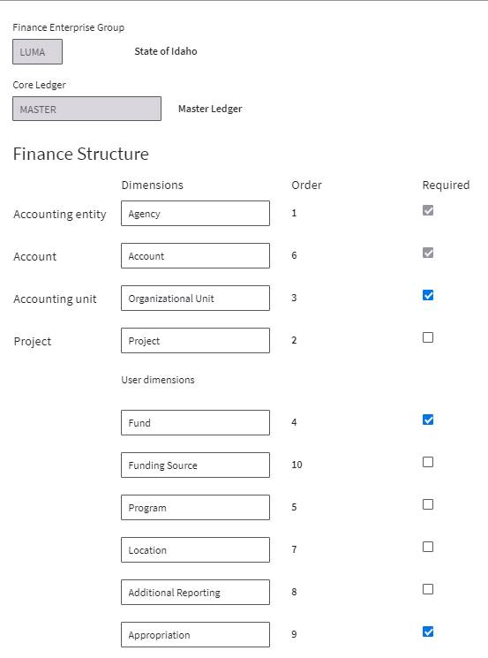
Finance Enterprise Group

Slide 43
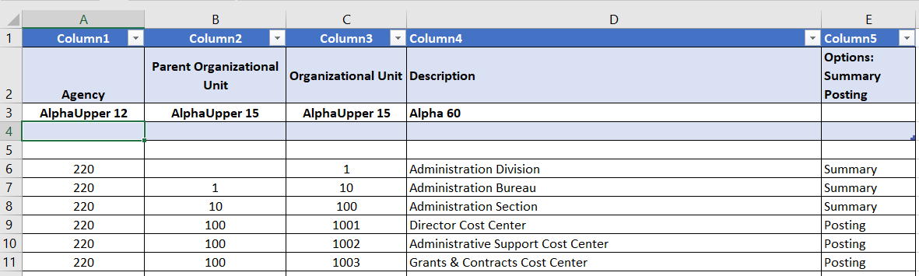
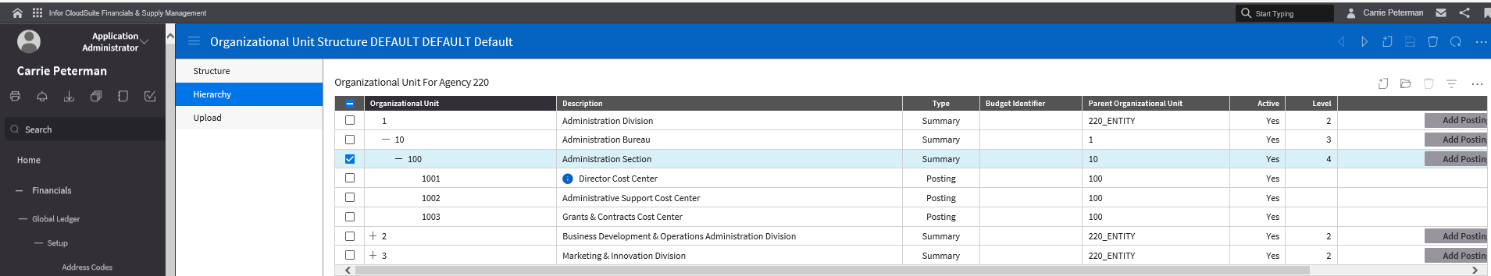
Organizational Unit Dimension
Agency Submission Example
Example in Luma
Notes:
Cathy

Slide 44
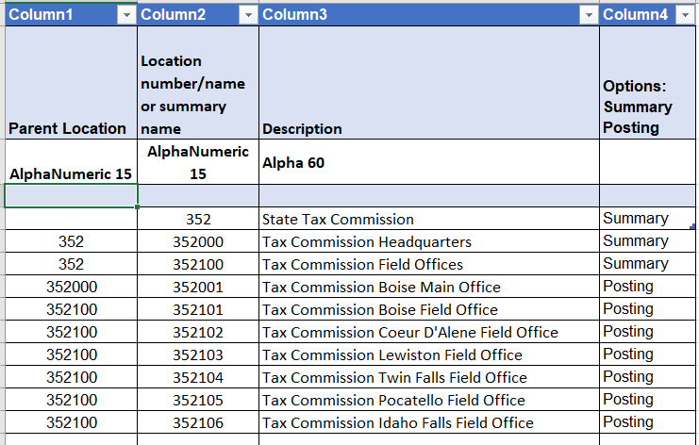
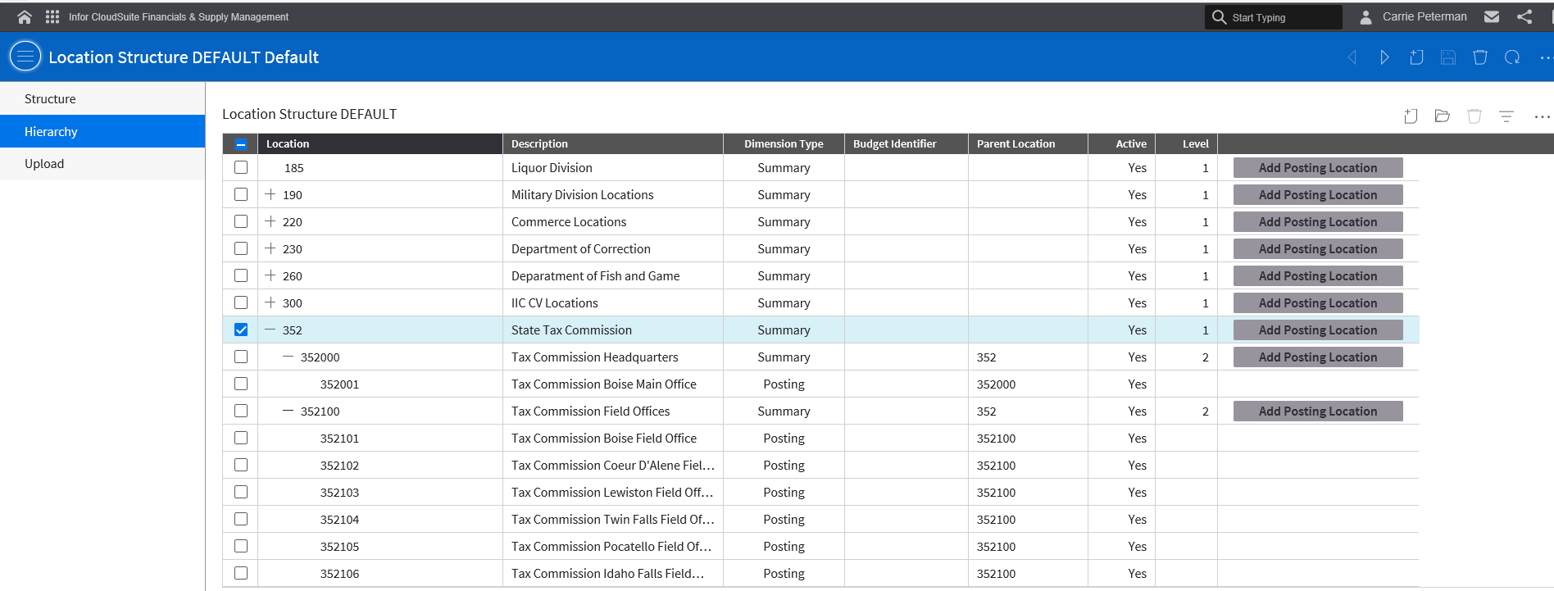
Location Dimension
Agency Submission Example
Example in Luma

Slide 45
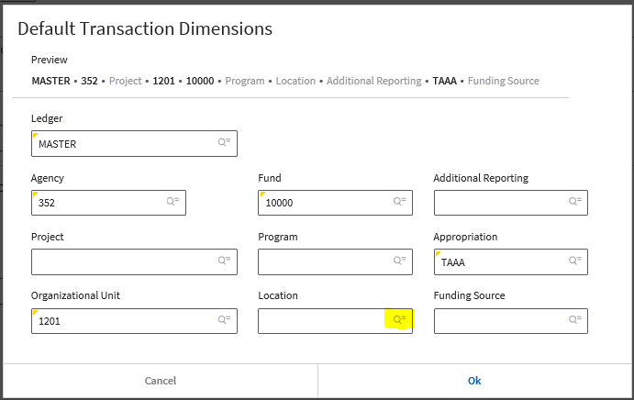
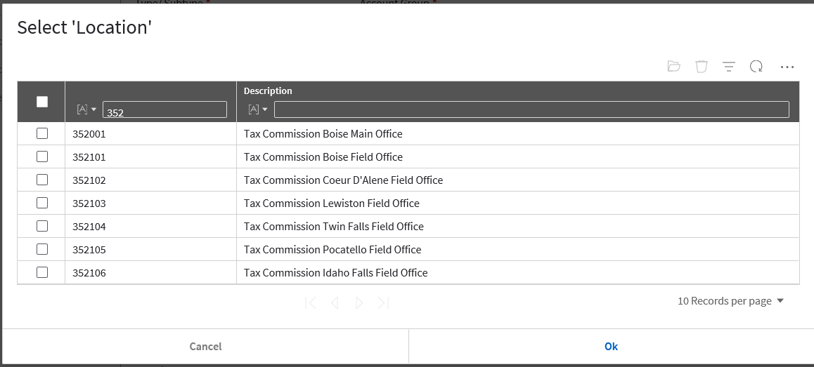
End-User Luma Views
View When Keying in a Transaction
View After Clicking Magnifier Icon

Slide 46
Question & Answer Session
46

Slide 47
COA State Contacts and Resources
Brandon Purcell
State Finance Lead
208-334-3100, ext. 8811
bpurcell@sco.idaho.gov
Carrie Peterman
State Finance Support
208-334-3100, ext. 8854
cpeterman@sco.idaho.gov
Please visit the Luma COA Website to learn more about the COA process.

