Slide 1






Luma Town Hall
December 2, 2020

Slide 2

Welcome!
THANK YOU for joining our virtual Luma Town Hall!
ABOUT THE WEBINAR:
  This meeting is being recorded and will be available at luma.sco.idaho.gov
  All attendees are muted, please utilize the Q&A functionality to ask questions.
  You will see a chat icon, but the chat functionality has been disabled.
X
Chat
Q&A
Notes:
Brandon’s Slide

Slide 3

Welcome!
THANK YOU for joining our virtual Luma Town Hall!
A MESSAGE FROM CONTROLLER WOOLF
Notes:
Brandon’s Slide

Slide 4
Welcome!
THANK YOU for joining our virtual Luma Town Hall!
AGENDA:
  Luma Project Update
  System Integration Testing 1 Update
  Asset Management Demo
Notes:
Brandon’s Slide

Slide 5
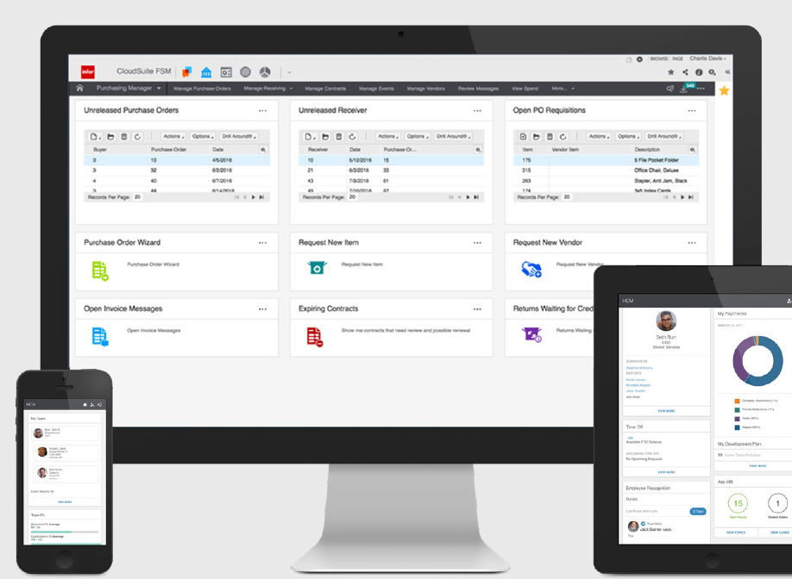
What is Luma?
A modern, cloud ERP is a software suite used to manage day-to-day business activities. ERP systems tie together and define a plethora of business processes and enable the flow of data between them, from a requisition to cutting a check, and hire to retire!
Notes:
In summary:
A standardized experience across multiple agencies allows you to skip converting data to get an apples to apples comparison - meaning less manual labor and quicker solutions.
The implemented system will be process-oriented. With future business processes in mind, configuration will make us more efficient.

Slide 6
Luma Project Vision and Goals
Vision:
Acquire, implement, and sustain a statewide enterprise system that modernizes and transforms the way the State of Idaho does business, improves transparency, and provides a core foundation for the future.
text
Goals:
An ERP solution that all agencies will use for budget planning, financial management, procurement, payroll, and human capital management.
4
Increase transparency of government operations and expenses.
1
5
Reduce risk exposure associated with the current outdated software systems.
Improve productivity and reduce costs by eliminating redundant systems and unnecessary complexity required to perform operational and administrative services.
2
Improve decision making by capturing and being able to report consistent expandable sets of data.
6
Modernize and standardize business processes for alignment with industry best practices inherent in COTS software for efficient workflow and accurate information reporting.
3
7
Ensure strength and efficiency of the State’s Data security management.
Notes:
In summary:
A standardized experience across multiple agencies allows you to skip converting data to get an apples to apples comparison - meaning less manual labor and quicker solutions.
The implemented system will be process-oriented. With future business processes in mind, configuration will make us more efficient.

Slide 7

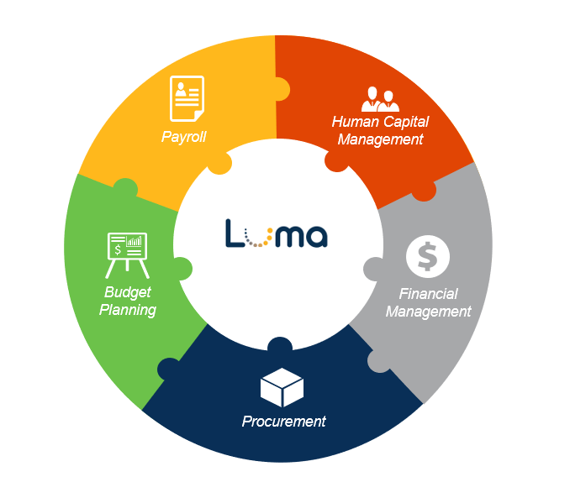
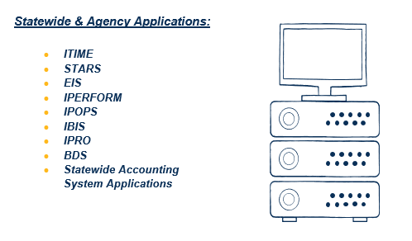
Current State vs. Future State
Future State – One Integrated System

Slide 8





Luma Benefits
Greater efficiency with automation so users can focus on high priority activities
Access Luma from almost anywhere
Agencies speak the same “language” making it easy to collaborate
Enhanced reporting with more options to compare data
Designed for continual upgrades
Notes:
A few Benefits include:
Mobile friendly system allowing for access from almost anywhere
Agencies will finally speak the same language allowing for the sharing of information
Computer automation will reduce repetitive tasks, freeing up staff time to work on more important things
Robust reporting
Dynamic system, meaning the technology will be able to evolve with constant updates instead of becoming dated.

Slide 9




Luma Implementation Timeline
text
Historical Events
Current Events
Upcoming Events
Notes:
In summary:
A standardized experience across multiple agencies allows you to skip converting data to get an apples to apples comparison - meaning less manual labor and quicker solutions.
The implemented system will be process-oriented. With future business processes in mind, configuration will make us more efficient.

Slide 10

Luma Implementation Timeline
text
Current Events
Upcoming Events
Historical Events
July 2020
August 2020
October 2020
October 2020
Sprint 2 configuration and process testing. Agency functional and technical specifications for data conversion and interfaces.
Sprint 3 configuration and process testing. Data conversion and interfaces. Script preparation for System Integration Testing (SIT).
SIT 1, which is end to end process design testing, data conversion testing, and interface testing.
Training needs assessment and planning for end user training material development.
Notes:
In summary:
A standardized experience across multiple agencies allows you to skip converting data to get an apples to apples comparison - meaning less manual labor and quicker solutions.
The implemented system will be process-oriented. With future business processes in mind, configuration will make us more efficient.

Slide 11
Luma Implementation Timeline
text
Historical Events
Current Events
Upcoming Events
Notes:
In summary:
A standardized experience across multiple agencies allows you to skip converting data to get an apples to apples comparison - meaning less manual labor and quicker solutions.
The implemented system will be process-oriented. With future business processes in mind, configuration will make us more efficient.

Slide 12

Luma Implementation Timeline
text
Historical Events
Upcoming Events
Current Events
November 2020
November 2020
November 2020
December 2020
System Integration Testing Cycle 1 completed.
Identification of System Integration Testing Cycle 2 participants
Agencies tasked with creating a payroll crosswalk that will allow current systems to run after Phase 1 go-live.
Project team member identification and request to agency directors for Phase 2
Notes:
In summary:
A standardized experience across multiple agencies allows you to skip converting data to get an apples to apples comparison - meaning less manual labor and quicker solutions.
The implemented system will be process-oriented. With future business processes in mind, configuration will make us more efficient.

Slide 13
Luma Implementation Timeline
text
Historical Events
Current Events
Upcoming Events
Notes:
In summary:
A standardized experience across multiple agencies allows you to skip converting data to get an apples to apples comparison - meaning less manual labor and quicker solutions.
The implemented system will be process-oriented. With future business processes in mind, configuration will make us more efficient.

Slide 14

Luma Implementation Timeline
text
Historical Events
Current Events
Upcoming Events
January 2020
March 2021
May 2021
July 2021
SIT 2, end to end process design testing, data conversion testing, forms and reports testing, interface testing. Design updates.
User Acceptance Testing, “dress rehearsal” testing with agencies. Continue training materials development.
End user training and budget module Go-Live.
Phase 1 Go-Live. Phase 2 implementation kick-off, project team onboarding, and software configuration training.
Notes:
In summary:
A standardized experience across multiple agencies allows you to skip converting data to get an apples to apples comparison - meaning less manual labor and quicker solutions.
The implemented system will be process-oriented. With future business processes in mind, configuration will make us more efficient.

Slide 15

Where are we Now?

Slide 16

Overview of Testing Phases
The project team recently concluded System Integration Testing Cycle 1 and are currently ramping up to begin Cycle 2. Integration tests utilize scripted scenarios and State provided data to ensure business processes within the Luma system run according to plan.
System Integration Testing
(SIT 1)
System Integration Testing
(SIT 2)
User Acceptance Testing
(UAT)
Objective
System Integration Testing allows both the project team and selected state agencies to follow step-by-step test script scenarios to validate processes, configurations, forms, reports, interfaces, and data conversions within the Luma test environment.
Involves a second execution of the integration test plan with a second run of conversions, additional FRICE-W components, and additional configurations identified in SIT1.
In UAT, a broader group of State agency users will follow scenarios to test the functionality of the Luma system. UAT is the system "dress rehearsal" and will confirm if the State is ready to move the ERP into the production environment and go-live.
Notes:
System Integration Testing (SIT) confirms that business processes work as designed across an integrated set of modules, FRICE-W components, and integration boundary applications.
SIT is a collaborative phase of testing that involves both core team members as well as additional stakeholders.
SIT will have teams working across multiple workstreams on a regular basis as we aim to test end to end processes.

Slide 17
System Integration Testing (SIT) 1 Update
194 State Employees
From 20 Agencies
Ran
On
766 Unique
Scripts & Scenarios
1,920 Tests
SIT 1 Testing Summary
Failed 1
Not Completed 62
No Run
346
Passed
1856
0
Blocked
1
500
1000
1500
2000

Slide 18
Engagement Opportunities

Slide 19
Luma Lunch & Learns
Are an opportunity for a quick overview of Luma topics and demonstrations of modules. The link to register for these Lunch and Learns will be distributed by your Agency Advocate or in Monthly Newsletters. Invitations for the Lunch and Learn will be sent to those who register as well as agency directors and Change Liaisons for distribution.
Upcoming Lunch & Learn Dates | Lunch & Learn Topics
December 15th & 17th | New Terminology in Luma
January 19th & 21st | Expense Management
February 16th & 18th | Budget & Upcoming Training

Slide 20
Luma Showcases
A series of Showcases will facilitate awareness, understanding and familiarity with the Luma System and highlight the benefits for Agencies and users.
Date & Time | Topic
Friday, December 11th | 1:00-2:00 PM Monday, December 14th | 1:00-2:00 PM | Showcases facilitate awareness, understanding, and familiarity with the Luma system. Attendees will gain a greater understanding of exciting new functionality and benefits for Agencies and users.

Slide 21
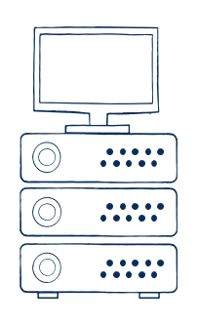
Luma Asset Management Demonstration
the lifecycle of an asset being requisitioned and added to the luma system.

Slide 22
Question & Answer Session
Thank you for attending our Luma town hall!
luma@sco.Idaho.gov

